Slide 1
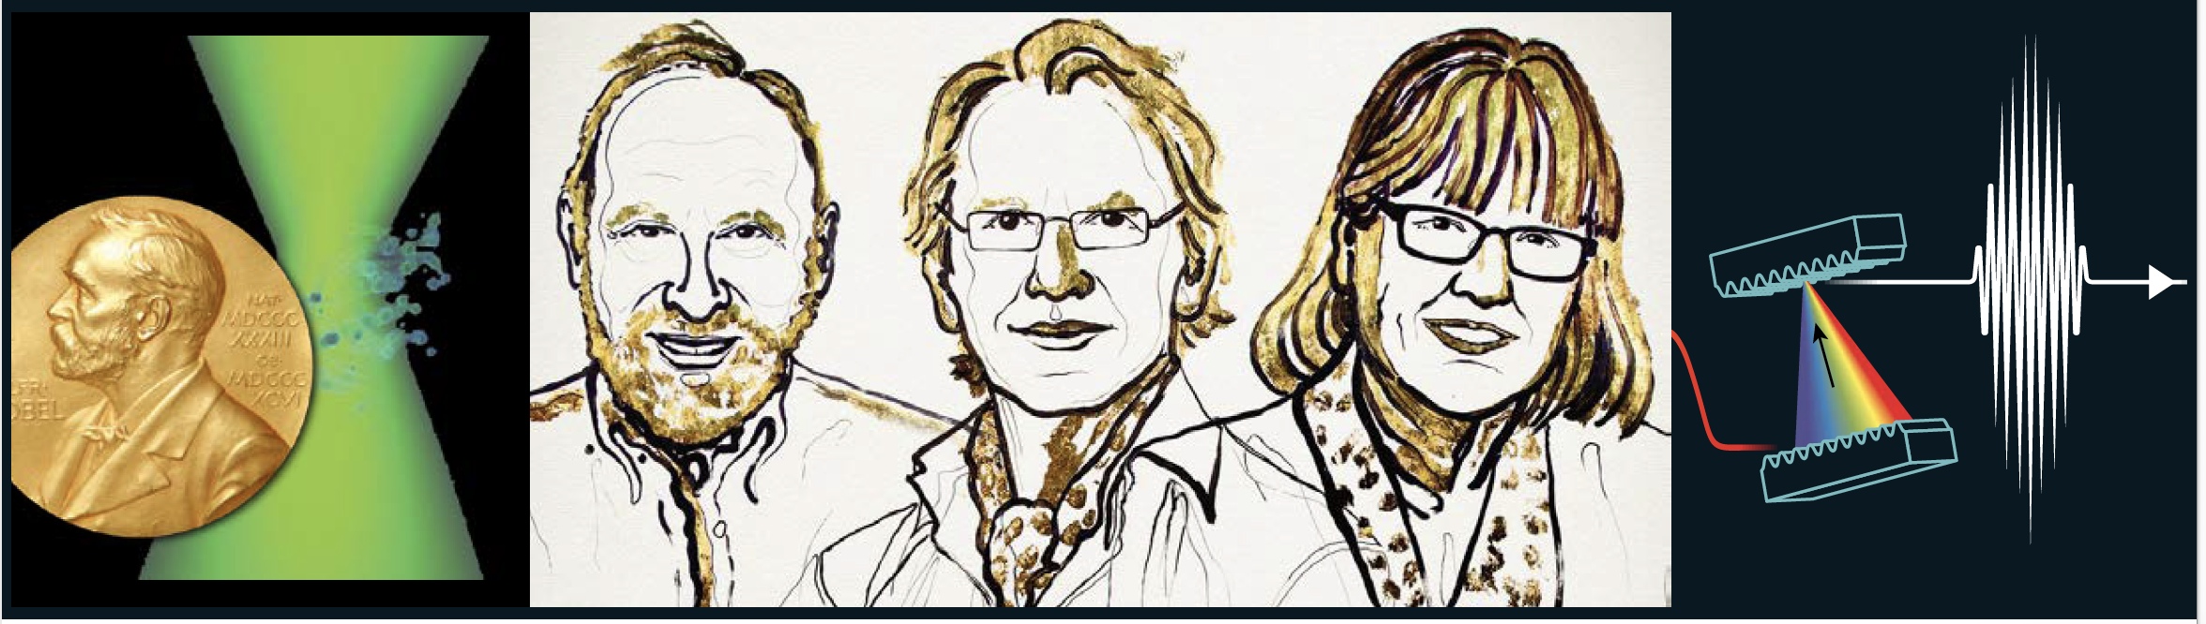
2018 Nobel Prize in Physics
The science behind the…
Quarks to the Cosmos, 17th September 2019
Presented by:
Dr Shelley Wickham
With help from Dr Andrea Blanco-Redondo
School of physics

Slide 2
Challenge questions
Why a researcher decide to change research area?
What are the most important scientific challenges of our time?
How do personal life events affect the path of research?
Is competition in academia good or bad?
How do we choose research directions?
Does research have to be done in a university?

Slide 3
Optical tweezers for studying molecular nanomachines

Slide 4
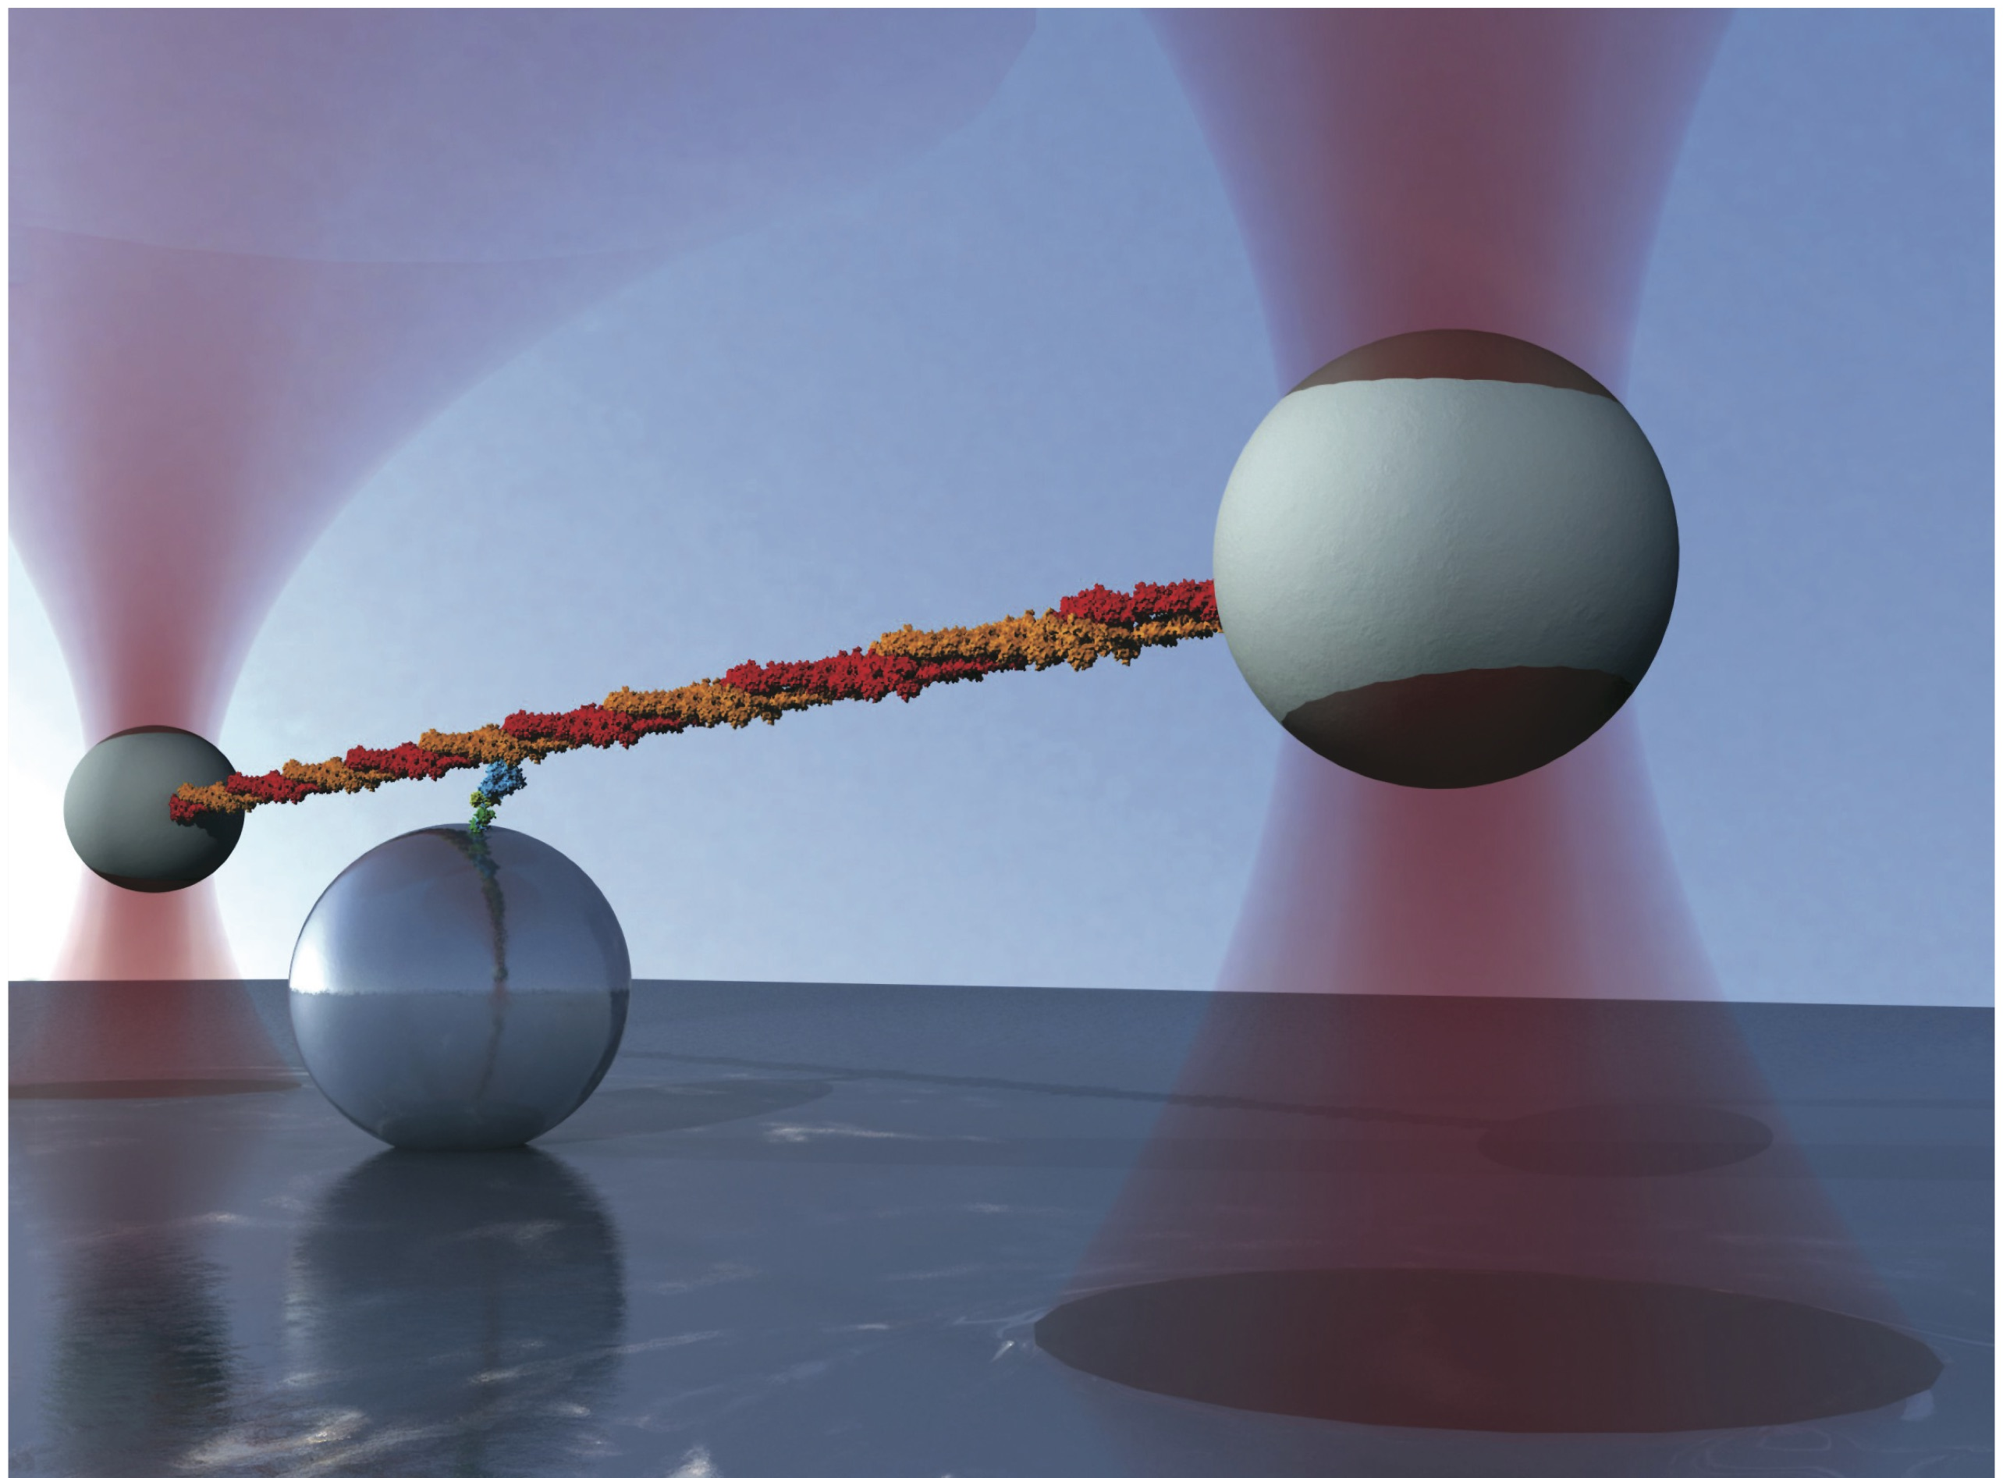
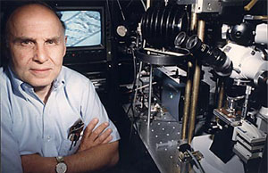
Arthur Ashkin
Physics Nobel Prize 2018
“for the optical tweezers and their application to biological systems”
Bell labs, 1988
Nature methods, 2012, cover
Notes:
https://www.youtube.com/watch?v=jCdnBmQZ6_s
https://www.youtube.com/watch?v=y-uuk4Pr2i8

Slide 5


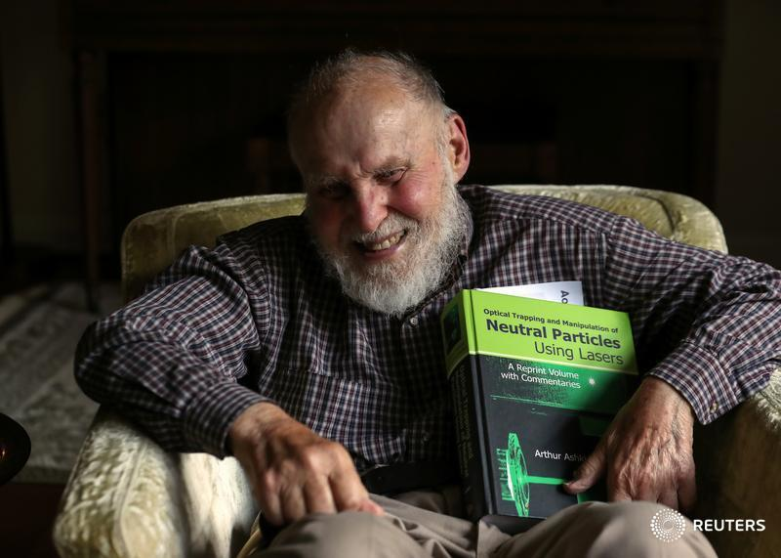
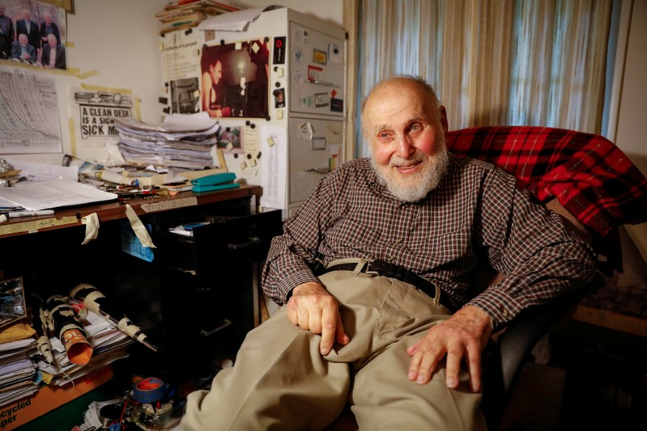
Who is Arthur?
AS: May I ask, are you still experimenting in your home lab?
AA: I am. In fact I’m writing a paper now that you guys are disturbing in my … I’m going to send it into Science and hope that they’ll accept it.
AA: …I was interested in science since I was a kid, so I tell my wife that’s the only thing that I’m really good at.
https://www.youtube.com/watch?time_continue=90&v=_atdJmegjXc, t=1 min

Slide 6

Fiction warning…

Slide 7
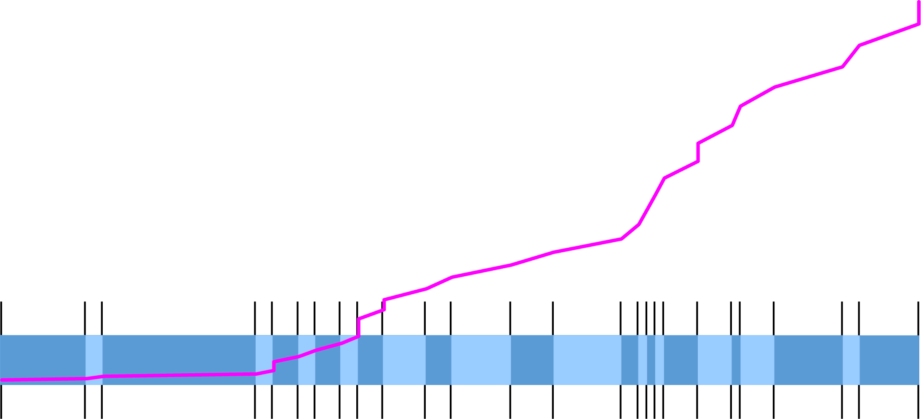
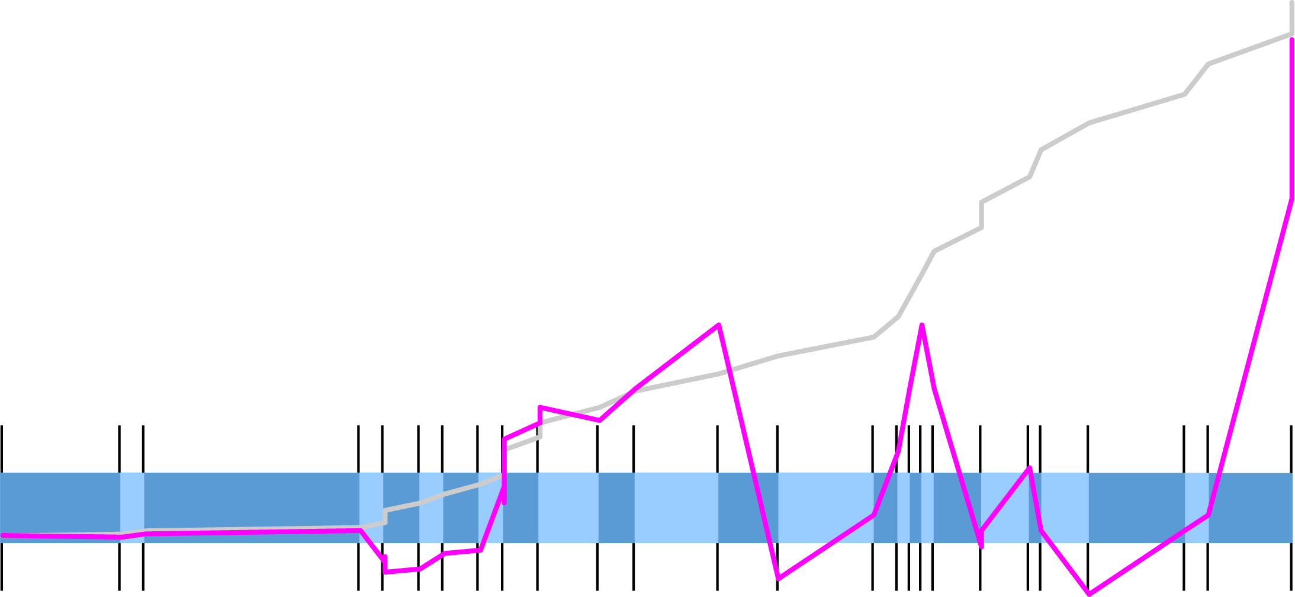

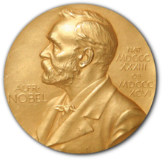



Graduated
PhD
Next paper:
solar energy
“It’s important because we’re facing a crisis because of the change in climate,”
Breakthrough:
‘Optical trapping and manipulation of single cells using infrared laser beams’
Graduated
Bachelors
Breakthrough:
‘Observation of a single-beam gradient force optical trap for dielectric particles'
Arthur
born
Steven Chu arrives
Ashkin: ’Wouldn't it be nice if you can hold on to an atom with light'
Chu: “I was this new, young person who he could corrupt”
Breakthrough:
‘Acceleration and trapping of particles by radiation pressure'
Parents
arrived USA
Ashkin
Finished
school
First paper
-12
0
20
25
30
38
48
53
61
65
70
96
2011
2018
1992
2009
1970
1985
1988
1947
1987
1950
1952
1960
1963
1910
1922
1942
1945
1955
1940
~1975
1983
1986
1997
2001
Reserve
Bose-Einstein
condensates
Conscripted
Funding cut
demoted
retired
Chu
Quit nuclear physics
'I was known as Ashkin's brother Ashkin'
Brother Julius born
WW2
22 papers !
“He was the family genius.”

Slide 8
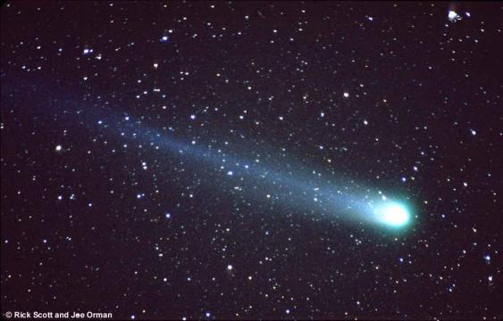
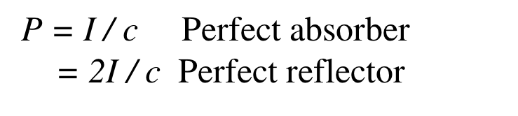
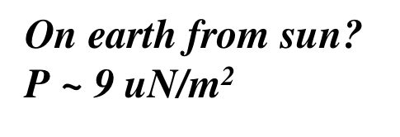
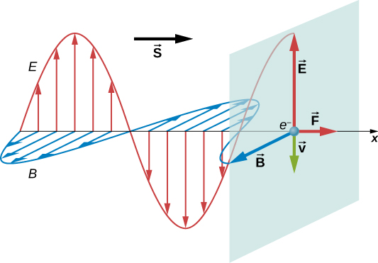
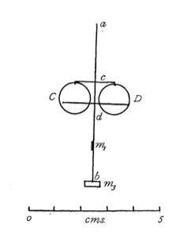
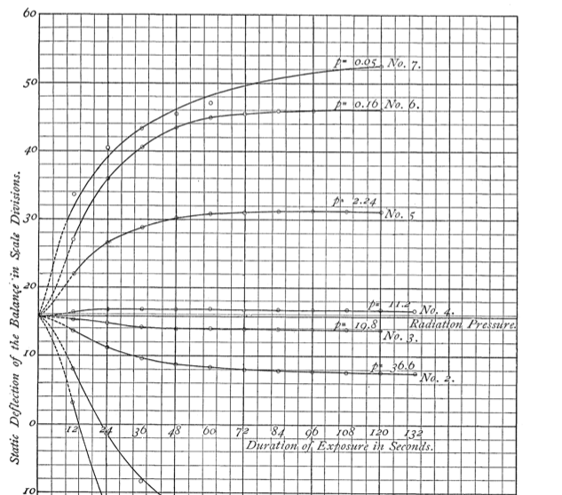
Radiation pressure
Maxwell predicted that an electromagnetic wave carries momentum, 1862
apod.nasa.gov
Kepler, 1619
phys.libretexts.org
Nichols, E.F., and Hull, G.F. (1903). Phys. Rev. 17, 26–50.

Slide 9
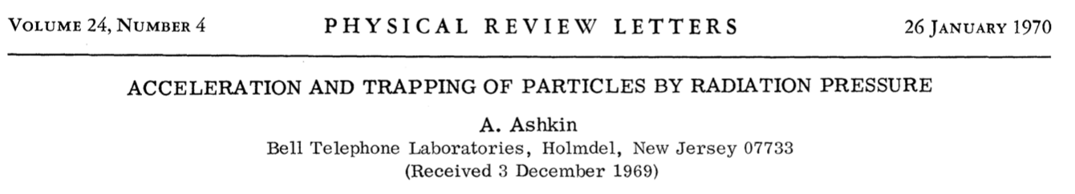
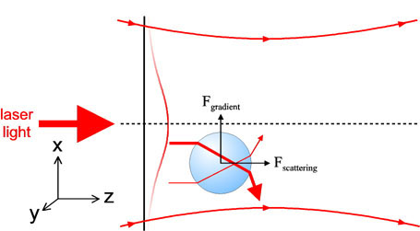
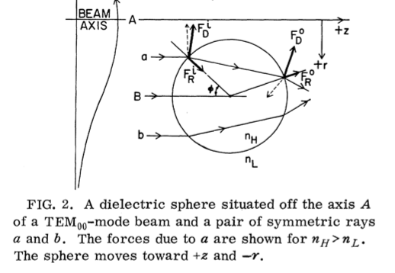
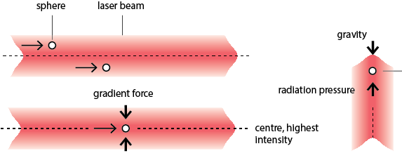
Moving objects with light

Slide 10
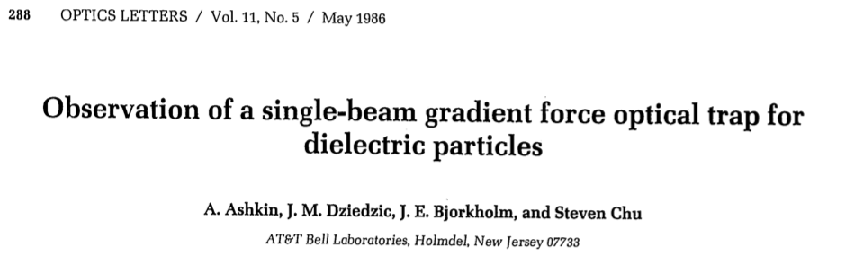
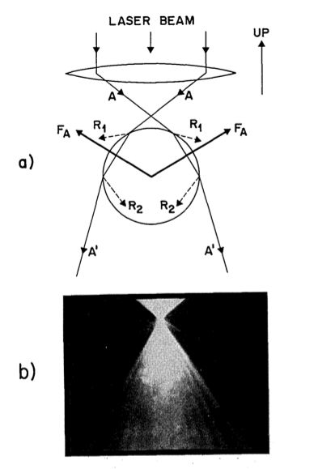
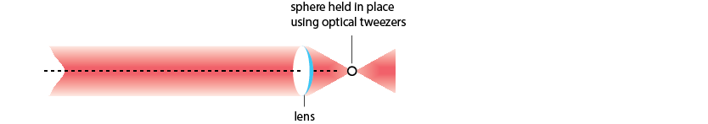
Optical tweezers
F_{gradient}
F_{radiation}
F_{gravity}

Slide 11
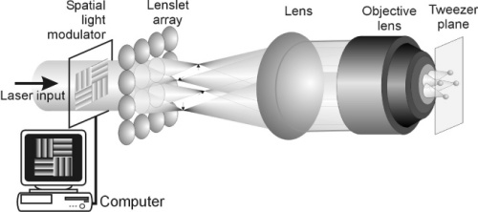
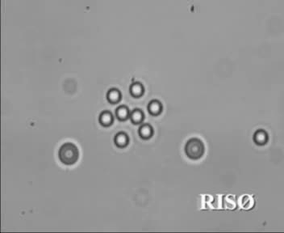

Optical tweezers – even better
https://www.youtube.com/watch?v=jCdnBmQZ6_s
Eriksen, Daria, & Jesper Glückstad,
Opt. Express 10, 597-602 (2002)
Gibson et al 2008 J. Opt. A: Pure Appl. Opt. 10 044009

Slide 12
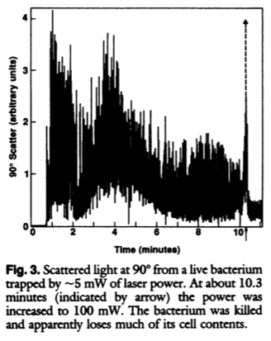
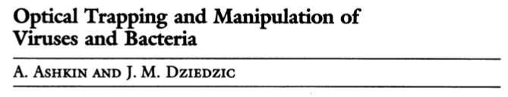

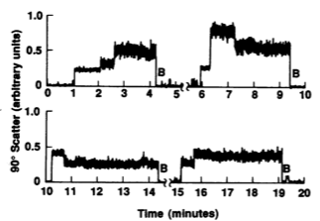
What can we do with them?

Slide 13
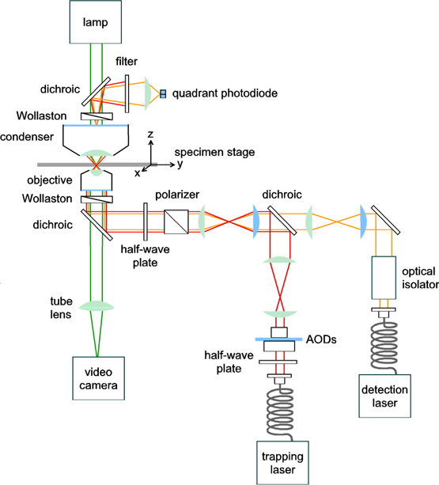
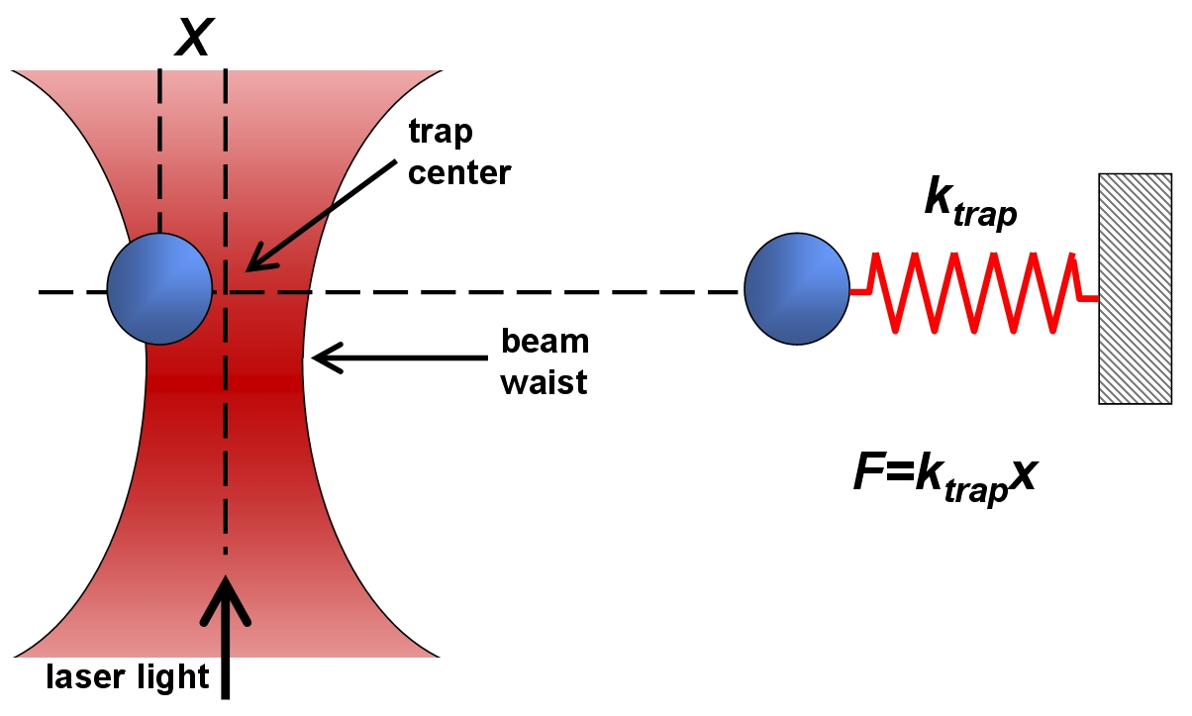
What else can we do with them?
Block Lab, 2015

Slide 14
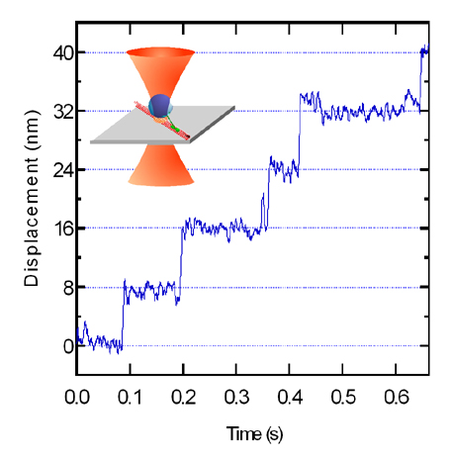
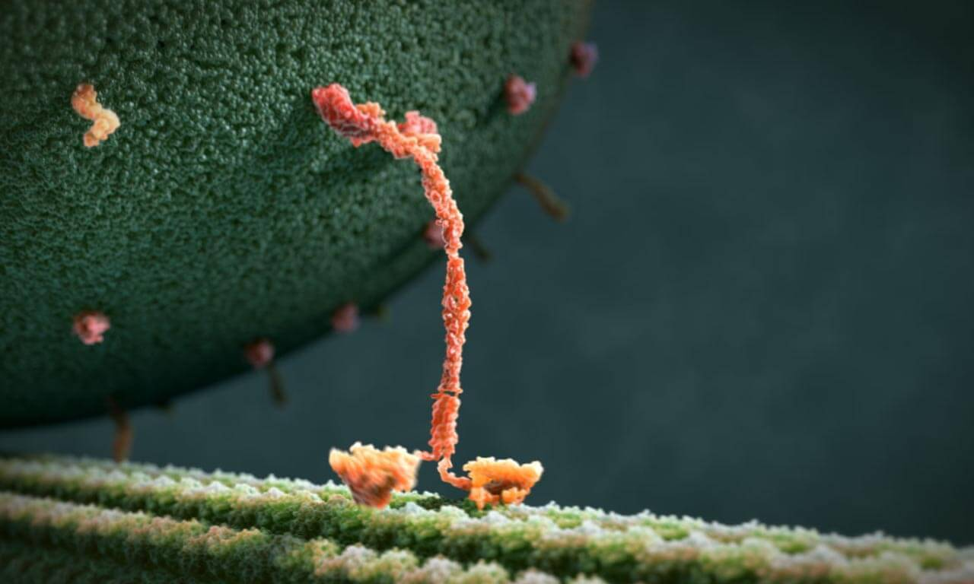
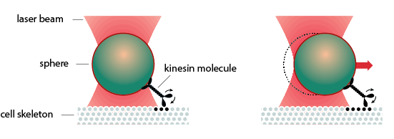
pN forces in biology
https://www.youtube.com/watch?v=y-uuk4Pr2i8
Block Lab, 2015

Slide 15
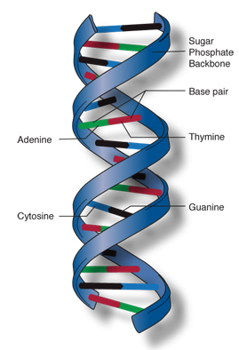

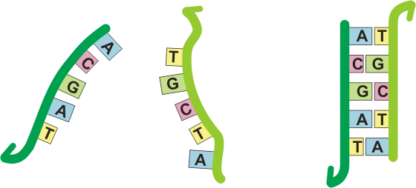

DNA?
School of Physics Research
‘The gene is a linear one-dimensional crystal, which lacks the periodic repeat, i.e., an aperiodic crystal.’
Schrödinger, What is life?
School of physics
A programmable information containing polymer
Base-pairing
NIH
Autodesk

Slide 16
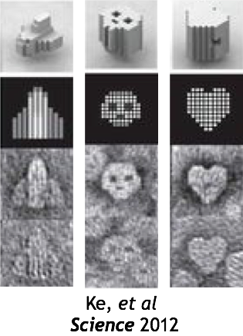
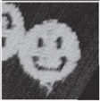
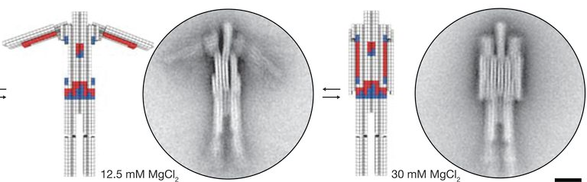
DNA origami
School of Physics Research
School of physics
P. Rothemund, Nature 2006
Deitz et al, Science 2015

Slide 17
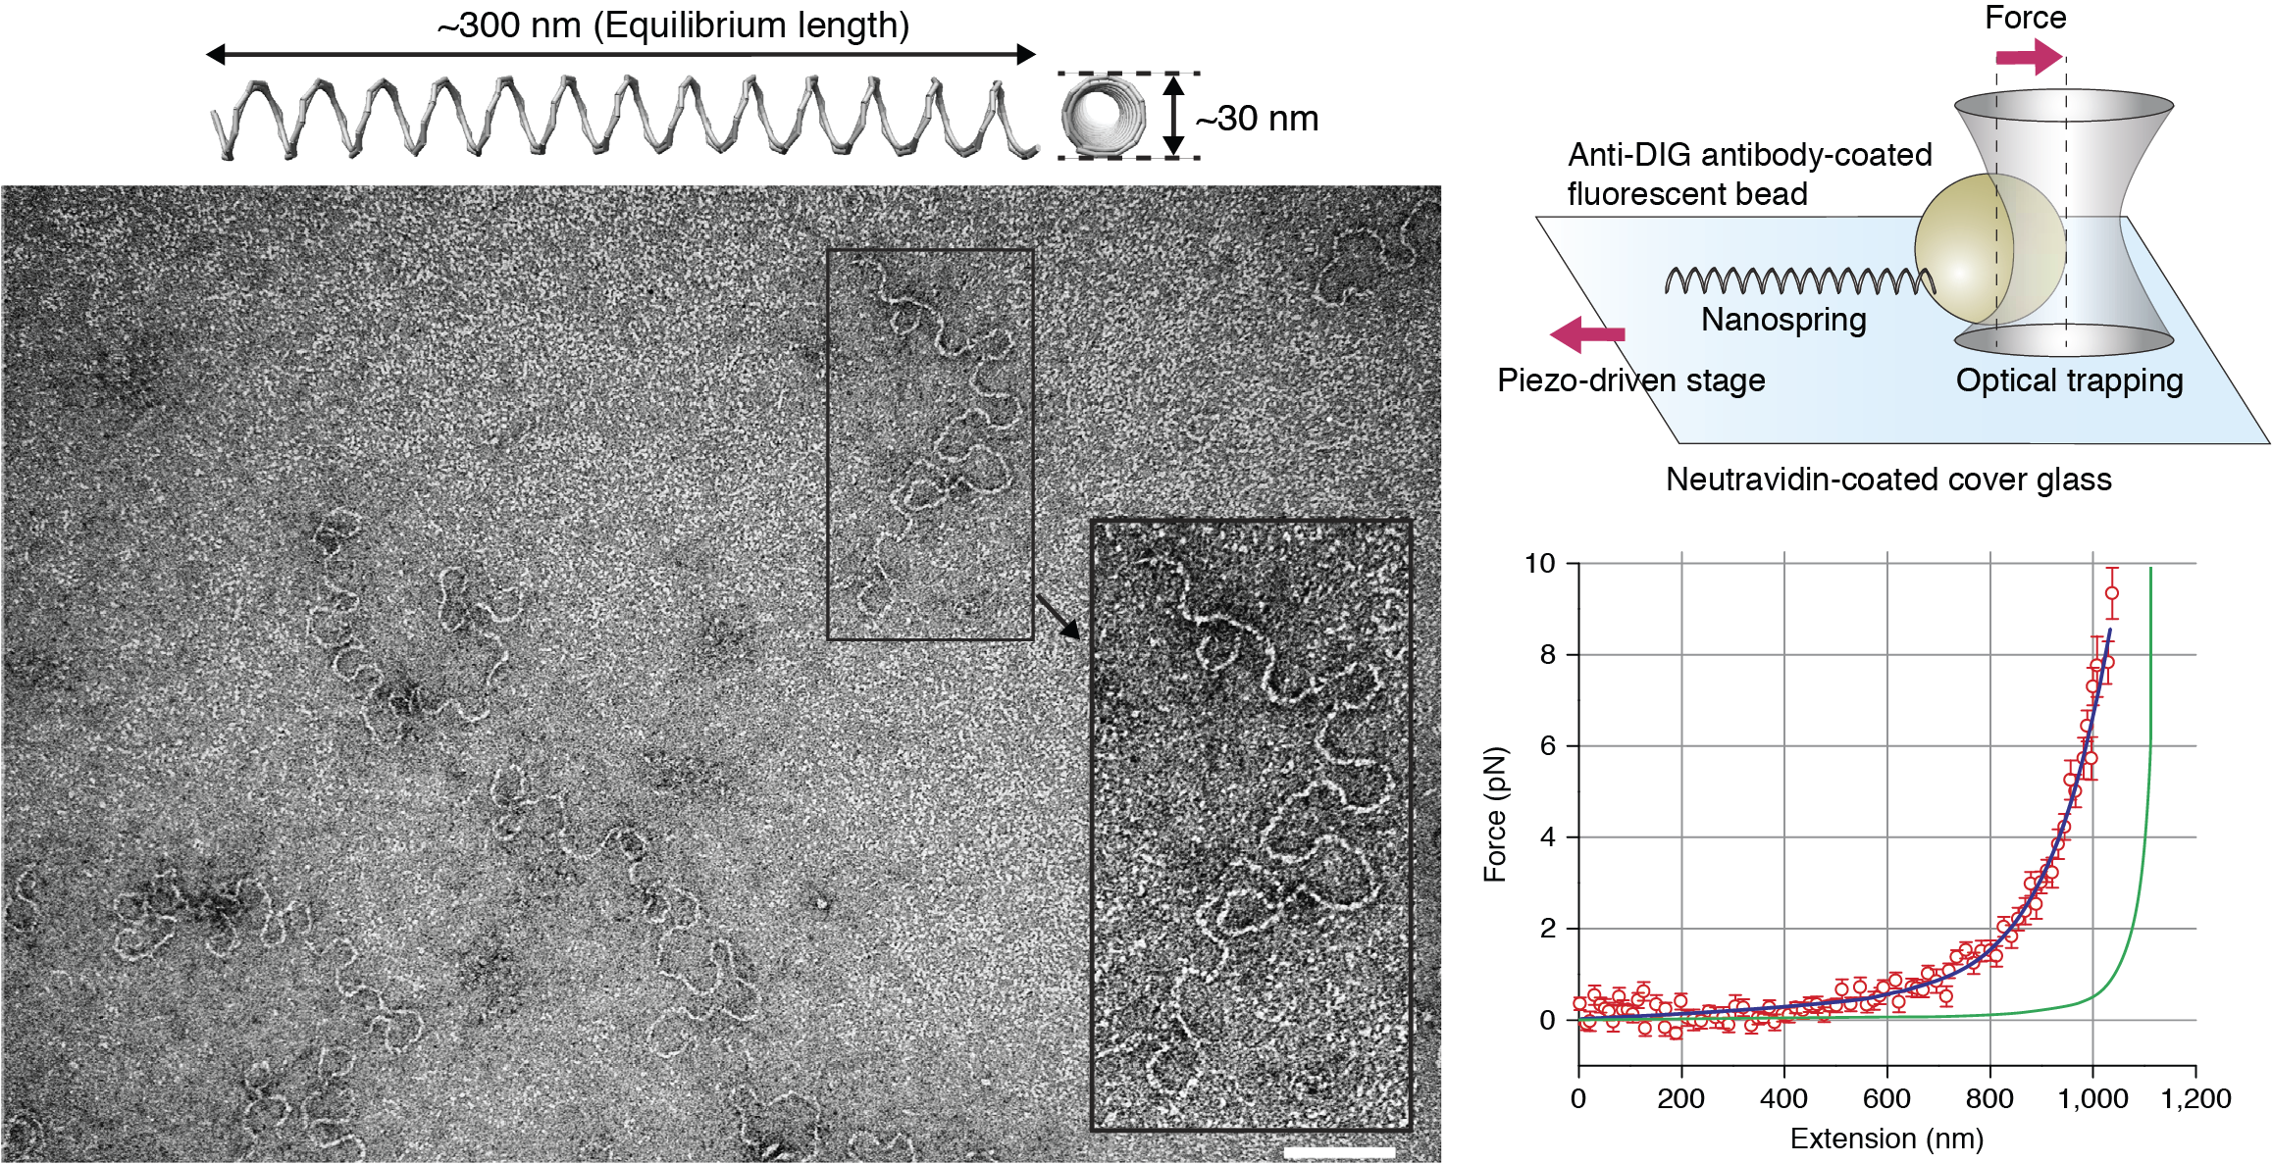
DNA origami springs
School of physics
with Mitsu Iwaki
Osaka University
Shih Lab
Harvard University
Iwaki, et al Nature Comm 2016

Slide 18
DNA origami springs
with Mitsu Iwaki
Osaka University
School of physics

Slide 19
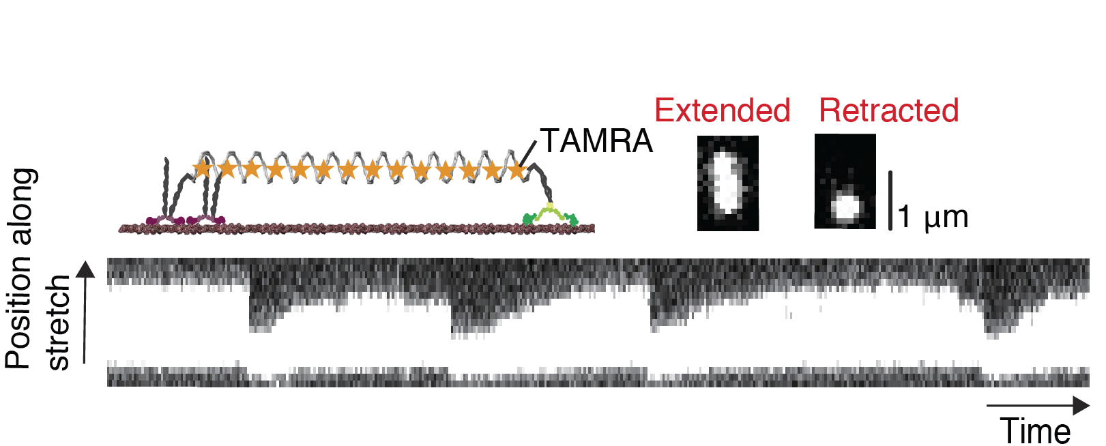

Molecular tug-of-war
School of physics

Slide 20
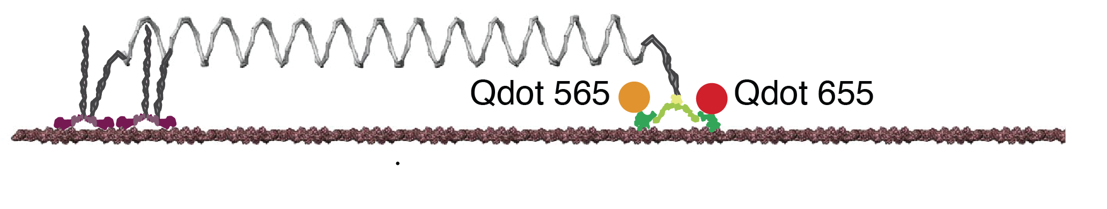
3D DNA origami + myosin
with Mitsu Iwaki

Slide 21
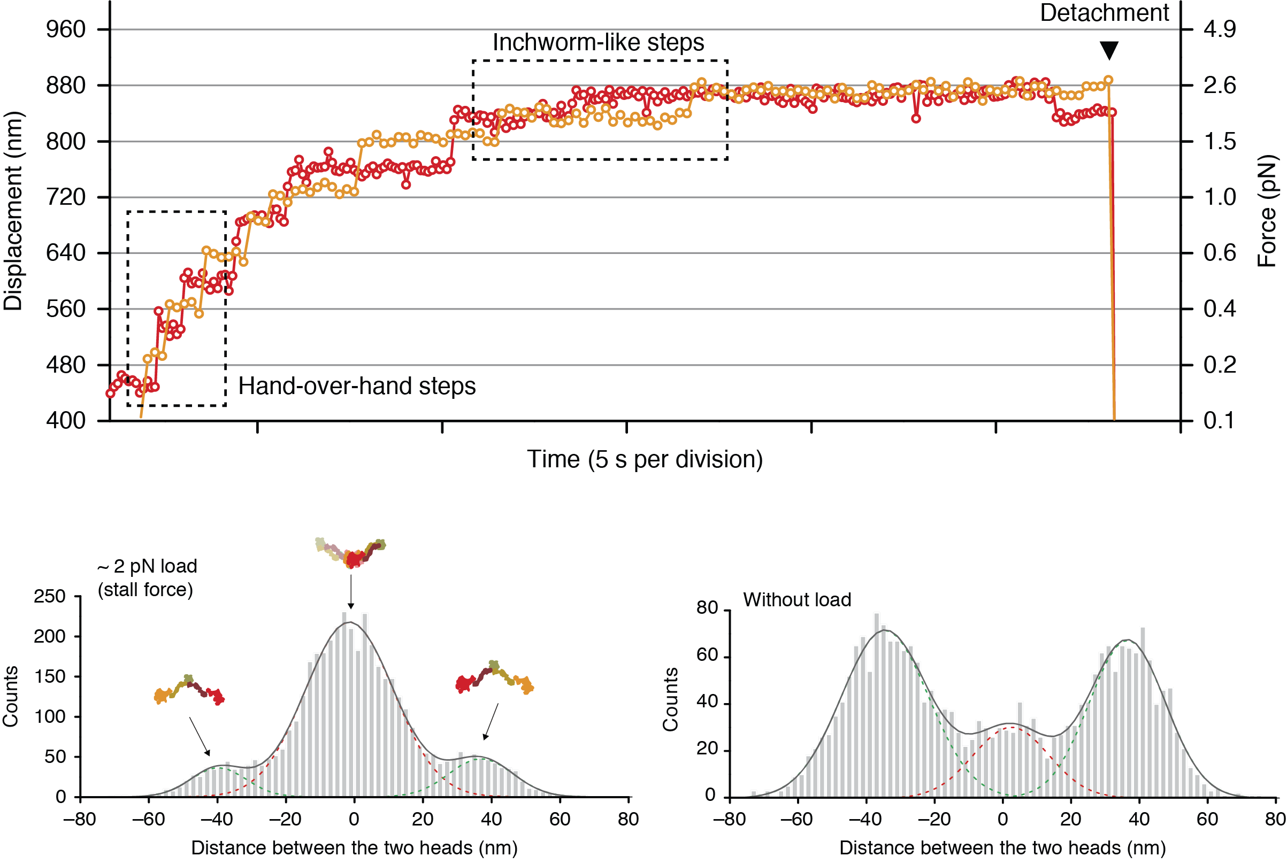
3D DNA origami + myosin
with Mitsu Iwaki

Slide 22
3D DNA origami + myosin
with Mitsu Iwaki

Slide 23
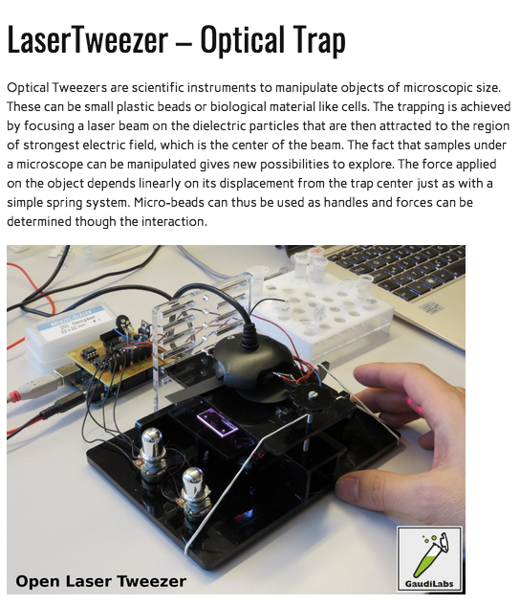
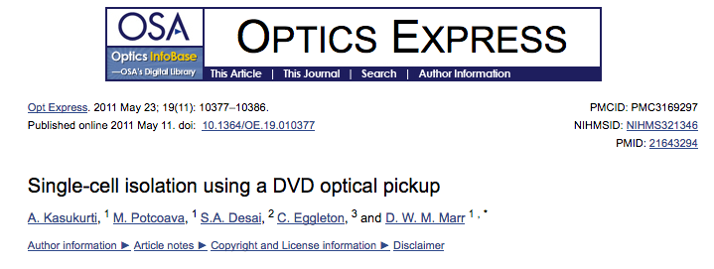
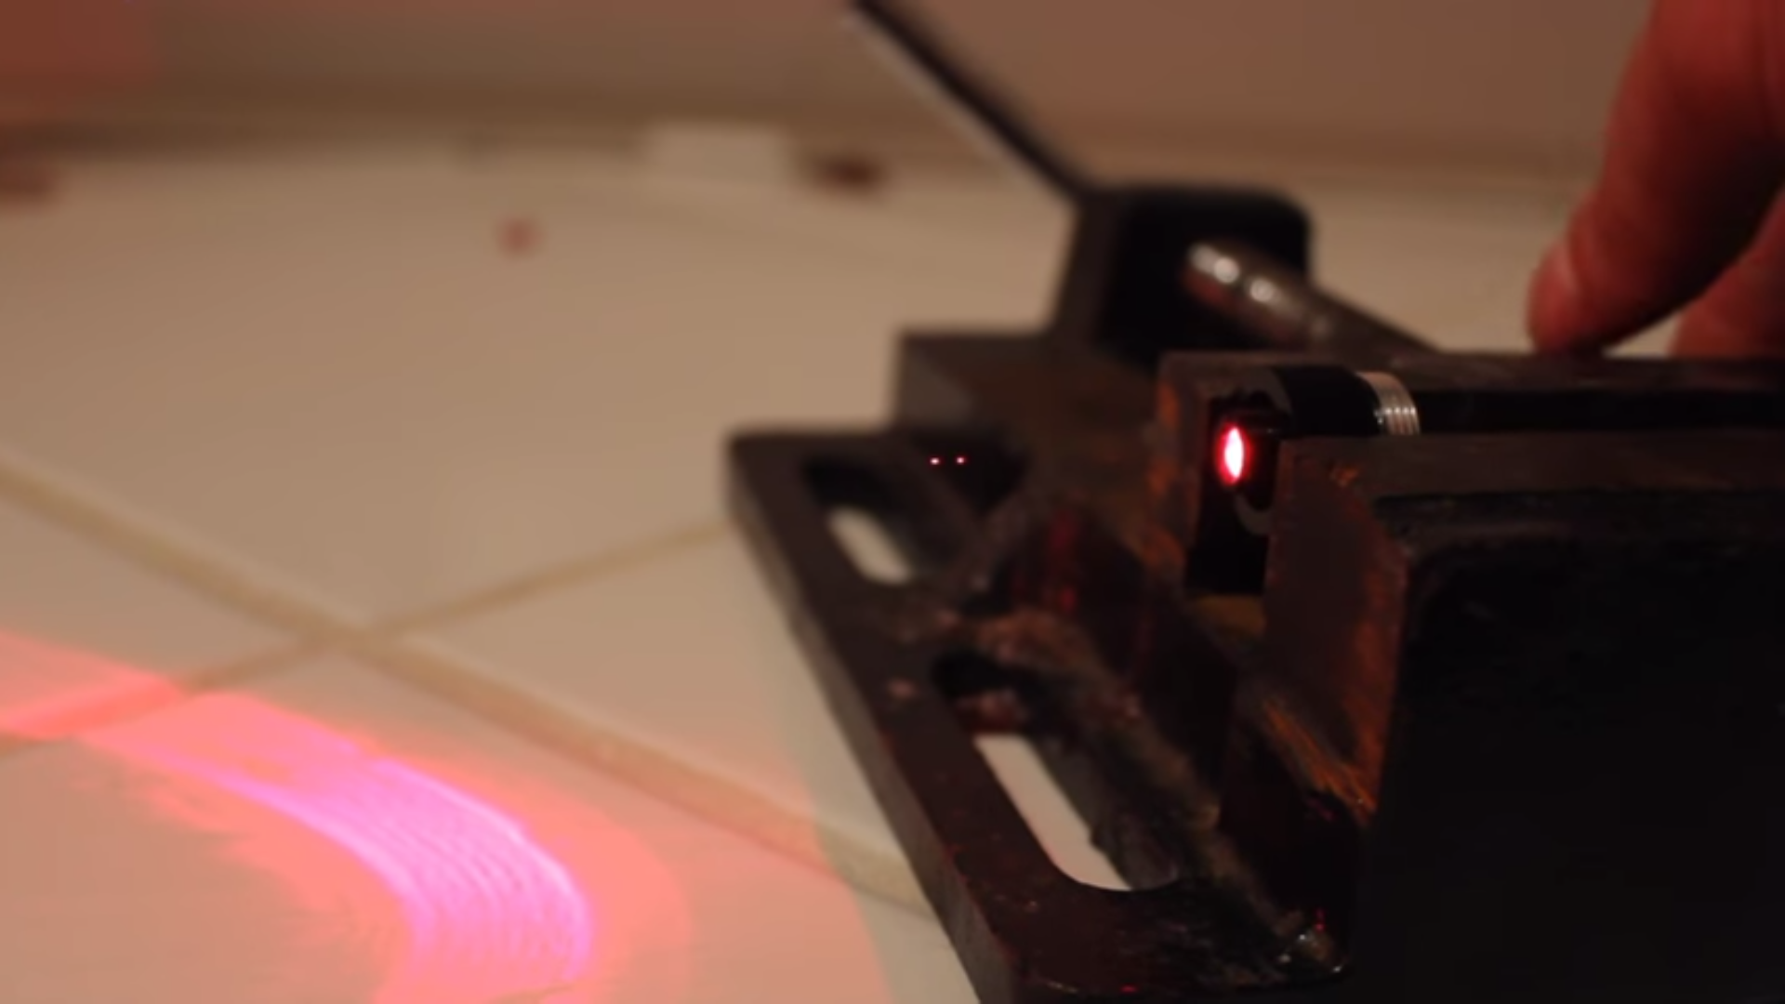
What next?
Always wear eye protection!
https://youtu.be/Sq7GaO8iqu8

Slide 24
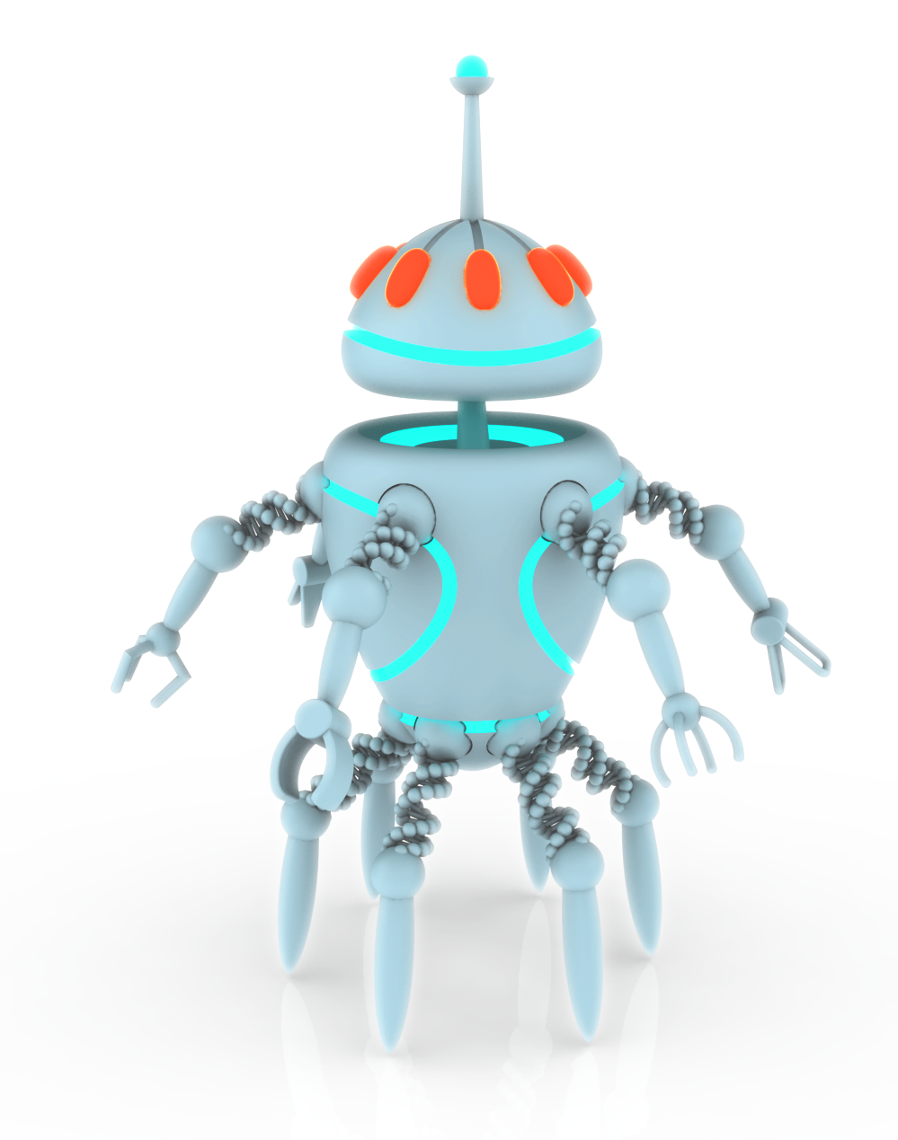
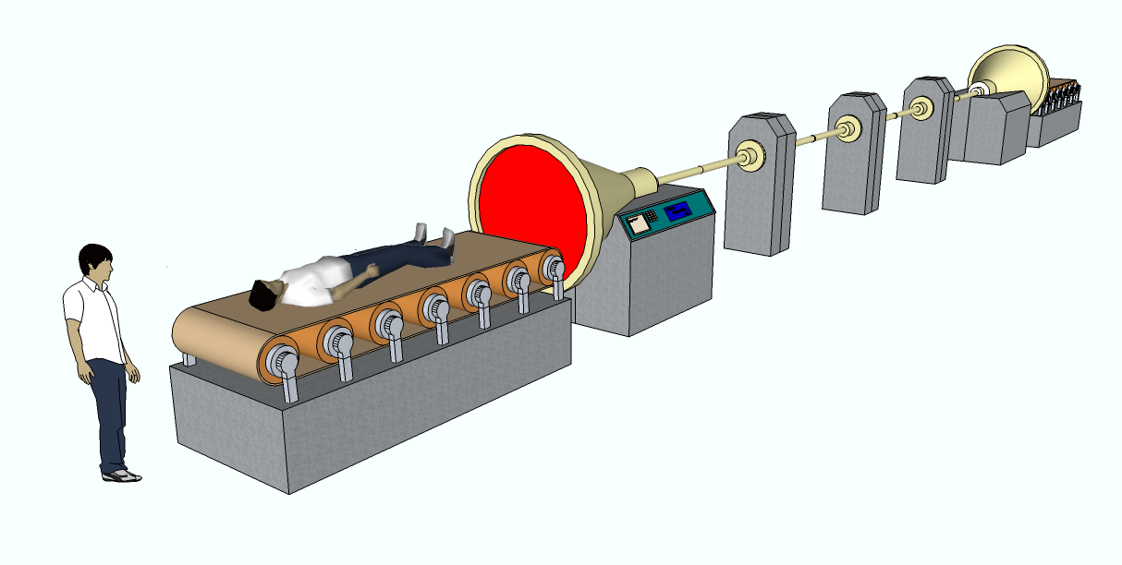
Science fiction?
School of physics
https://engineerzero.blog/2011/01/20/teleportation-by-optical-tweezers/
The University of Sydney Nano Institute
Grand Challenge
Molecular nanorobotics

Slide 25
Ultrashort high-intensity beams for extreme light-matter interaction

Slide 26
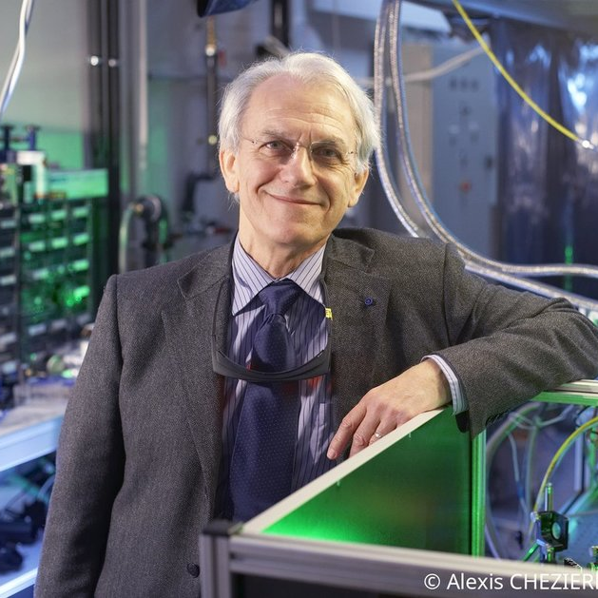
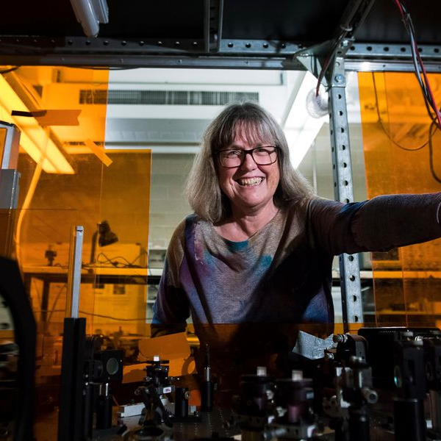
Gerard Mourou
Donna Strickland
École Polytechnique, Palaiseau, France
University of Michigan, Ann Arbor, USA
University of Waterloo, Canada

Slide 27
1981 at the University of Rochester
The supervisor
The PhD student
Extremely enthusiastic
Very practical person
Highly competitive
Proud to be an engineer
Typically French
Loved Christmas lights
The insider
" I did not set out to save world. I think you should do what you are good at. That is enough.”
Prof. Judith Dawes
Macquarie University

Slide 28
1981 at the University of Rochester
The supervisor
The PhD student
Extremely enthusiastic
Very practical person
Highly competitive
Proud to be an engineer
Typically French
Loved Christmas lights
1st female Nobel prize in
Physics in 55 years, 3rd ever
Age in 1985 = 26
(PhD student)
The insider
" I did not set out to save world. I think you should do what you are good at. That is enough.”
Prof. Judith Dawes
Macquarie University

Slide 29

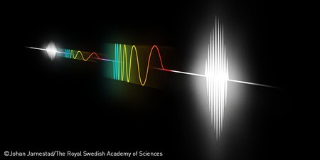
Chirped Pulse Amplification (CPA)
"for their method of generating high-intensity, ultra-short optical pulses.”
The Royal Swedish Academy of Sciences

Slide 30
At the point of the discovery, pulsed lasers were at an impasse…
10³⁰
MJ
10²⁵
kJ
Focused intensity (W/cm²)
10²⁰
J
CPA
10¹⁵
mJ
Mode-locking
Q-switching
10¹⁰
LASER
1960
1970
1980
1990
2000
2010
2020
2030
Year
First laser:
Schawlow and Townes, Infrared and optical masers, Phys. Rev. 112, 1940 (1958)
Maiman, Stimulated optical radiation in ruby, Nature 187, 493 (1960)
First pulsed lasers – Q-switching and mode-locking:
McClung and Hellwarth, Giant optical pulsations from ruby, J. Appl. Phys. 33, 828 (1962)
Hargrove, Fork and Pollack, Locking of He−Ne laser modes induced by synchronous intracavity modulation, Appl. Phys. Lett. 5, 4 (1964)

Slide 31
What is an optical pulse
Continuous wave
Optical pulse
1
1
Electric Field (V/m)
Electric Field (V/m)
0
0
-1
-1
-100
0
100
-100
0
100
Time (fs)
Time (fs)
Notes:
amplitude

Slide 32


The challenge of amplifying short optical pulses
Goal: Increasing the peak power of ultrashort pulses
Gain medium
Optical pulse
1
Focused Intensity
I = P₀ / A
Peak power P₀
Pulse duration $τ$
Stimulated emission
Power - |Electric field|² (W)
Energy
E ~ P₀ $× τ$
0
-100
0
100
Time (fs)
Notes:
amplitude

Slide 33
The challenge of amplifying short optical pulses
Goal: Increasing the peak power of ultrashort pulses
Gain medium
Optical pulse
1
Peak power P₀
Pulse duration $τ$
Problem: High peak powers damage the gain medium via self-focusing
Power - |Electric field|² (W)
Energy
E ~ P₀ $× τ$
0
-100
0
100
Time (fs)
Notes:
amplitude

Slide 34
The solution was found in the spectrum
Continuous wave
Optical pulse
1
1
1
1
Electric Field (V/m)
Electric Field (V/m)
0
0
Power - |Electric field|² (W)
Power - |Electric field|² (W)
-1
-1
0
100
0
-100
0
-100
0
100
140
193.5
250
140
193.5
250
Time (fs)
Time (fs)
Frequency (THz)
Frequency (THz)
Notes:
amplitude

Slide 35
The concept of pulse stretching
Dispersive medium:
different frequencies travel at different speed
Lower peak power
Longer pulse
Time
Time
Time
Frequency
Frequency
Frequency
Dispersion in optical fibers:
Williams and Kao, Proc. IEEE 56, 197 (1968).
Gloge, Dispersion in weakly guiding fibers App. J. Opt. 10,2442 (1971).

Slide 36
The award winning technique:
P₀ ~ 500 W
P₀ ~ 500 MW
Original paper: D. Strickland and G. Mourou, Compression of amplified chirped optical pulses, Opt. Commun. 56, 219 (1985)
(Illustration: ©Johan Jarnestad/The Royal Swedish Academy of Sciences )

Slide 37
The award winning technique:
Original paper: D. Strickland and G. Mourou, Compression of amplified chirped optical pulses, Opt. Commun. 56, 219 (1985)
(Illustration: ©Johan Jarnestad/The Royal Swedish Academy of Sciences )

Slide 38






A tool for changing the properties of matter – Medical and Industrial applications
Laser eye surgery
Cold ablation - Material processing
Data storage – Precise magnetization
$τ$~ 100’s fs
P₀ ~ 100’s kW
E ~ 100 nJ/pulse
$τ$~ 100’s fs
P₀ ~ 100’s MW
E ~ 100 µJ/pulse
$τ$~ 20 fs
P₀ ~ 100 GW
E ~ 2.5 mJ/pulse

Slide 39

Attosecond science: the world fastest camera
Molecular imaging
First attosecond (<1 fs) laser pulses:
Paul et al., Observation of a train of attosecond pulses from high harmonic generation, Science 292, 1689 (2001)
Hentschel et al., Attosecond metrology, Nature 414, 509 (2001)
Baker et al. Science, 312, 424–427 (2006).
The attoclock: imaging electron motion
Hartman et al., Nature Photonics 12, 215-220 (2018)
Notes:
Nature Photonicsvolume 12, pages215–220 (2018)

Slide 40
Towards even higher intensities
High-energy density physics
High-intensity laser roadmap
Nonlinear QED
MJ
10³⁰
Vacuum polarization
Ultra-relativistic optics
Ultra-relativistic plasma
10²⁵
kJ
Extreme Light Infrastructure (ELI)
Relativistic optics
Focused intensity (W/cm²)
10²⁰
J
CPA
10¹⁵
Nuclear fusion
Mode-locking
mJ
Q-switching
10¹⁰
LASER
1960
1970
1980
1990
2000
2010
2020
2030
Year
Notes:
inertial confinement experiments for nuclear fusion

Slide 41

Towards even higher intensities
High-energy density physics
Ultra-relativistic plasma
Nuclear fusion
Notes:
inertial confinement experiments for nuclear fusion

Slide 42




School of Physics Research
Novel ultrafast lasers
Entangled photons from nonlinearity
School of physics
Blanco-Redondo, de Sterke et al., Nat. Comm. 7, 10427 (2016)
Blanco-Redondo, Bell, Oren, Eggleton, Segev, Science (in press)
Lo, Stefani, de Sterke & Blanco-Redondo, Opt. Express 26, 7786-7796 (2018)
Optical memories
Compact source of entangled photons
Fastest optical networks
Merklein*, Stiller*, Vu, Madden, Eggleton, Nat. Comm. (2017).
Li, de Sterke, and Palomba, ACS Photonics 5, 1034−1040 (2018)
Tuniz, Weidlich, and Schmidt, Phys. Rev. Applied 9, 044012 (2018)
Choudhary, Pelusi, et al., Optics Letters (2017)

Slide 43
Lessons learned
Scientific discovery isn’t a linear process
Neither are science careers
There are lots of factors – some personal – in the choices scientists make and the process of discovery

Slide 44
Questions!

