Slide 1
All attempts to date to make pre-specified, realistic N-body models with true long-term stability have failed, leading some authors to say this means MW and others like it are rapidly evolving and not even equilibrium figures.
It is true that if you shove JBH & Gerhard (2016) parameters into a simulation and ran it with N=infinity particles, it would fall apart or evolve into something very different.
DF f(x,v) models are the only way to go, steep learning curve but worth it! This was tried with some success by Widrow, i.e. GALACTICS. But with total success by Vasiliev, i.e. AGAMA. This feeds into RAMSES N-body. The specified system settles immediately – amazing to see!
Notes:
GALACTICS not impressive, see N. Deg et al 2019, “GALACTICS + gas”

Slide 2
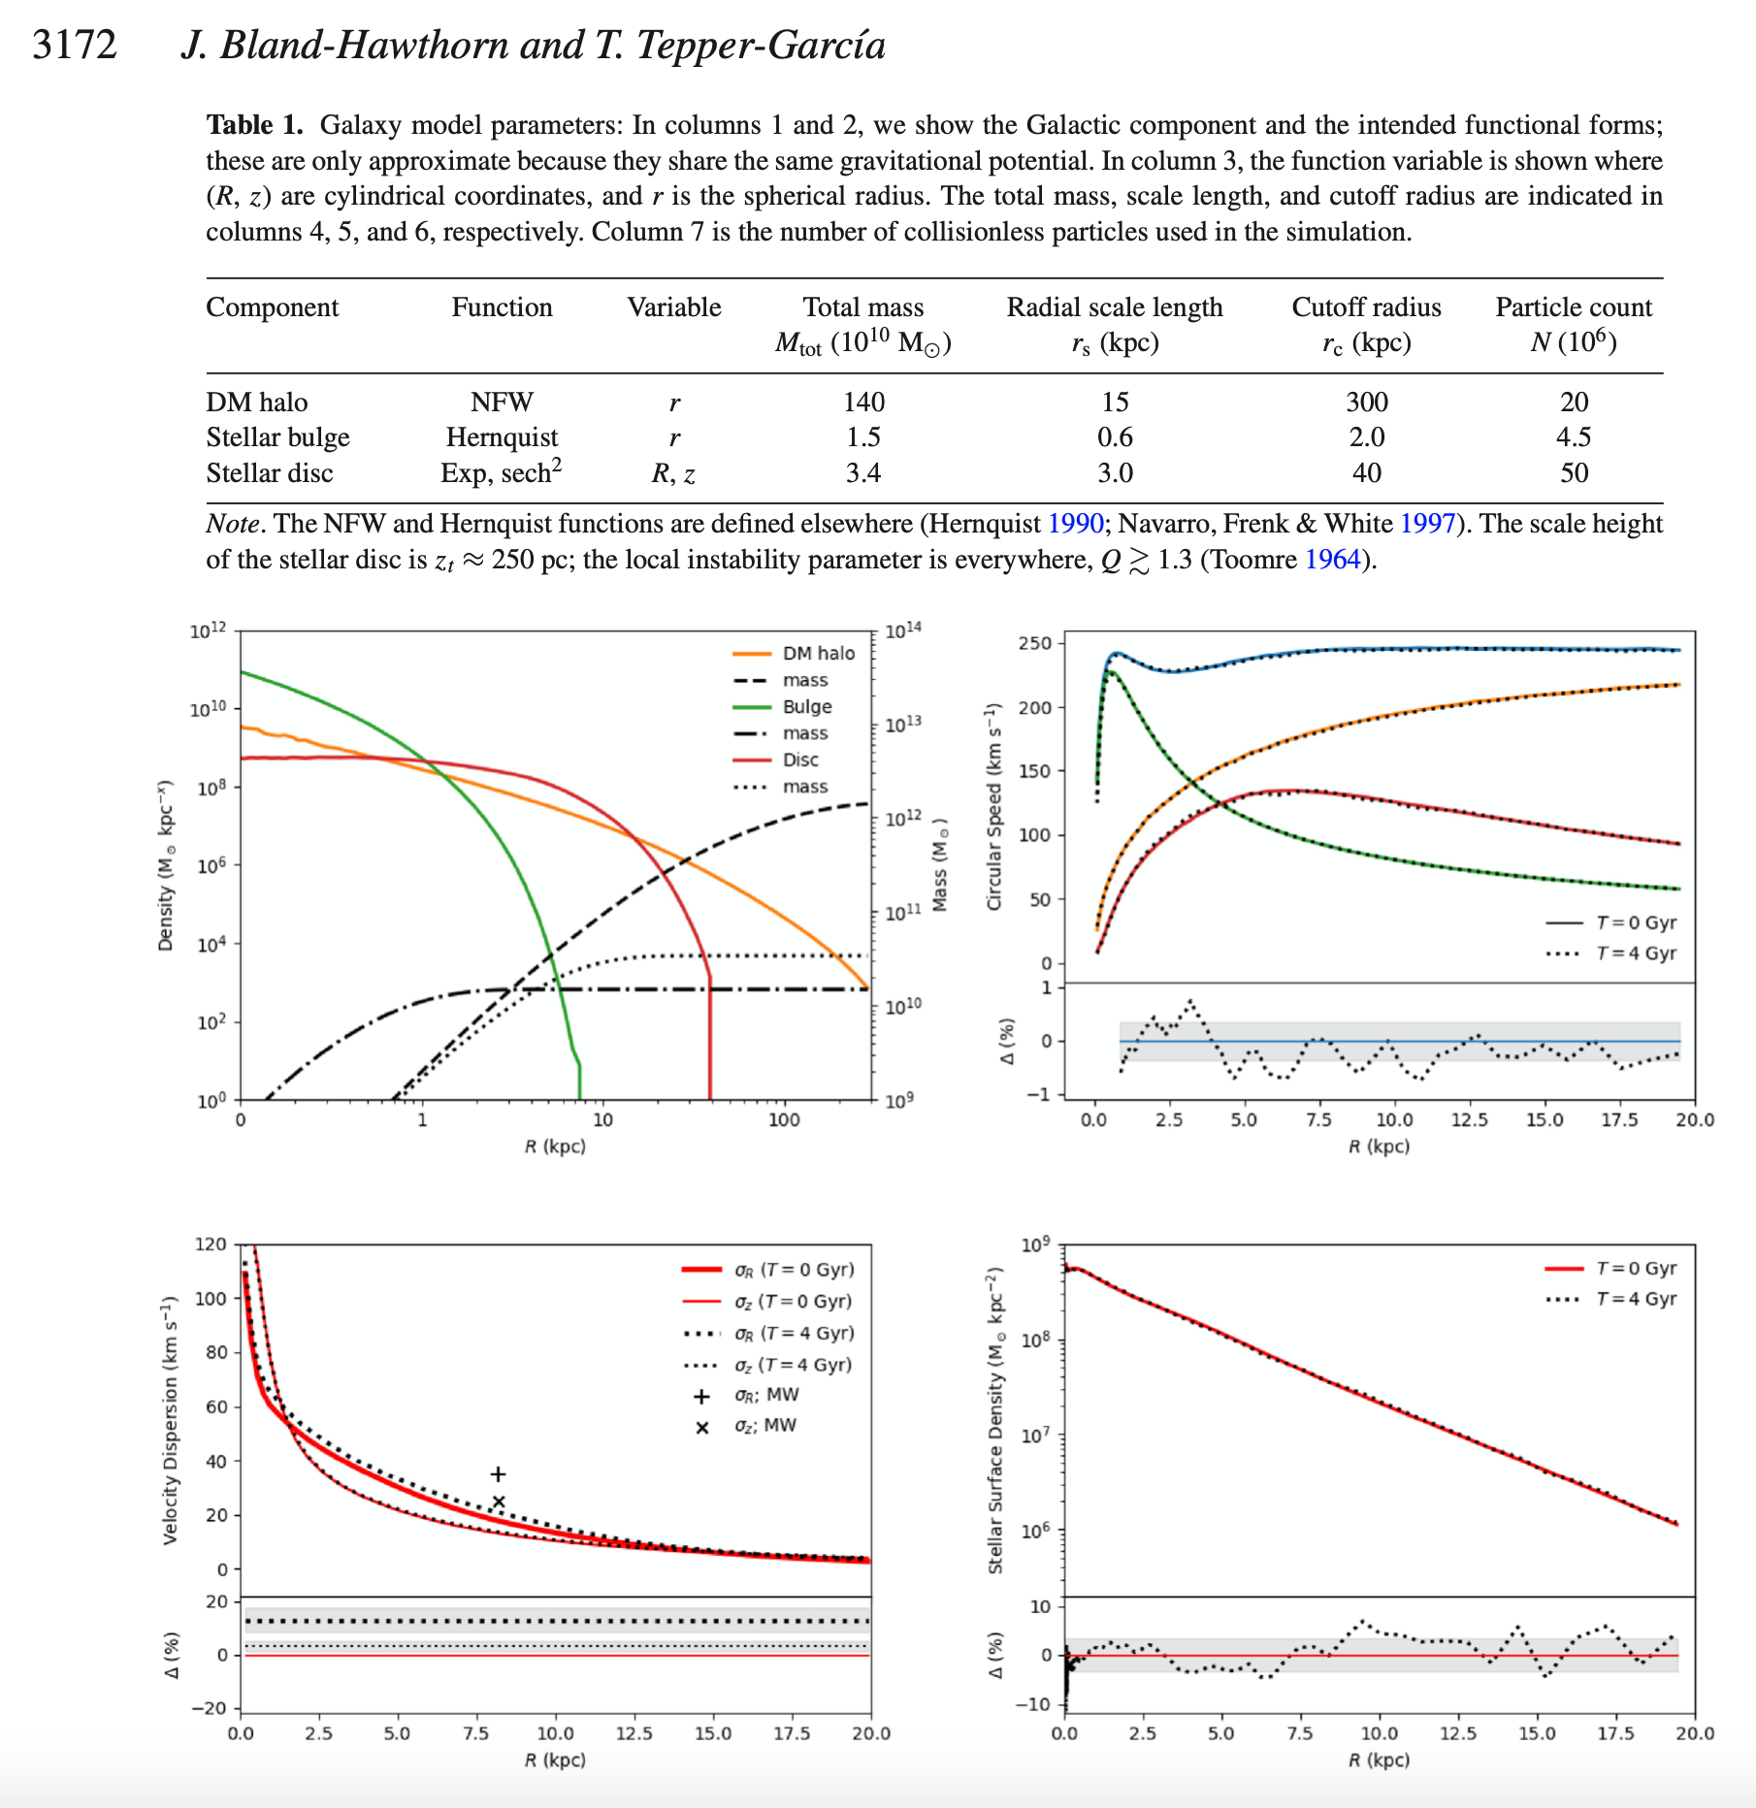
Building N-body models with long-term stability that conform to MW parameters:
Stellar
Stellar + arms
Stellar + bar
Stellar + bar + arms
Stellar + arms + gas
Stellar + bar + gas
Stellar + arms + bar + gas
Repeat same with GMCs
Targetted surveys:
GALAH, Gaia, Hector, MUSE
Notes:
Hector science

Slide 4
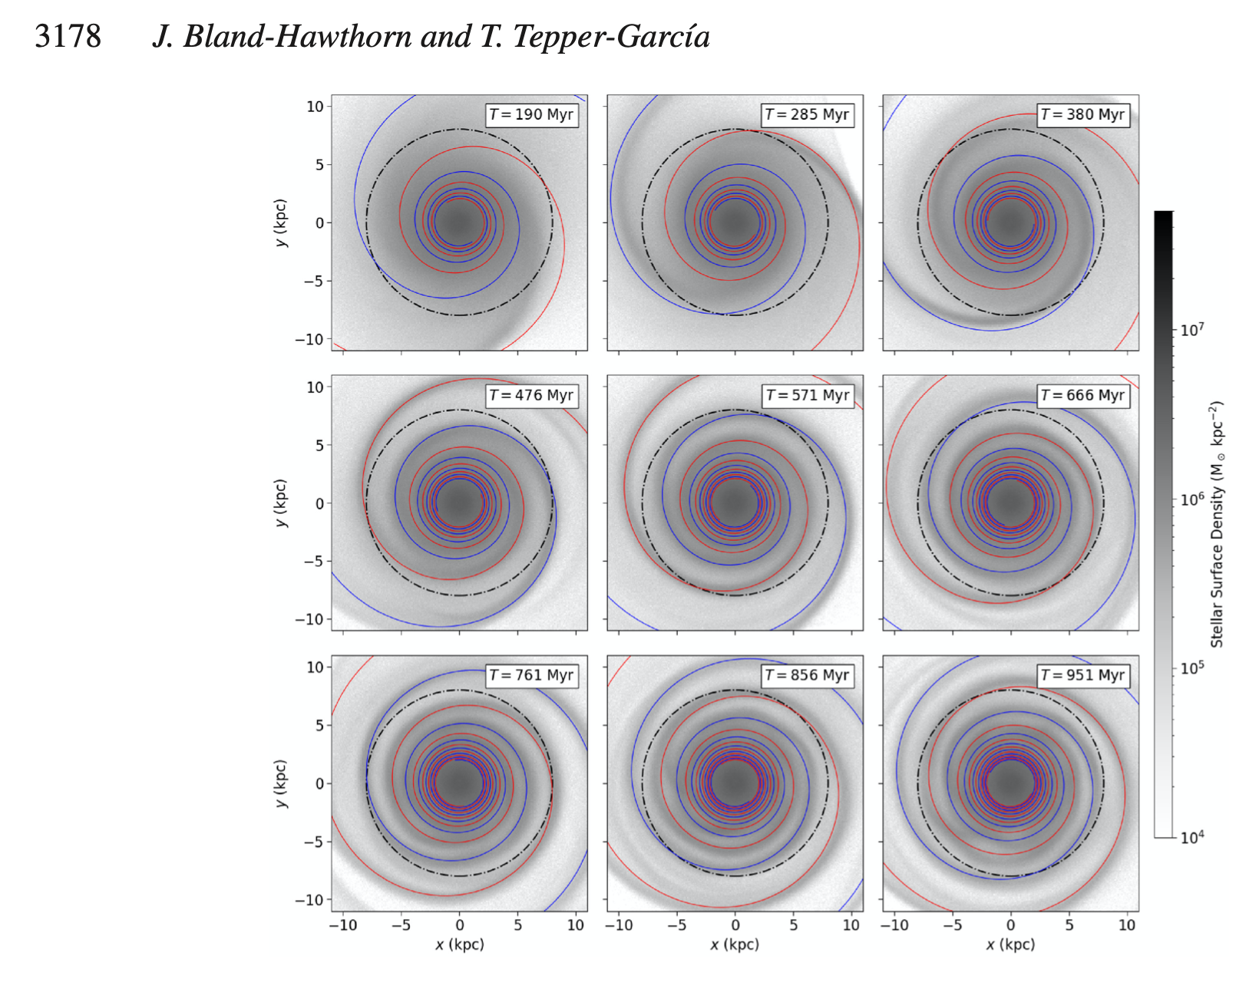
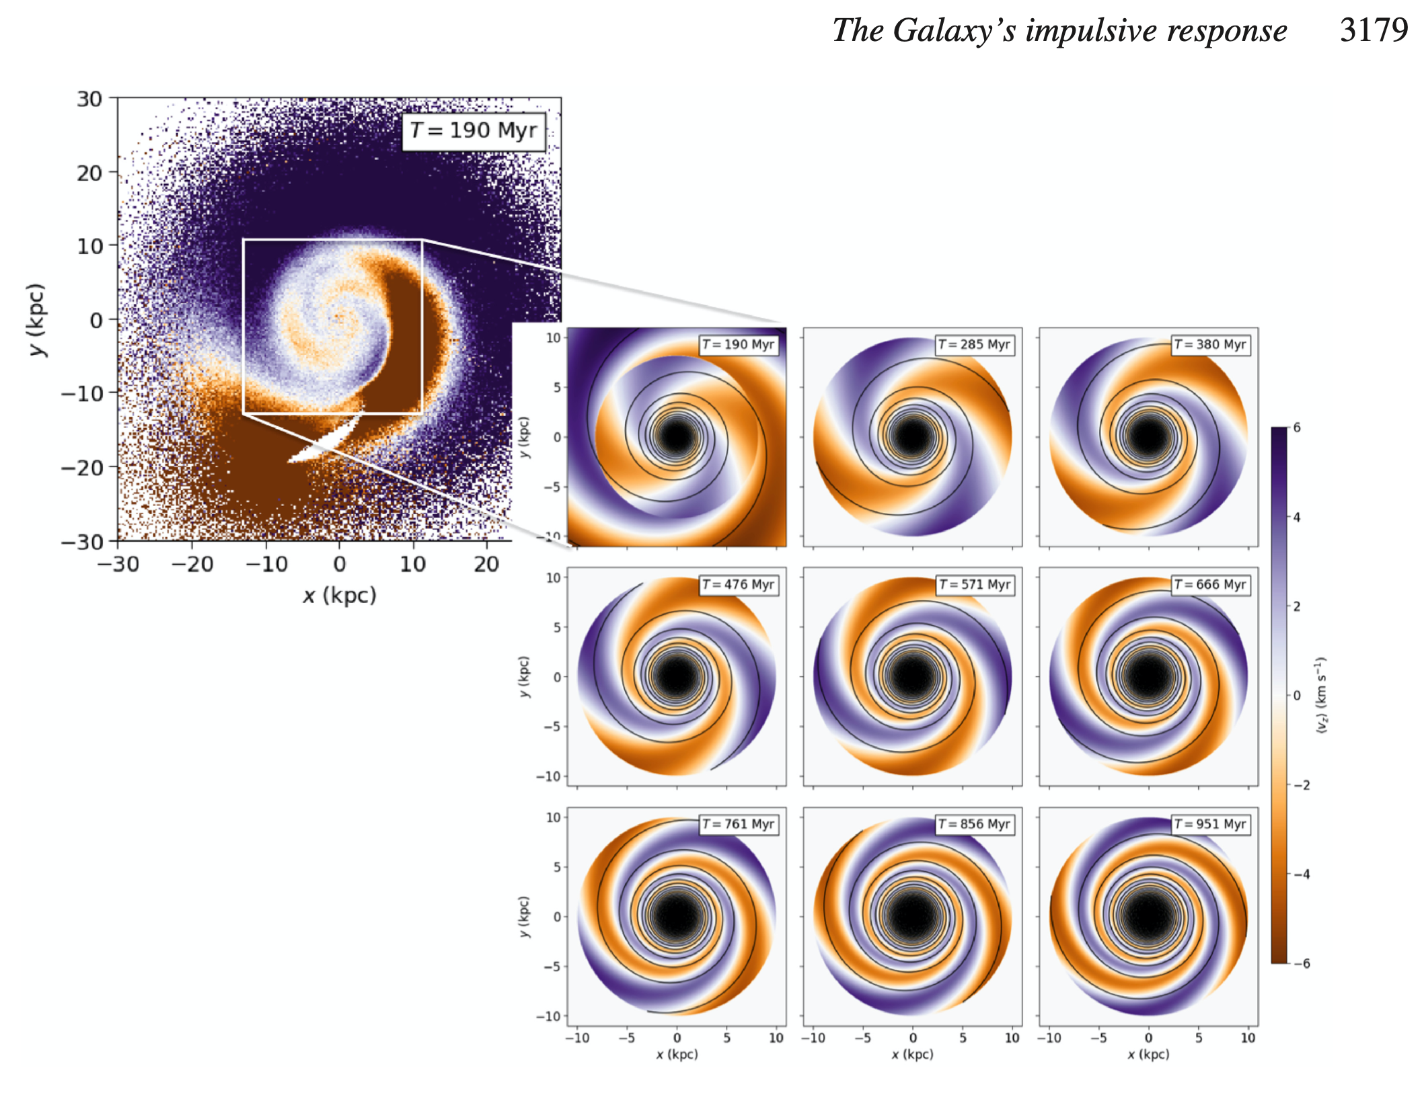

Slide 5
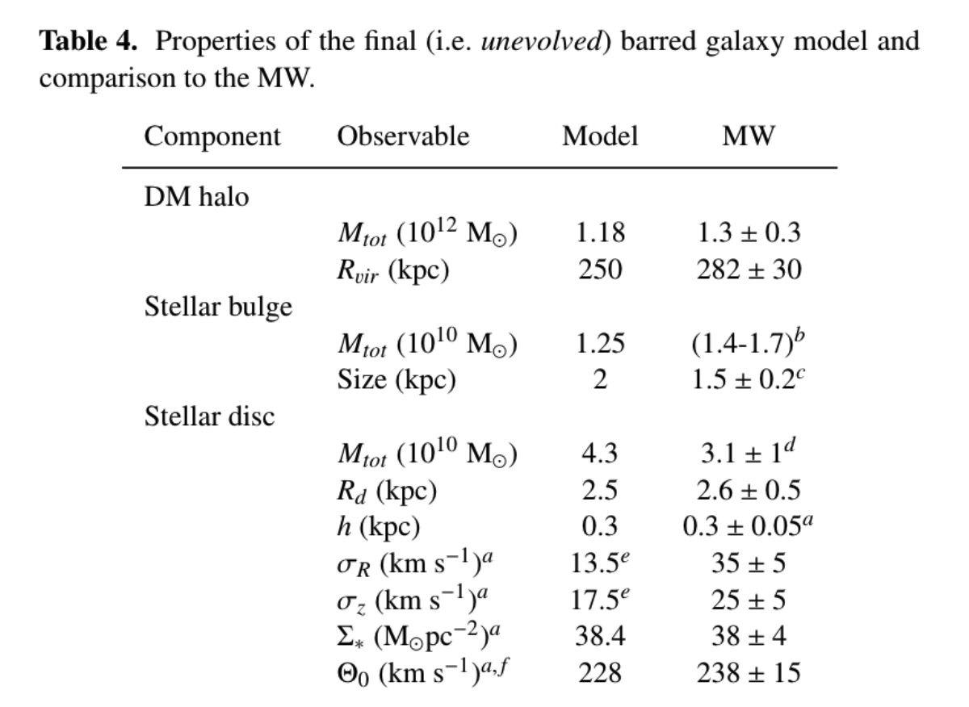

Slide 6
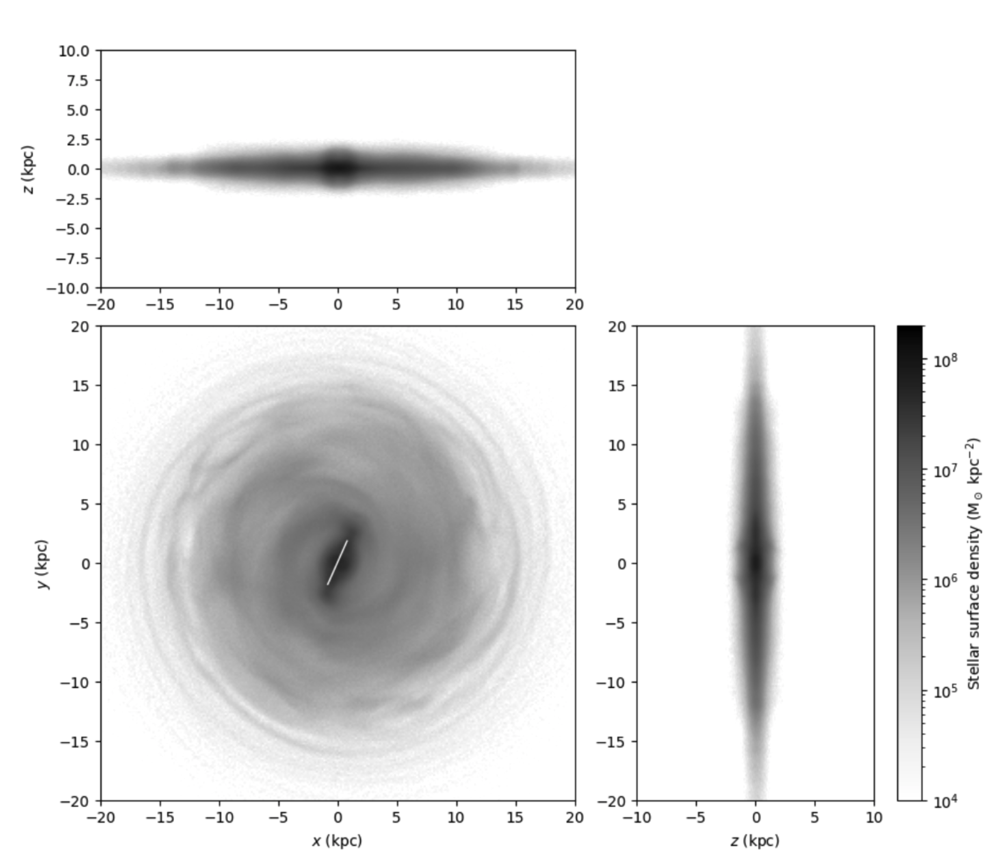
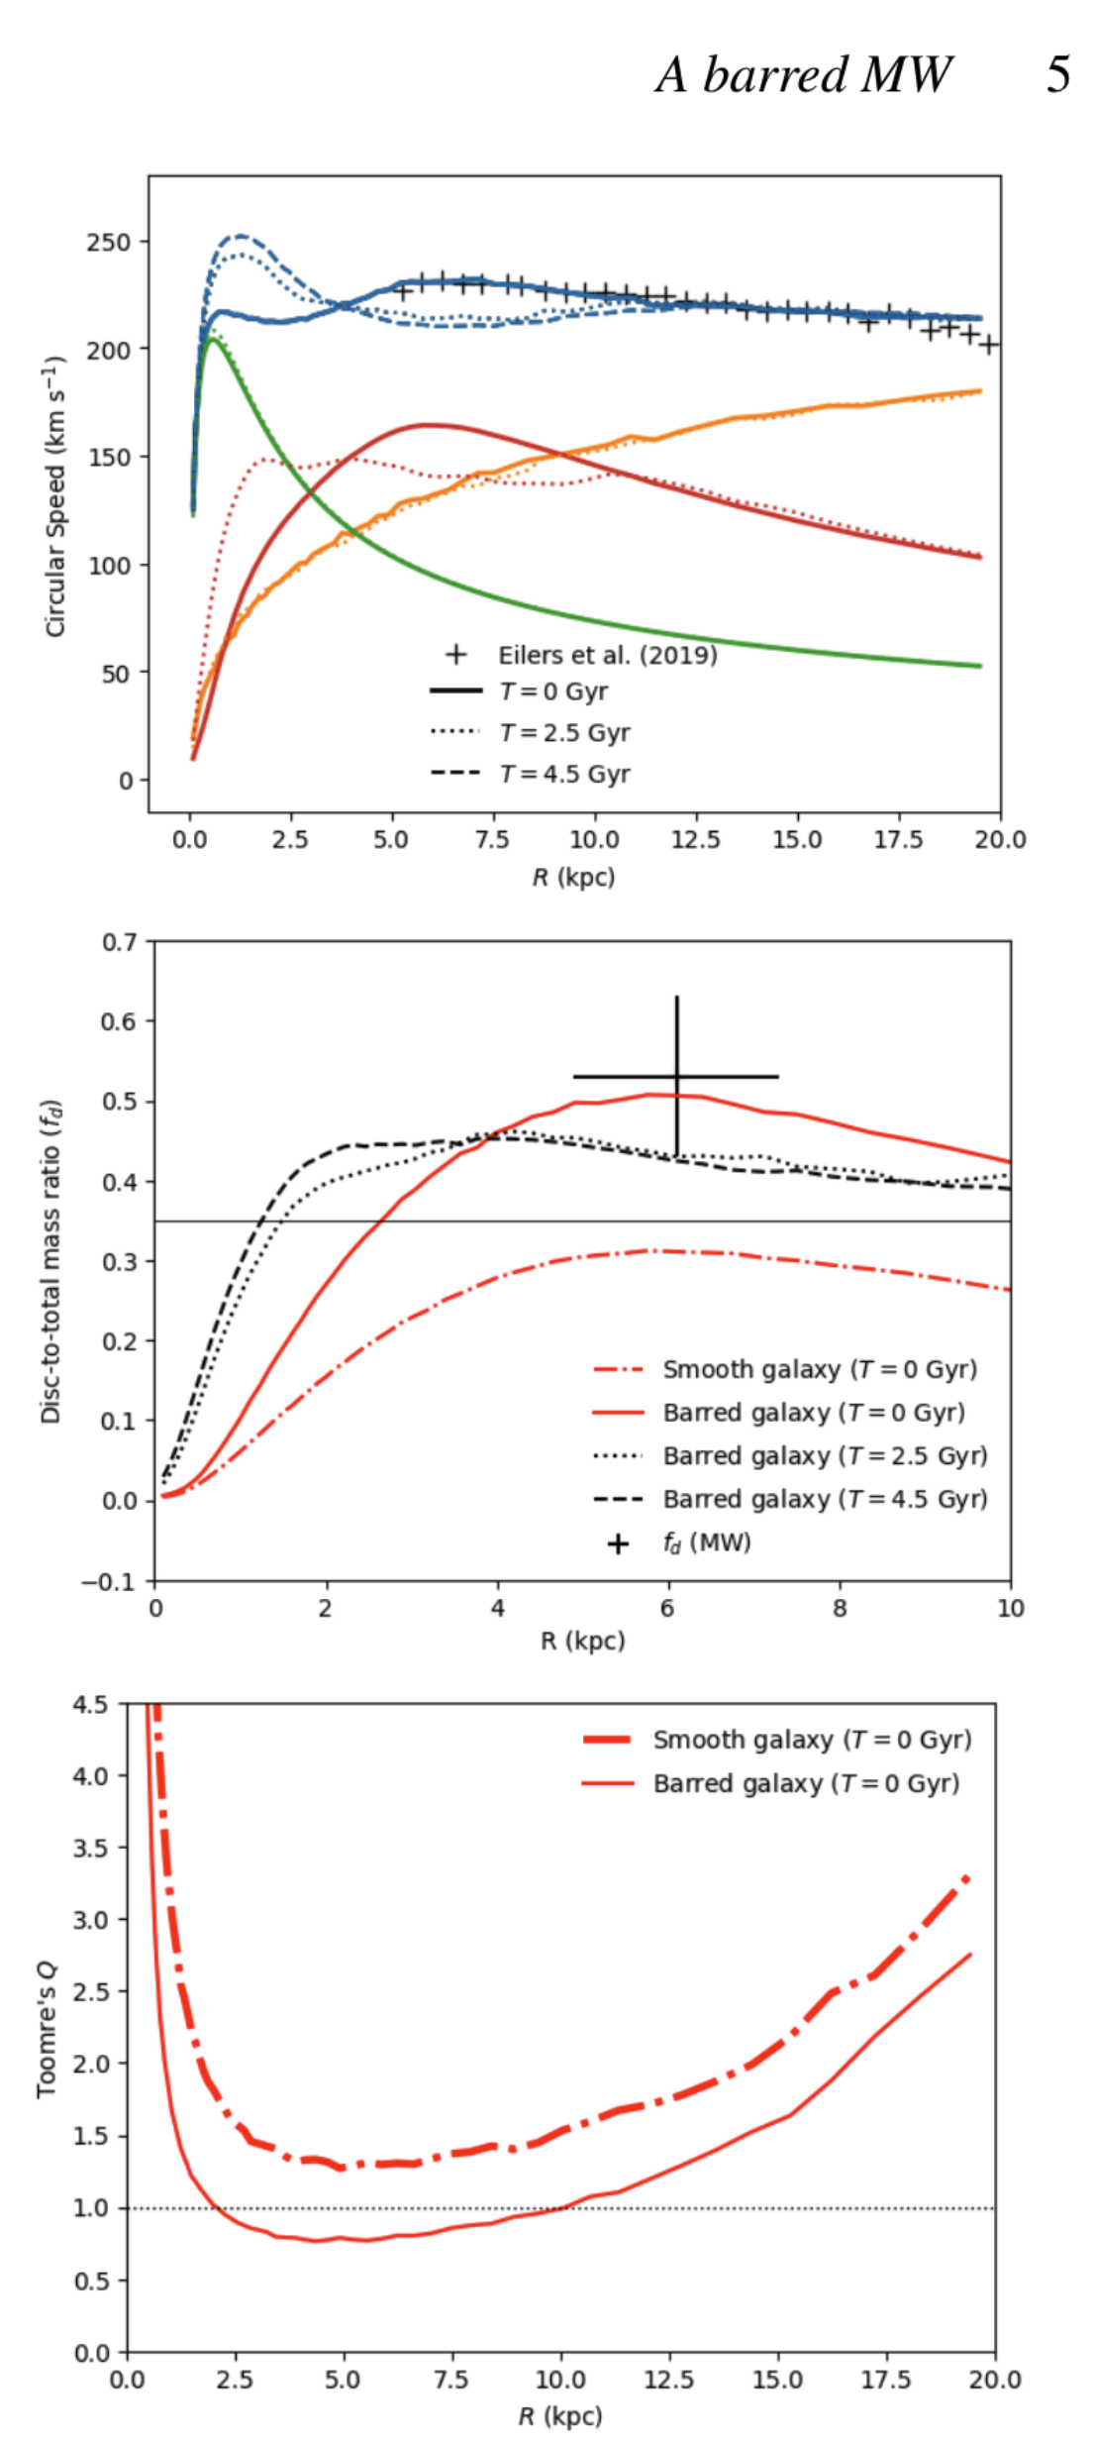

Slide 7
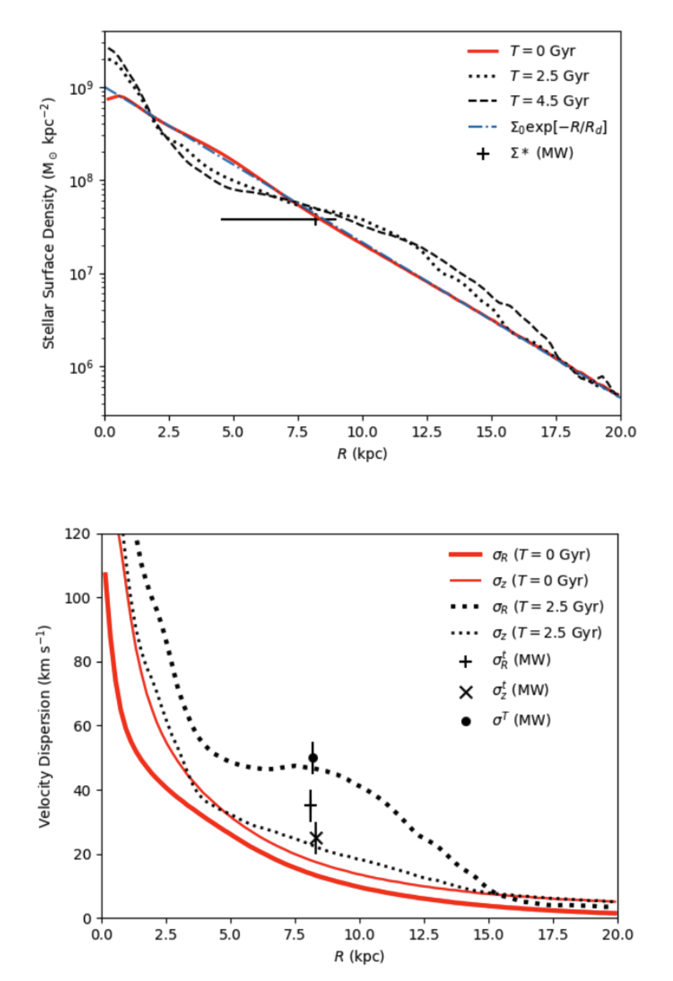

Slide 9
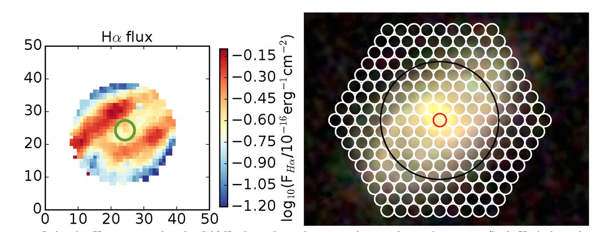
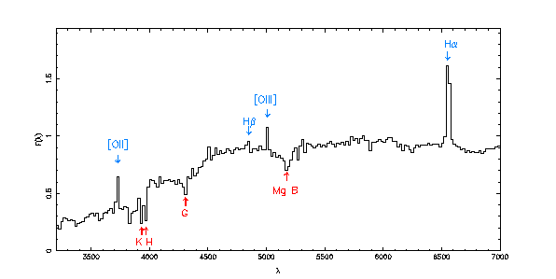
J. Bryant, A. Wang, R. Brown
papers on hexabundles

Slide 10
Notes:
TTG’s first AGAMA+ RAMSES with gas

Slide 11
Notes:
TTG’s first cloud N ~ 10^7 so too low res, but GMC disc stays cold

