Slide 1
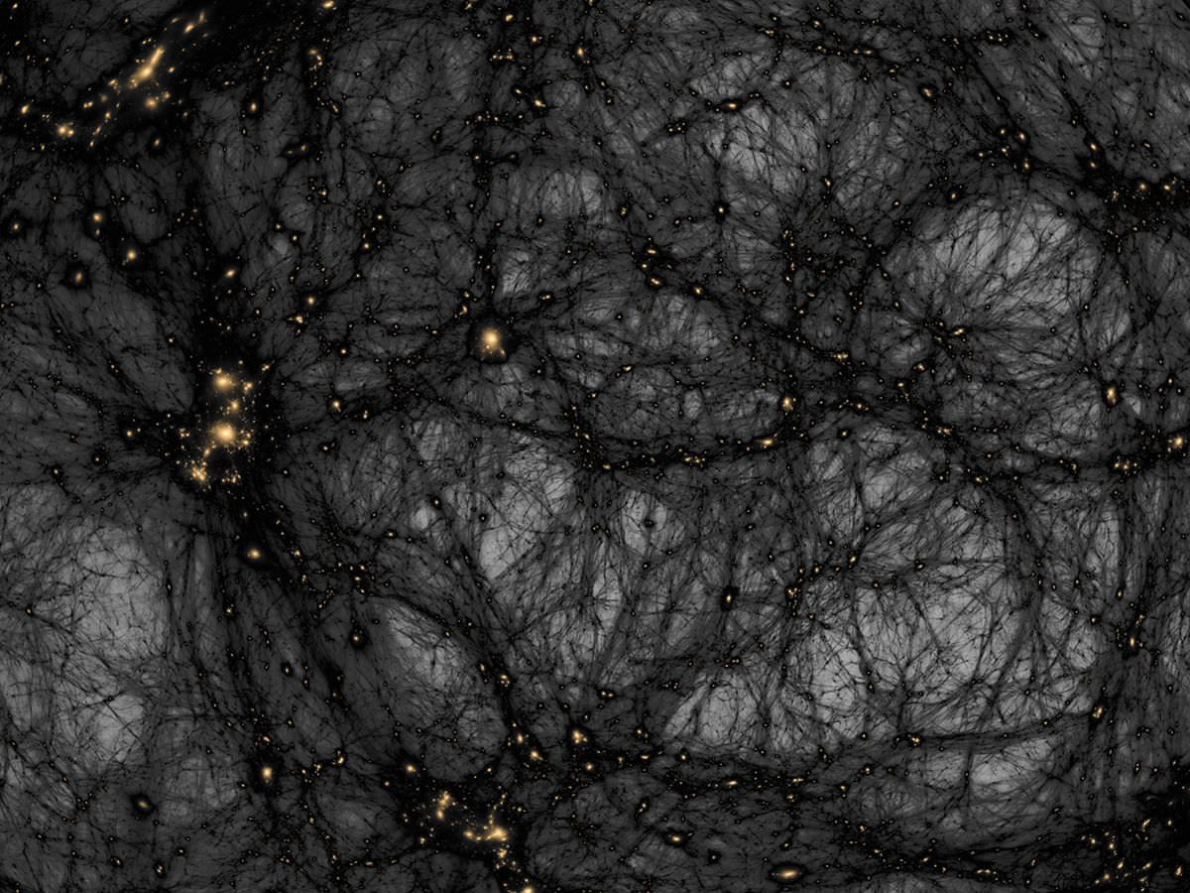
A Milky Way perspective on the Magellanic Clouds
(in search of a narrative)
Joss Bland-Hawthorn
Sydney Institute for Astronomy, University of Sydney
Centre of Excellence for All Sky Astrophysics in 3D (ASTRO-3D)
ESO Conference, Sept. 2019: “A synoptic view of the Magellanic Clouds: VMC, Gaia & beyond”
Notes:
ESO Garching, Sep 2019
“A synoptic view of the Magellanic Clouds: VMC, Gaia and beyond”
VISTA Magellanic Cloud Survey

Slide 2
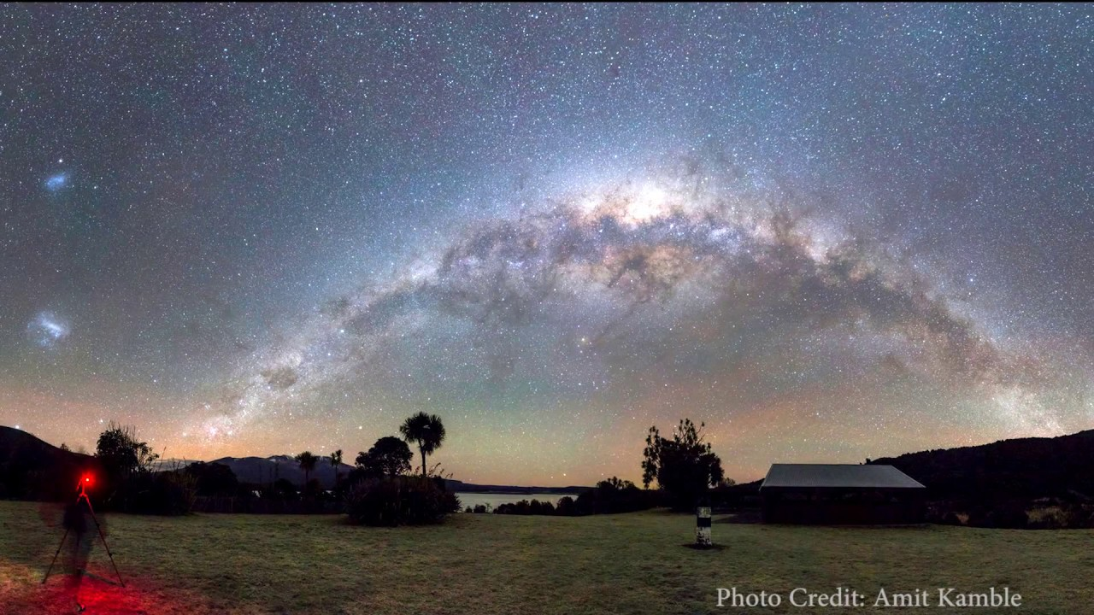
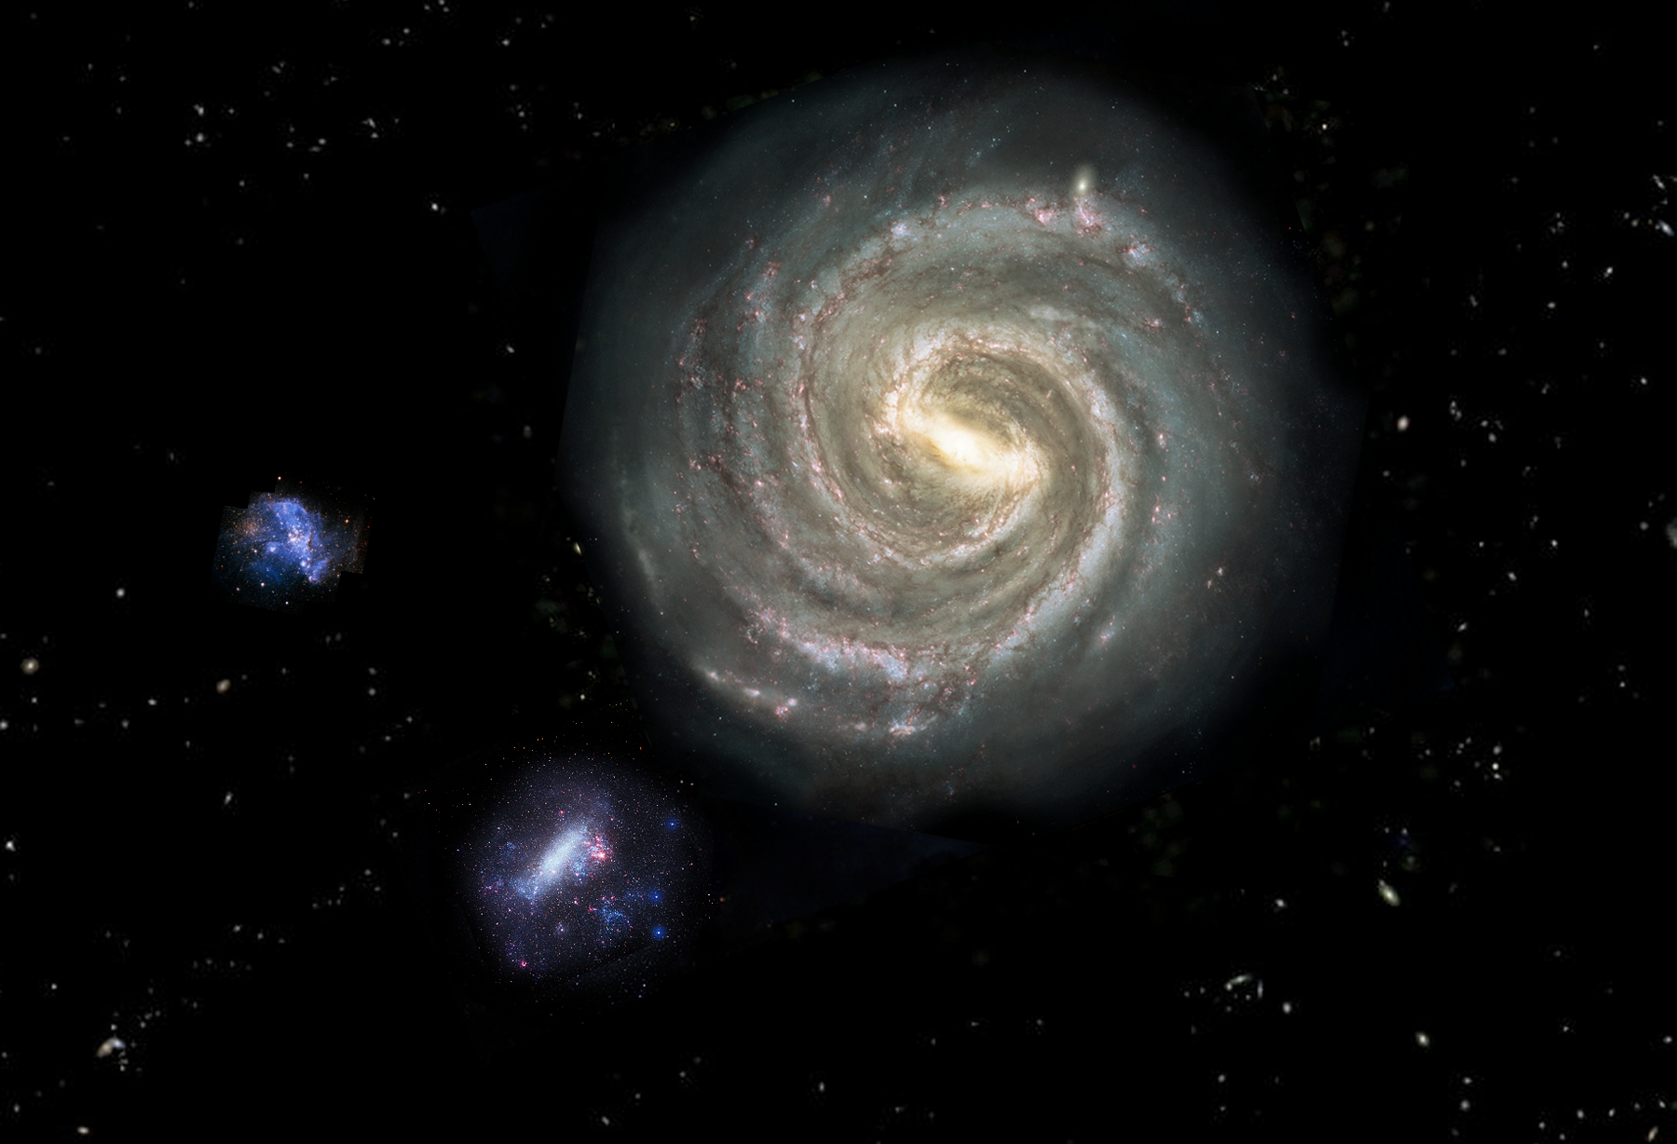
1519: Magellan – 500 years on
Seen from above
•
Galactic
Centre
•
Notes:
Mesozoic (245-66 Myr): Triassic, Jurassic, Cretaceous.
200 Myr ago, LMC and SMC over SGP, we’ve done a full orbit since then.
Magellan could never have foreseen SMBH, Fermi Bubbles, Mag Stream

Slide 3
Why are the Magellanic Clouds important?
They are surely important in the cosmological narrative for the Milky Way. Some have even predicted the end product of the merger and compared the future Galaxy’s properties to external L★ systems.
They allow study of many astrophysical processes under different environmental conditions, e.g. stellar chemistry, cluster formation, dust production, feedback & recycling, bar dynamics, SN & ULX rates, etc.
They probe the mysterious hot corona & CGM, e.g. is the corona massive, structured, magnetic, multi-phase, rotating ?
Their interaction with the Milky Way can – in principle – probe new physics. Does the dark-matter halo absorb energy and momentum, i.e. is it fermionic, non-degenerate in nature ?
Notes:
Nate Bastian showed a great slide of LMC & SMC globulars,
Their ages spread over 14 Gyr so excellent calibrators of
Evolutionary effects, maybe the best.

Slide 4
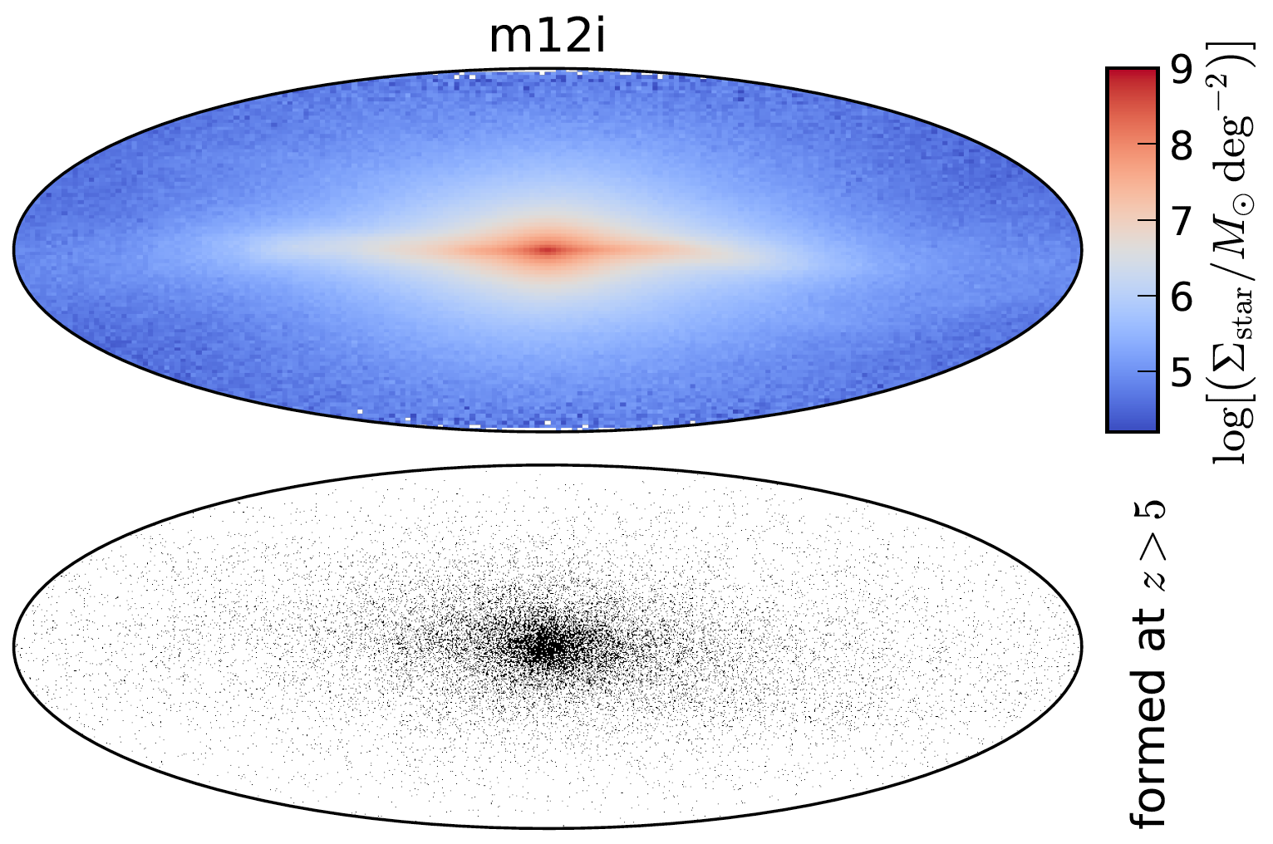
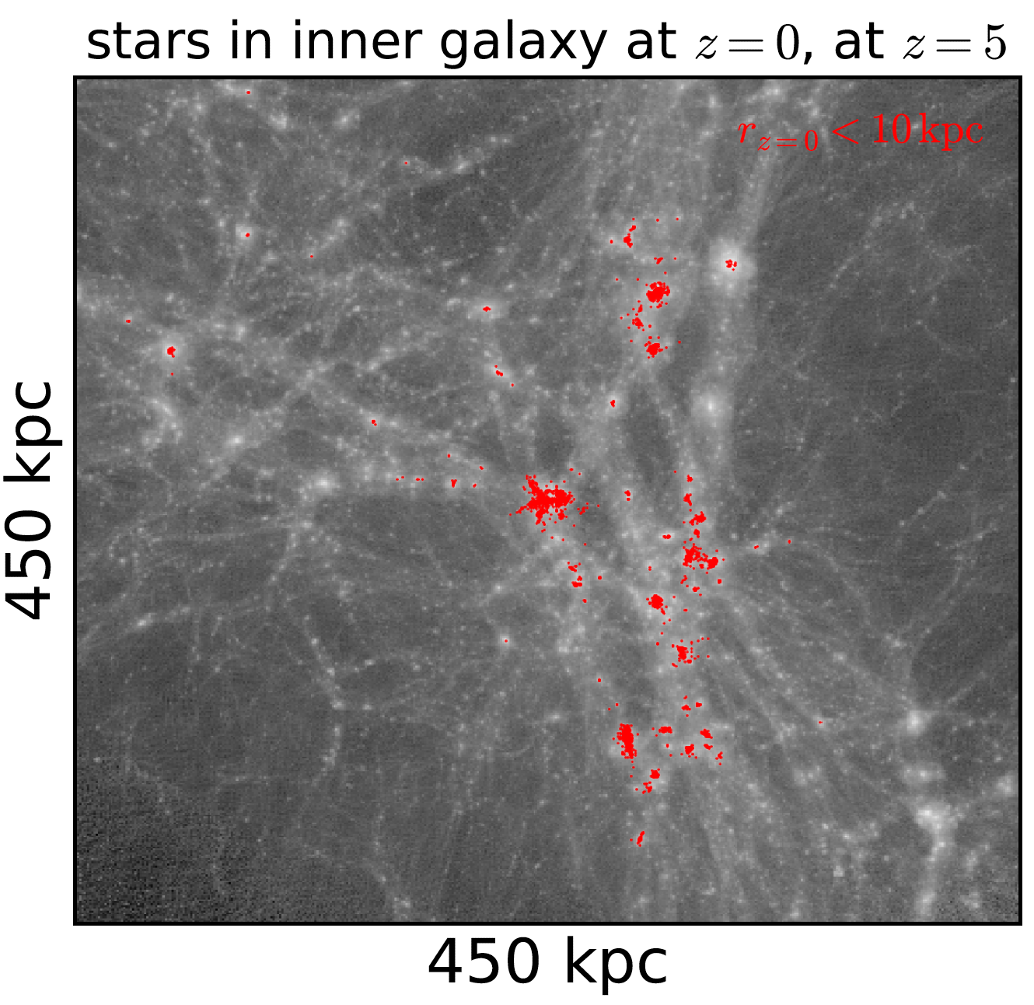
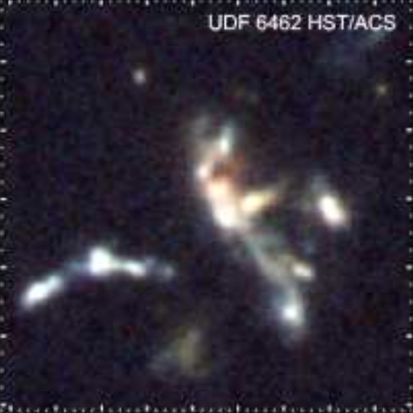
Near field and far field are intimately connected via the CDM hierarchy.
All galaxies build up through a hierarchy of merging fragments of gas and dark matter which continues today.
Today
But we struggle to identify “building blocks” in the
far field, and the key gas phases at all epochs.
MW growing
FIRE: El-Badry+ 2018
See also: Starkenberg+ 2017
Big Bang
T. McCavana
Notes:
LMC is not really a building block – wrong a/Fe for ex.
Does not represent Galaxy, 2x mass, major mergers since 10 Gyr like M31
Amazing to think we were the mass of the MCs at z=15
Had student Tom McCavana make this.
Which channels are BH, SF, gas, etc.
And the dark matter is mostly unseen and driving most of what we see…

Slide 5
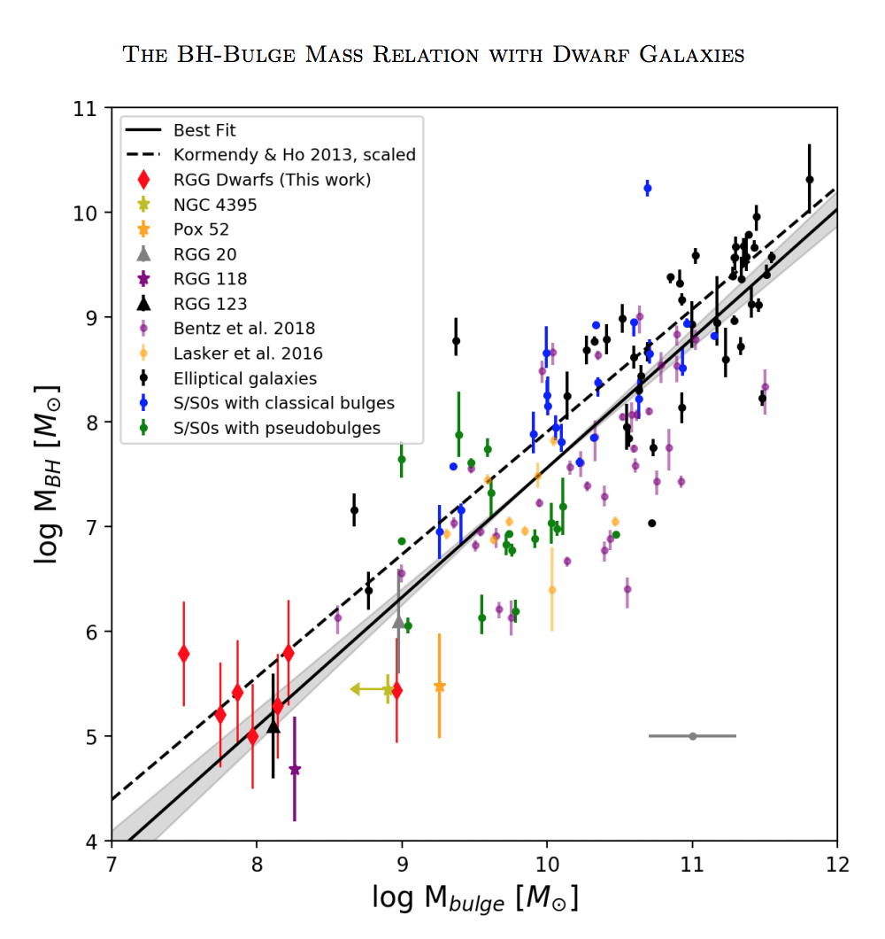
How are supermassive black holes formed ?
Do all dwarf galaxies harbour IMBHs such that the Milky Way accretes
M• = 10⁴ – 10⁵ M per merger ?
Greene, Ho & Strayder (2020, ARAA)
suggest ~50% chance of IMBH in LMC, lower odds in SMC.
Some hypervelocity B stars are argued post Gaia as evidence for IMBH in LMC,
consistent with young age, direction (q.v. Erkal+ 2018; cf. Boubert+ 2019).
M31
✪
★
Milky Way
✚
?
LMC
✜
?
SMC
Schutte, Reines, Greene 2019
Post-LMC merger can lift Galaxy onto relation like M31 (Cautun+ 2018), but mostly gas accretion.
Notes:
I’ve added symbols here to Jenny’s figure

Slide 6
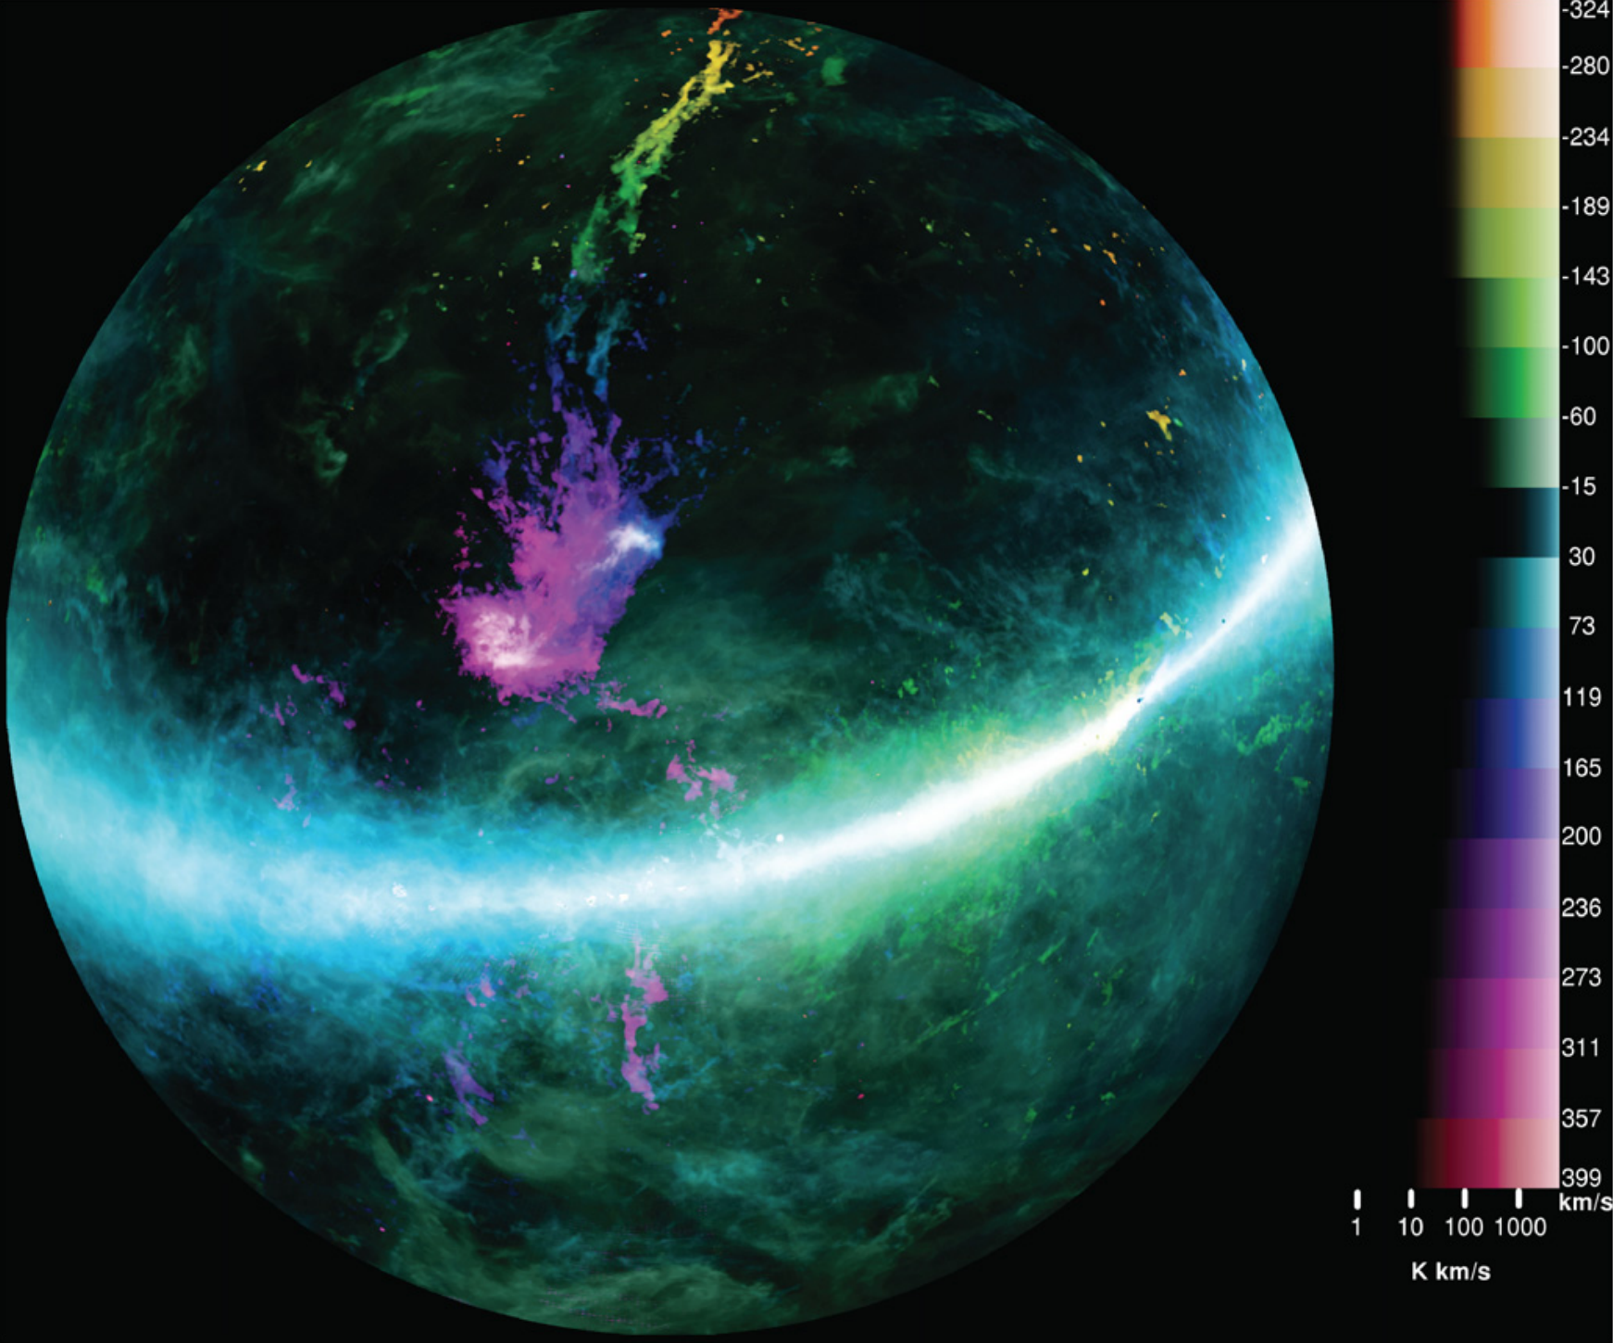
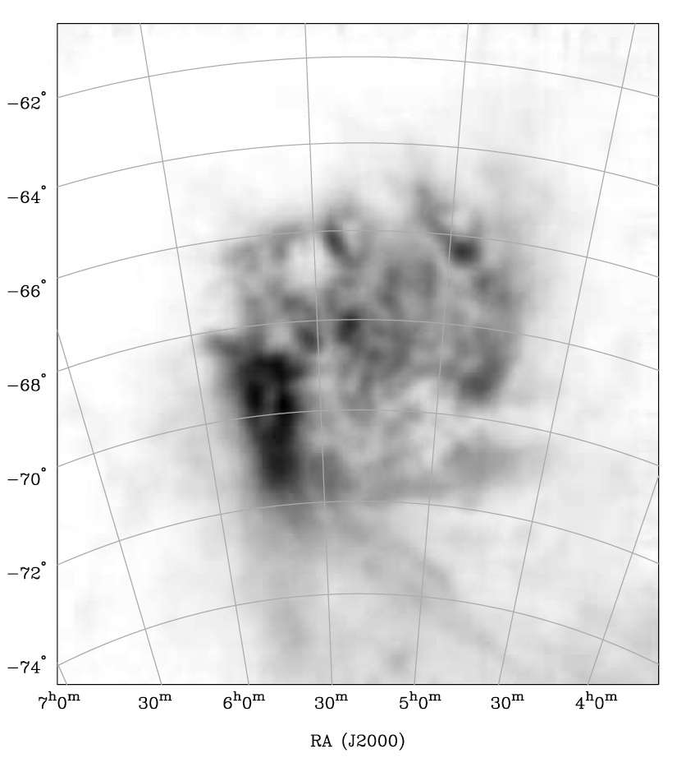
Gas accretion - halo interaction
Trailing stream
Leading edge, LMC HI
SMC
LMC
Leading arms ?
HI mass ~ 10⁹ M
H⁺ mass ~ 10⁹ M
GASS Survey
McClure-Griffiths + 2009
Notes:
Staveley-Smith et al 2003, leading edge ~ 5x10^21 cm^-2
This must mean molecular gas shows same asymmetry – check.
Bridge gas too? SMC more messy, and behind LMC.
NMG to check all of this with ASKAP?
Simple pressure balance rho1.v1^2 ~ n2.k.T2 consistent with TTG’s pressure confinement of leading arm
(rho1=n1.Mp, where n1=1e-4, v1=300 km/s; n2=10, T2=100).

Slide 7
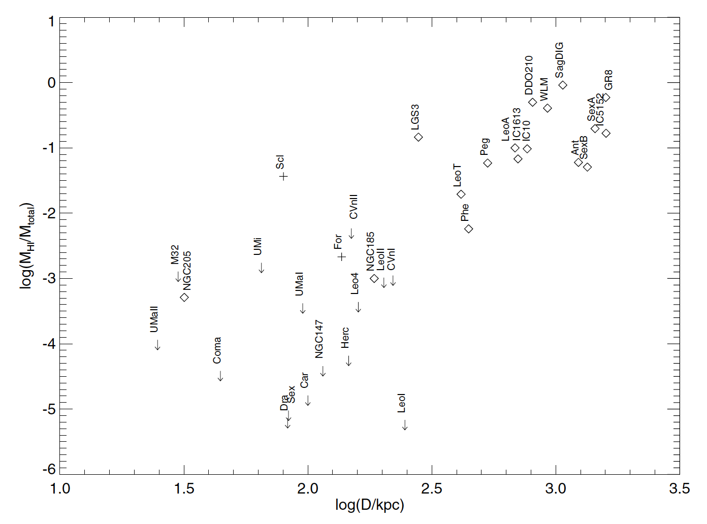
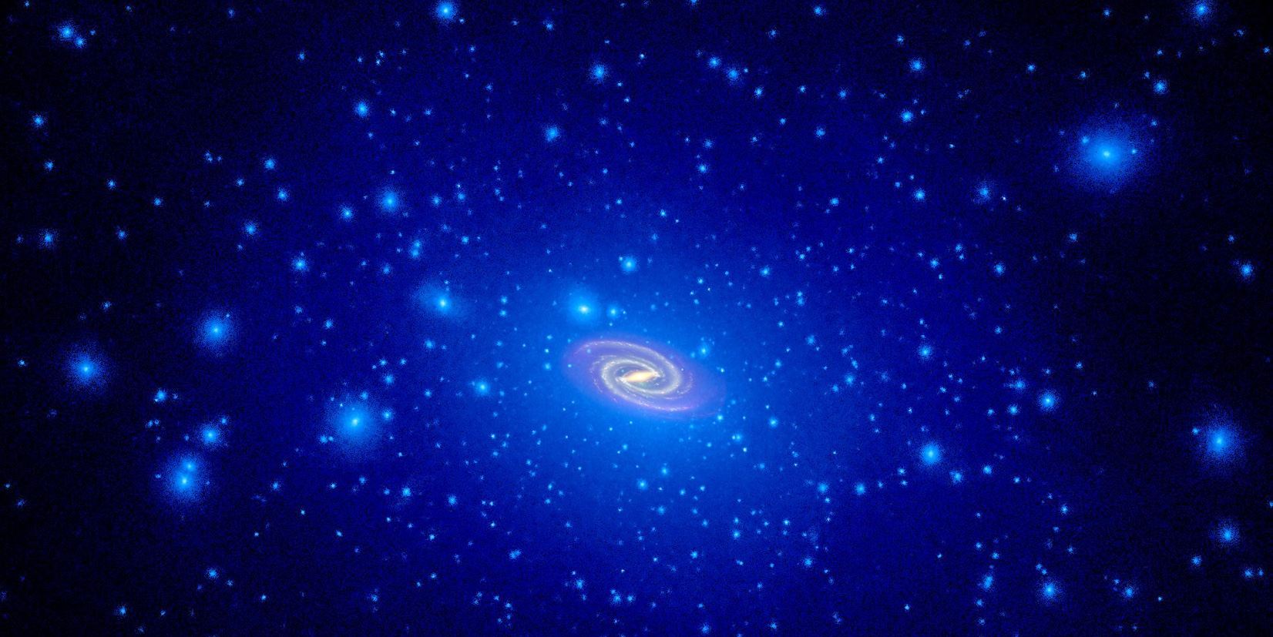
LMC and SMC are too big to fail, so what happened to Sgr and others that suffered the same fate ?
The same model set-up produces the Mag Stream but not the “leading arm”
Grcevich & Putman 2009: only a few M31 & Galactic dwarfs have HI inside R_{VIR}
SMC
✜
LMC
Tepper-Garcia & JBH (2018)
✚
Sgr
Tepper-Garcia + (2019)
T. Brown, J. Tumlinson STScI
Notes:
e.g. Gaia Enceladus

Slide 8
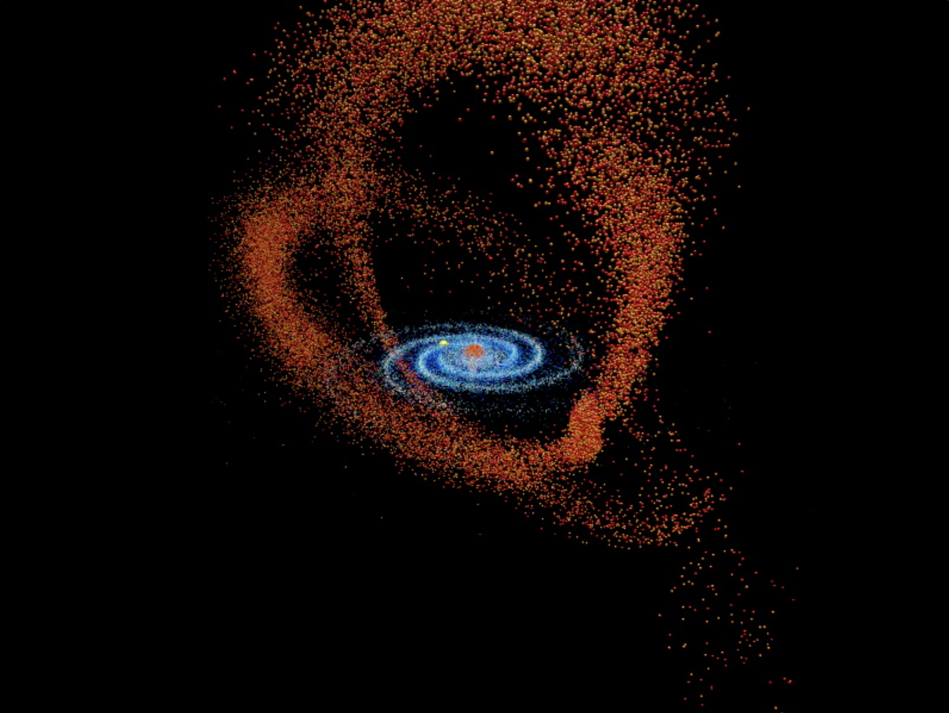
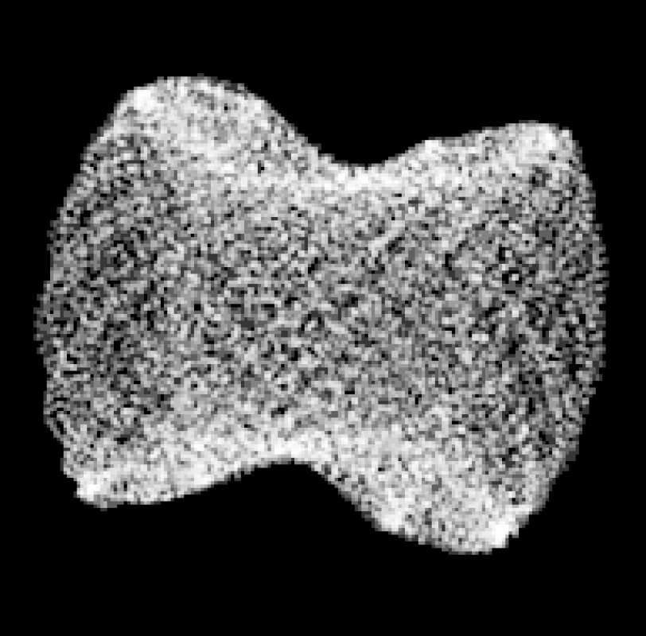
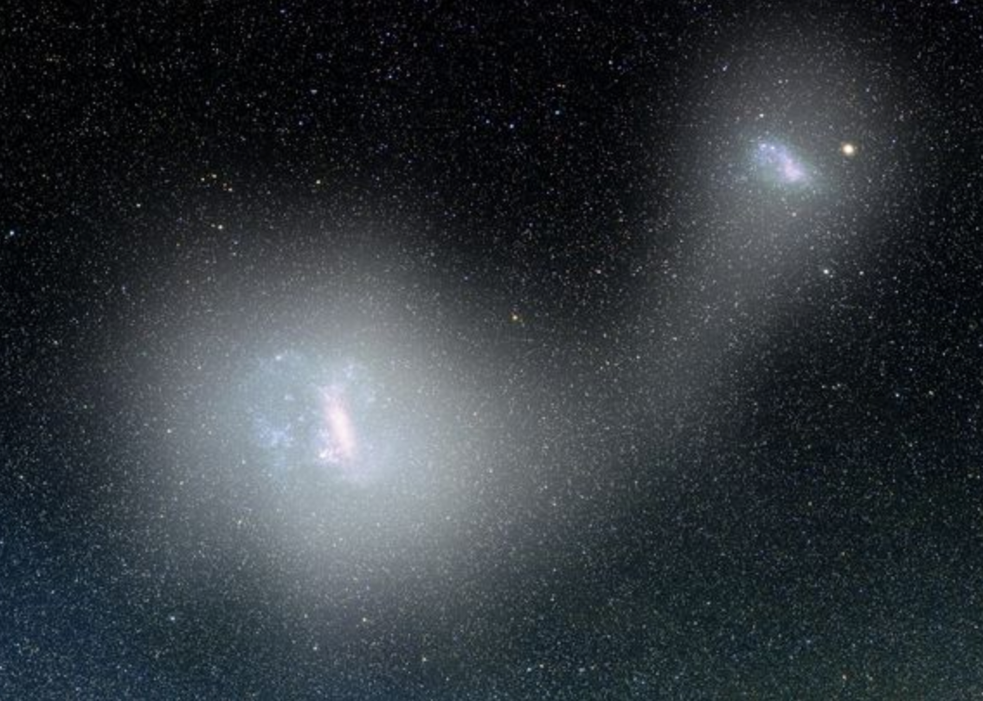
Sun
“The Sausage”
Sgr core
Magellanic Clouds
Post Gaia DR2, we now see evidence of other infalling massive systems, e.g. Gaia-Enceladus-Sausage-Sequoia
(e.g. Belokurov, Evans, Helmi, Erkal)
Notes:
How much dark matter was in G.E.S.S.
MCs and Sgr move in orthogonal planes, Sausage ~ MCs
Credits: image from JBH

Slide 9
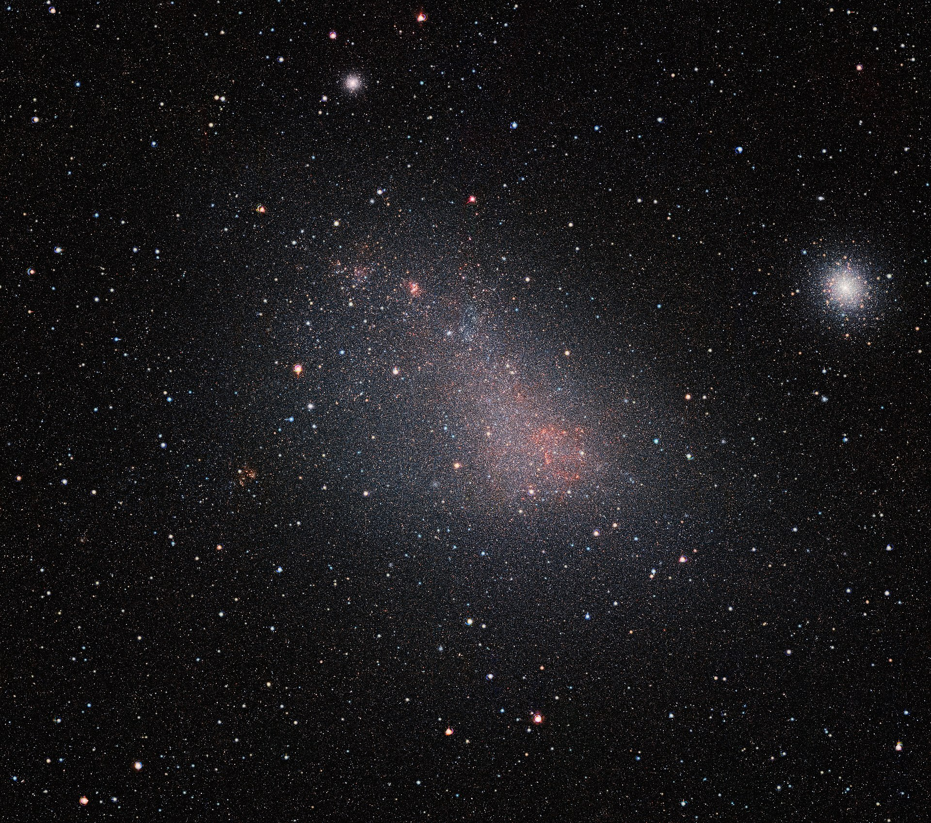
Small Magellanic Cloud
VISTA MC (VMC) Survey
ESO: M.-R. Cioni
47 Tuc
Notes:
www.eso.org/public/news/eso1714 – very good notes
47 Tuc only 4 kpc away
Study propagation of star formation across the dwarfs… spatially resolved

Slide 10
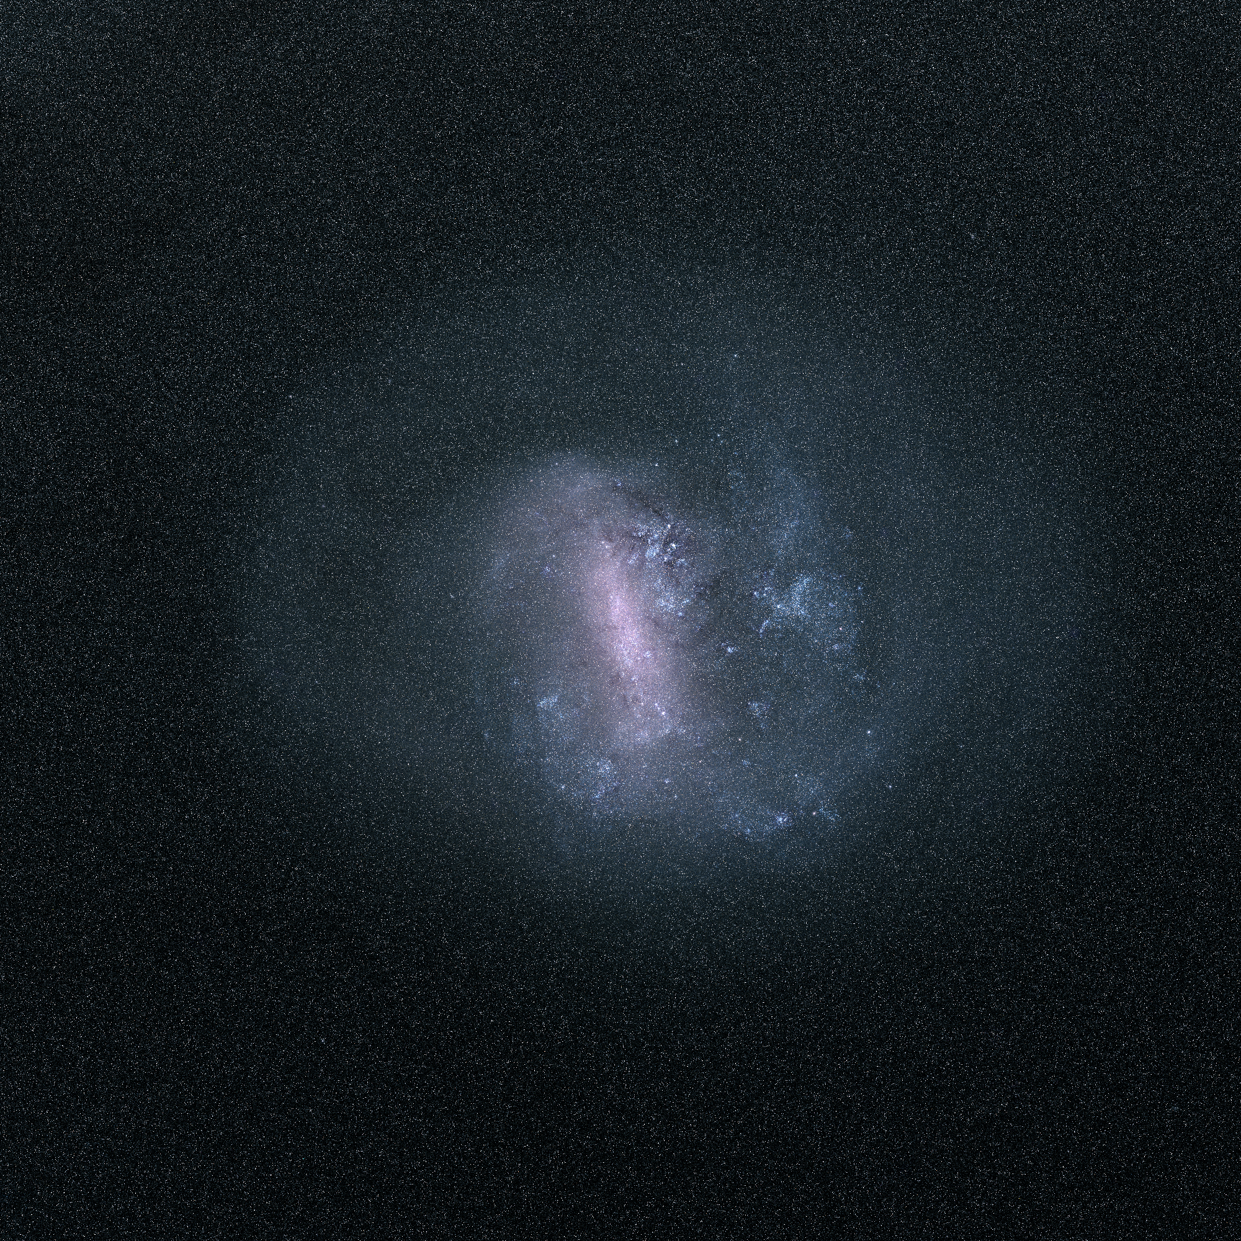
Large Magellanic Cloud
ESA Gaia DPAC (Portugal)
Total radiation falling on pixels in Gaia bands
Notes:
Dominated by most massive stars; 30 Dor, Bar

Slide 11
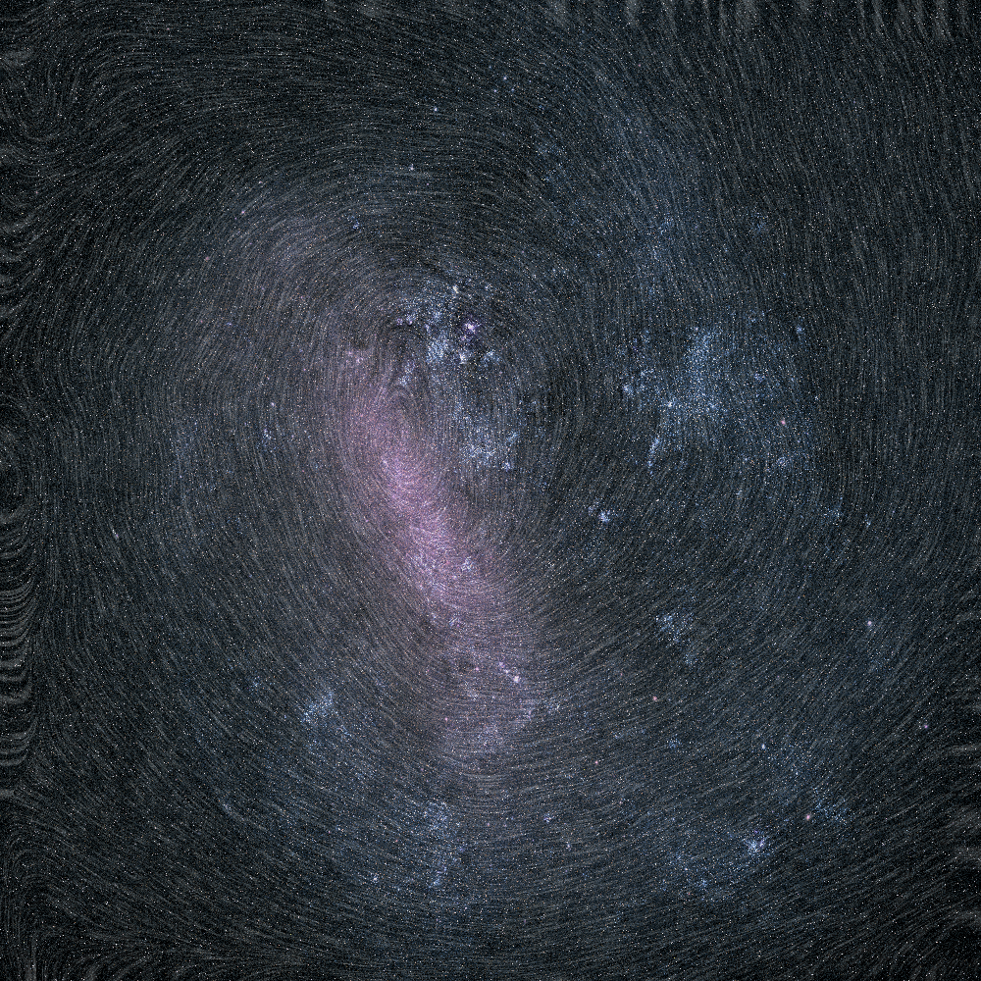
Large Magellanic Cloud
ESA Gaia DPAC (Sweden)
Flow lines from proper motions of 2 million stars
Notes:
Dominated by most massive stars (Paul McMillan)
Line integral convolution

Slide 12
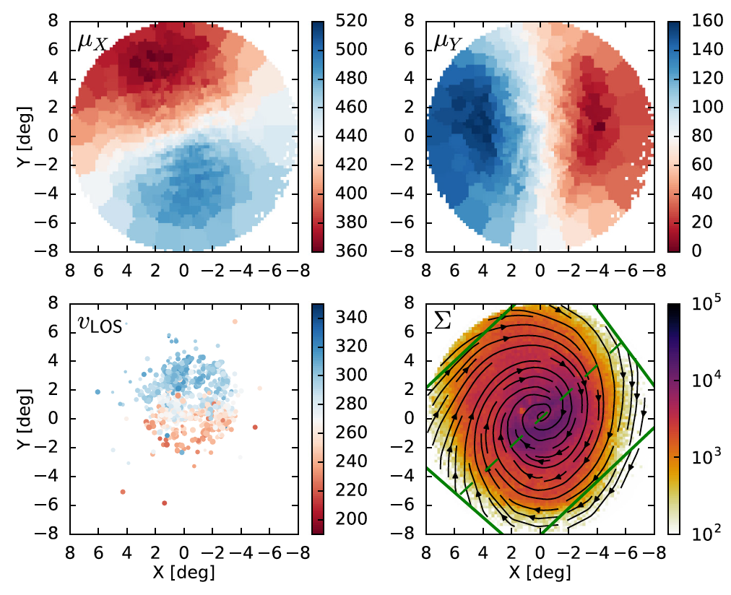
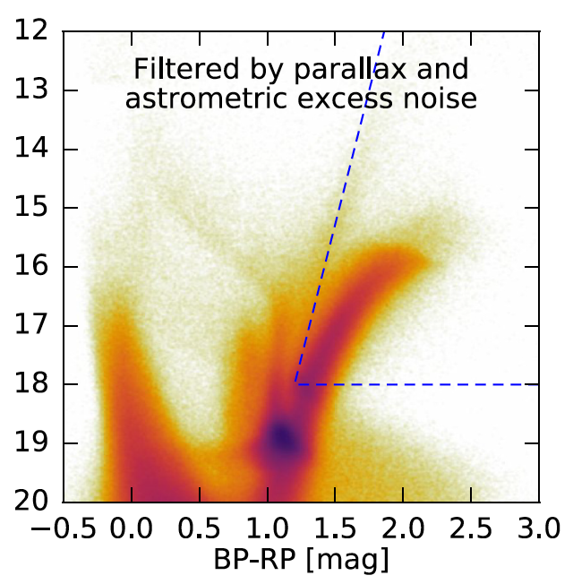
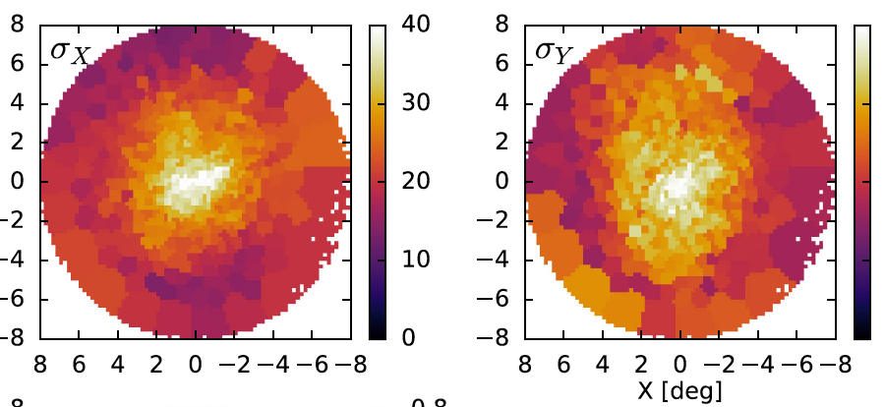
LMC internal dynamics from Gaia (e.g. Vasiliev 2018)
500,000 red giants in Gaia DR2
Reject all those with non-zero parallaxes, and high levels of extinction.
x,y proper
motions
Orientation is well established.
<1% foreground contaminants
PMs are better
x,y sigma
dispersions
Notes:
The orientation plane is also shown in green – see next slide
Voronoi pixel binning

Slide 13
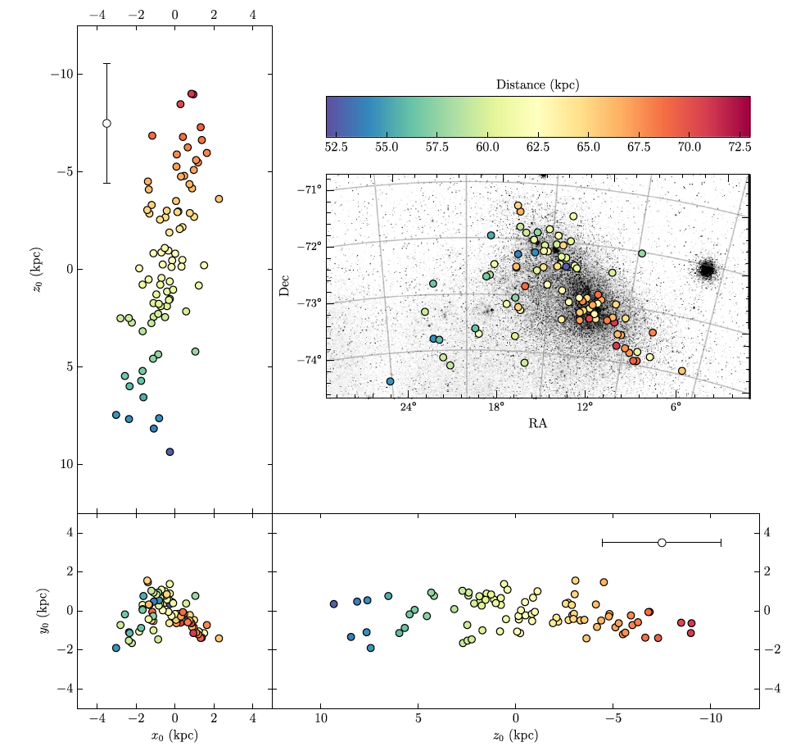
Perspective, orientation and geometry
Euclidean effects of near-side vs. far-side are clearly seen, e.g. VMC Survey papers.
SMC example is taken from HST selected CVs observed with warm Spitzer; distances to ~5% uncertainty (Scowcroft+ 2016).
150th Anniversary of H. Leavitt; 110th Anniversary of P-L relation.
Notes:
Vicky Scowcroft, U Bath, Sept 19
Galactic bar good also, but not so common

Slide 14
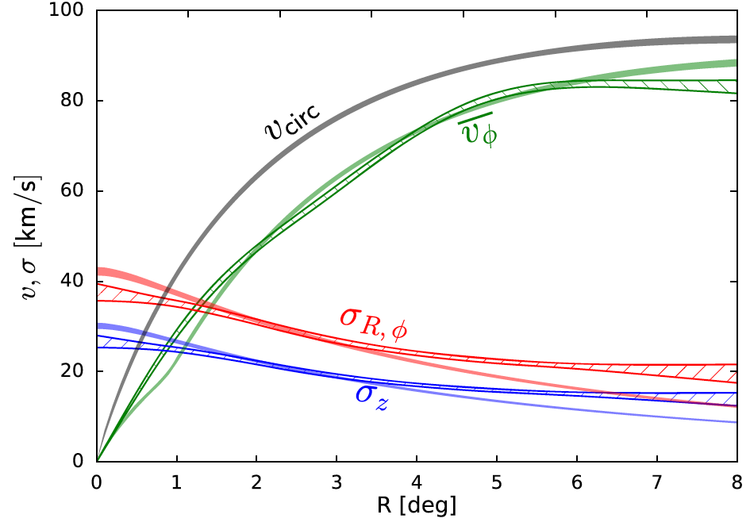
LMC dynamical classification
(V/σ)_{e}
ε
LMC (and SMC) is a fast rotator when compared to the SAMI Galaxy Survey:
by mass, ellipticity or λ-parameter
(van de Sande + 2018, 2019).
Note: Vasiliev (2018) is unable to discern vertical disk structure, e.g. thin vs. thick disk?
(V/σ)_{e}
Notes:
This is light-weighted through an aperture, r_e ~ 2 kpc or so. V® comes
Way down because only some of stars are at V ~ 80
Difficult…
No a/Fe evidence of a second component, e.g. Dalcanton & Yoachim (2006)
So no evidence of a thick disk. DY06 found that lower mass gals, more thick disk.
Ellipticity from vd Marel, says Jesse

Slide 15
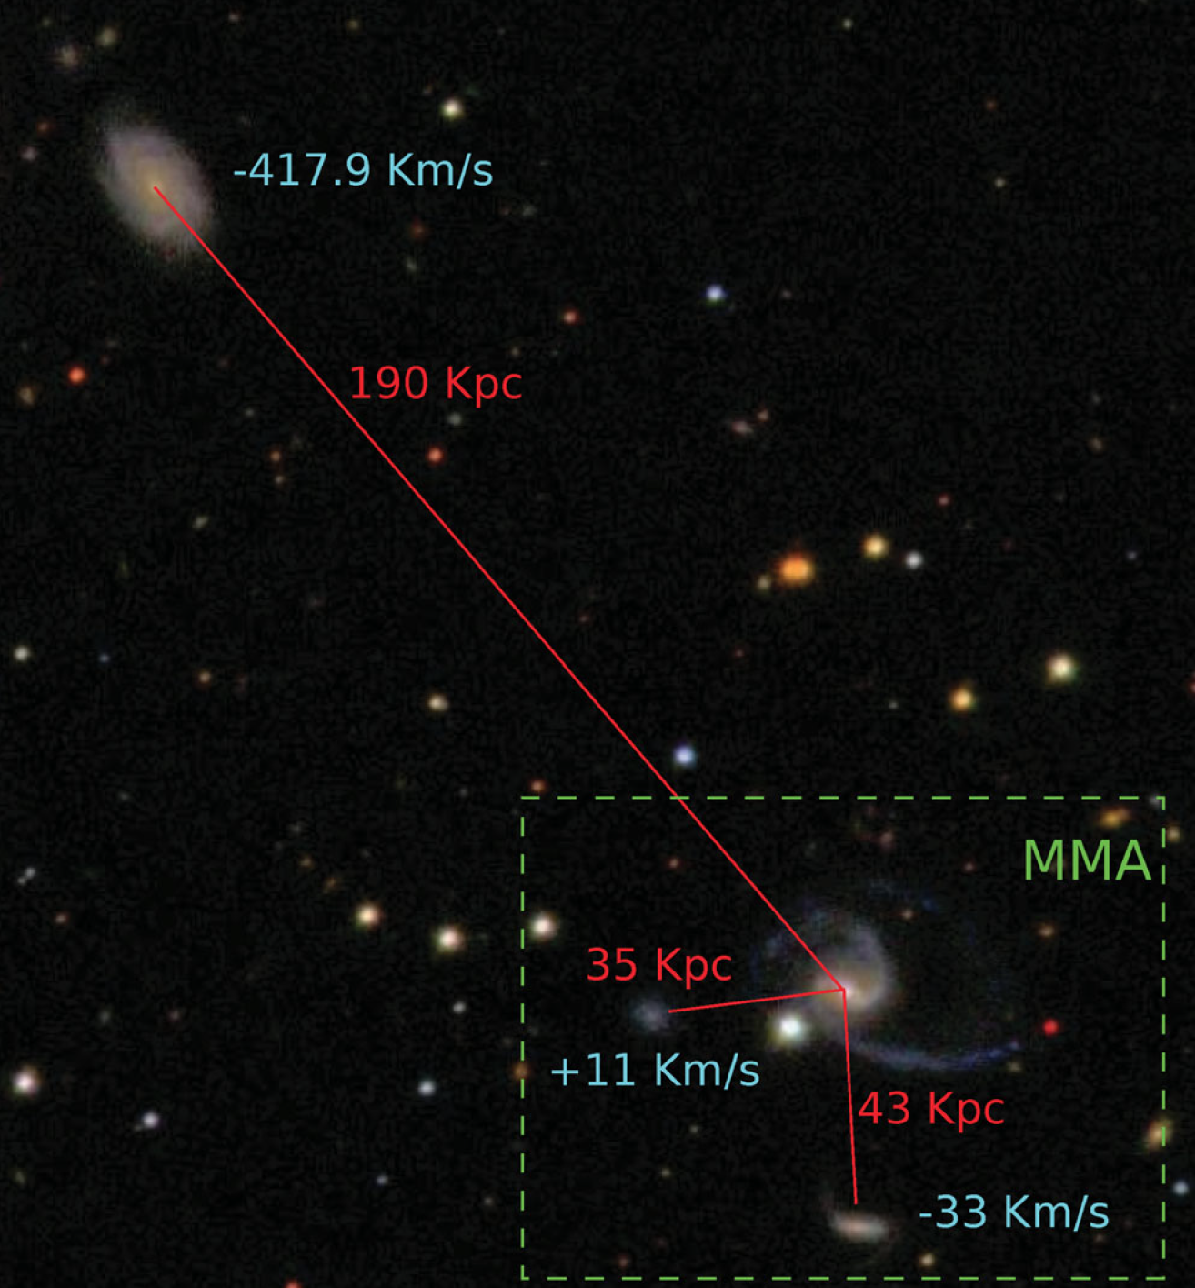
Is the Milky Way – LMC – SMC relationship special ?
The GAMA survey of 300,000 galaxies finds ~ 1% have two star forming close dwarf companions. One bright companion is ~10% occurrence.
LMC and SMC are infalling massive dwarfs
forming stars today under diverse conditions,
with different star formation histories.
Sub-solar [Fe/H] abundance in gas and stars
consistent with mass-metallicity relation.
Star formation efficiencies are low, e.g. the
recently revealed “sub-α sequence.”
We see clear stellar abundance signatures
(chemical tags) not observed in the Galaxy.
Both have ancient stars & clusters and
may be part of a first-time group infall.
They move within the hot corona; gas is
being heated and stripped.
GAMA: Robotham et al 2012
Notes:
What kinds of supernovae, ULXs etc. exist at such low Fe/H – so many questions to ask?
Molecules and dust
Inset is Milky Way Magellanic Analogue

Slide 16
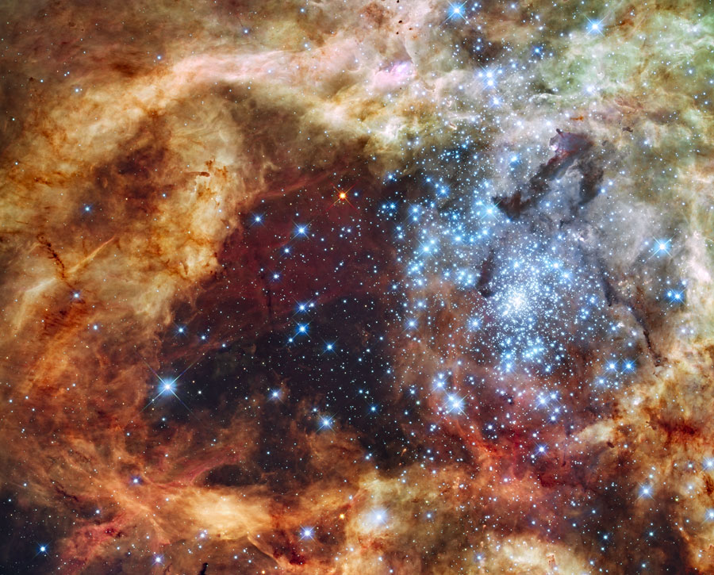
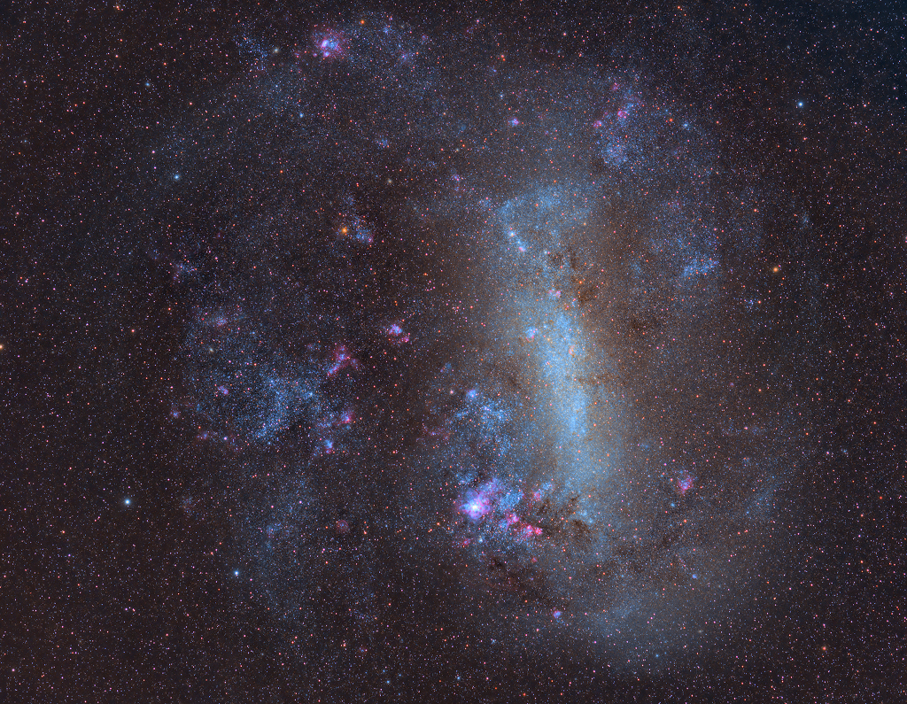
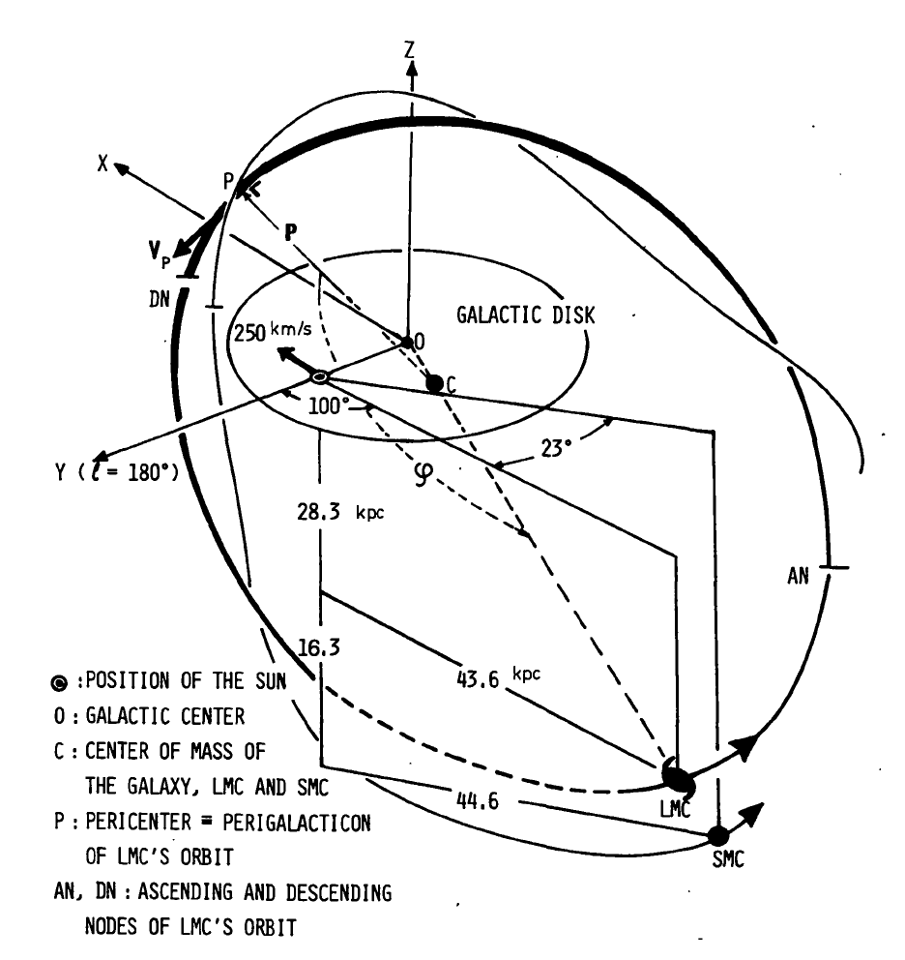
Star formation history is surely related to orbit history (at least in part)…
HST - Hunter et al 1995
Fujimoto & Sofue 1976
HST proper motions may argue for first infall:
Data: Kallivayalil+ 2006a,b, 2009, 2013; Piatek+ 2007
Models: Besla+ 2007, 2010, 2012; many papers
Arguably, the LMC-SMC orbits are reflected in the star formation histories.
Notes:
LMC/SMC have high ang mom orbit, torqued by M31?
Only if first infall (Kallivayalil + 2009)

Slide 17
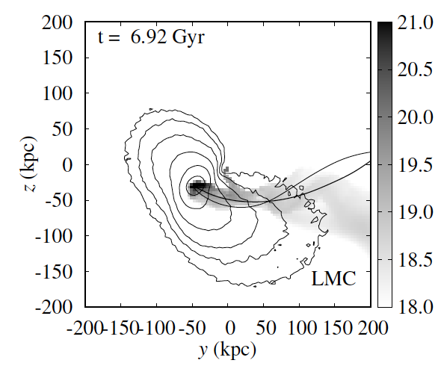
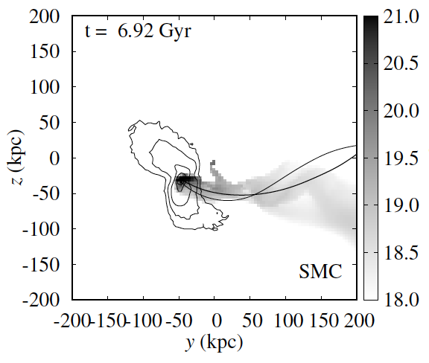
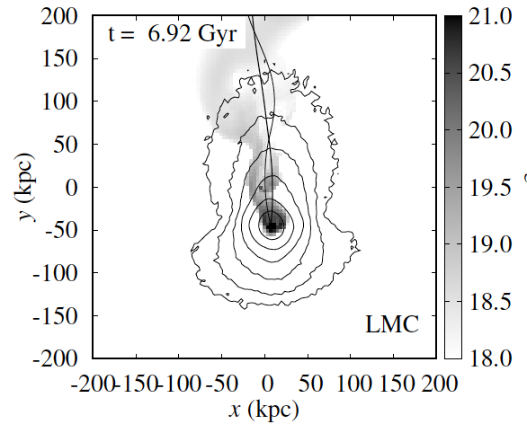
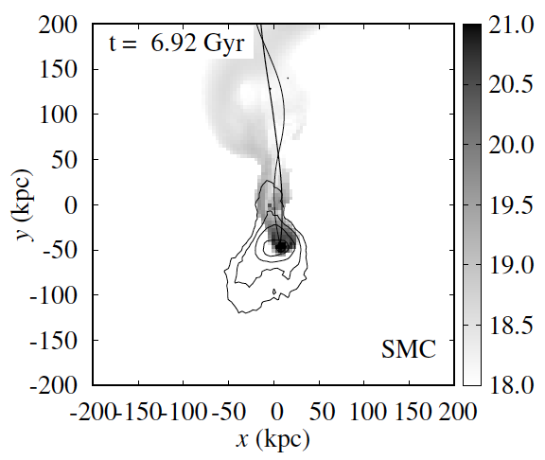
Orbit history of the MCs: internal SFH, group infall, corona & Milky Way influence
dark matter
gas
Gas + DM + 3 coronal models
No leading arms
Tepper-Garcia
& JBH (2018)
Notes:
TTG & JBH 2018, greyscale is gas, Nh
Also abundance matching tests

Slide 18
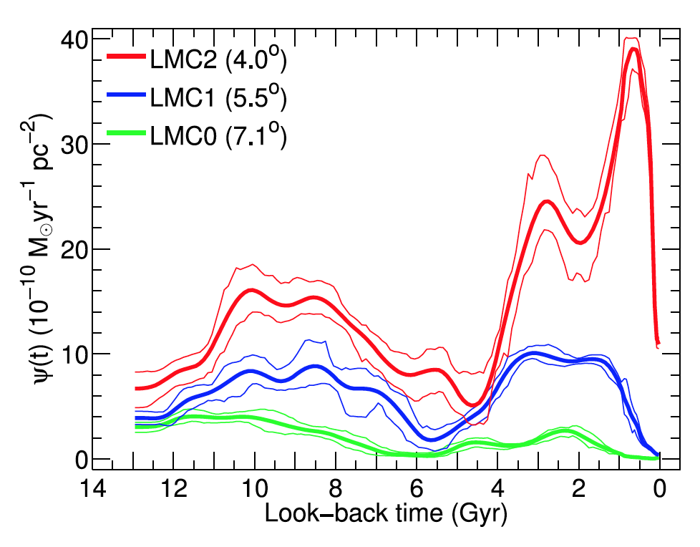
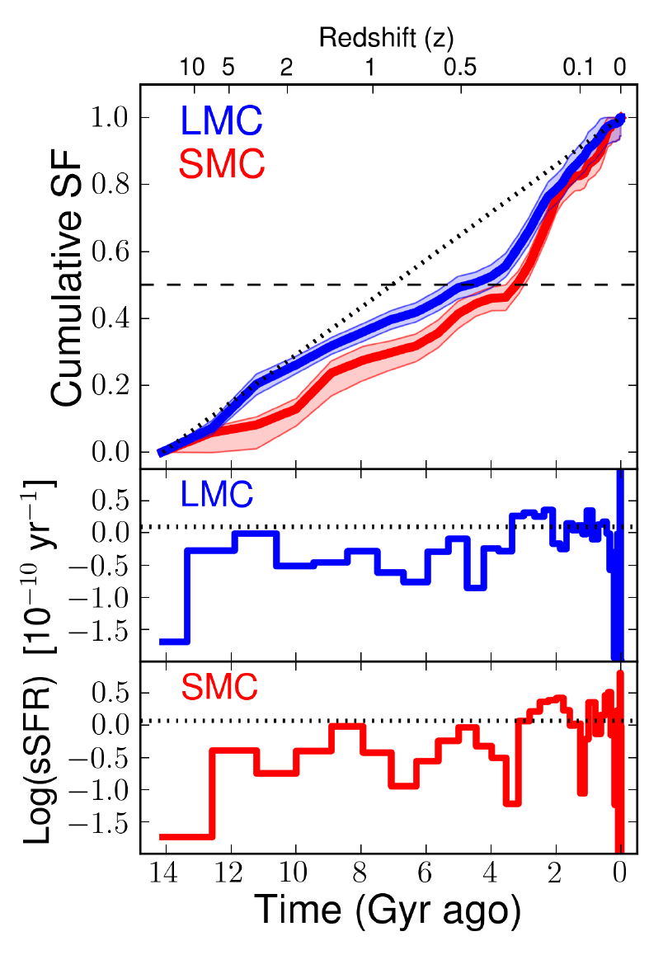
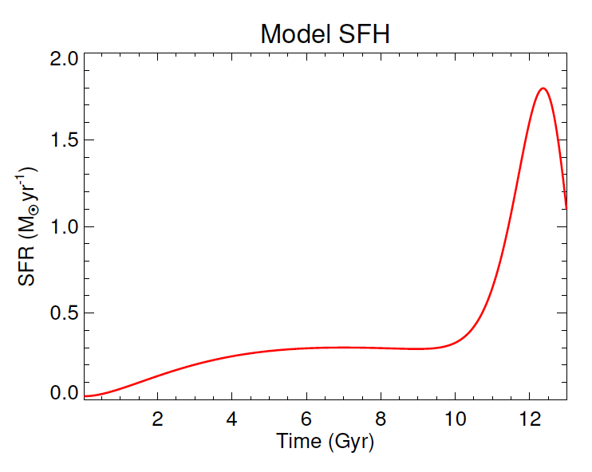
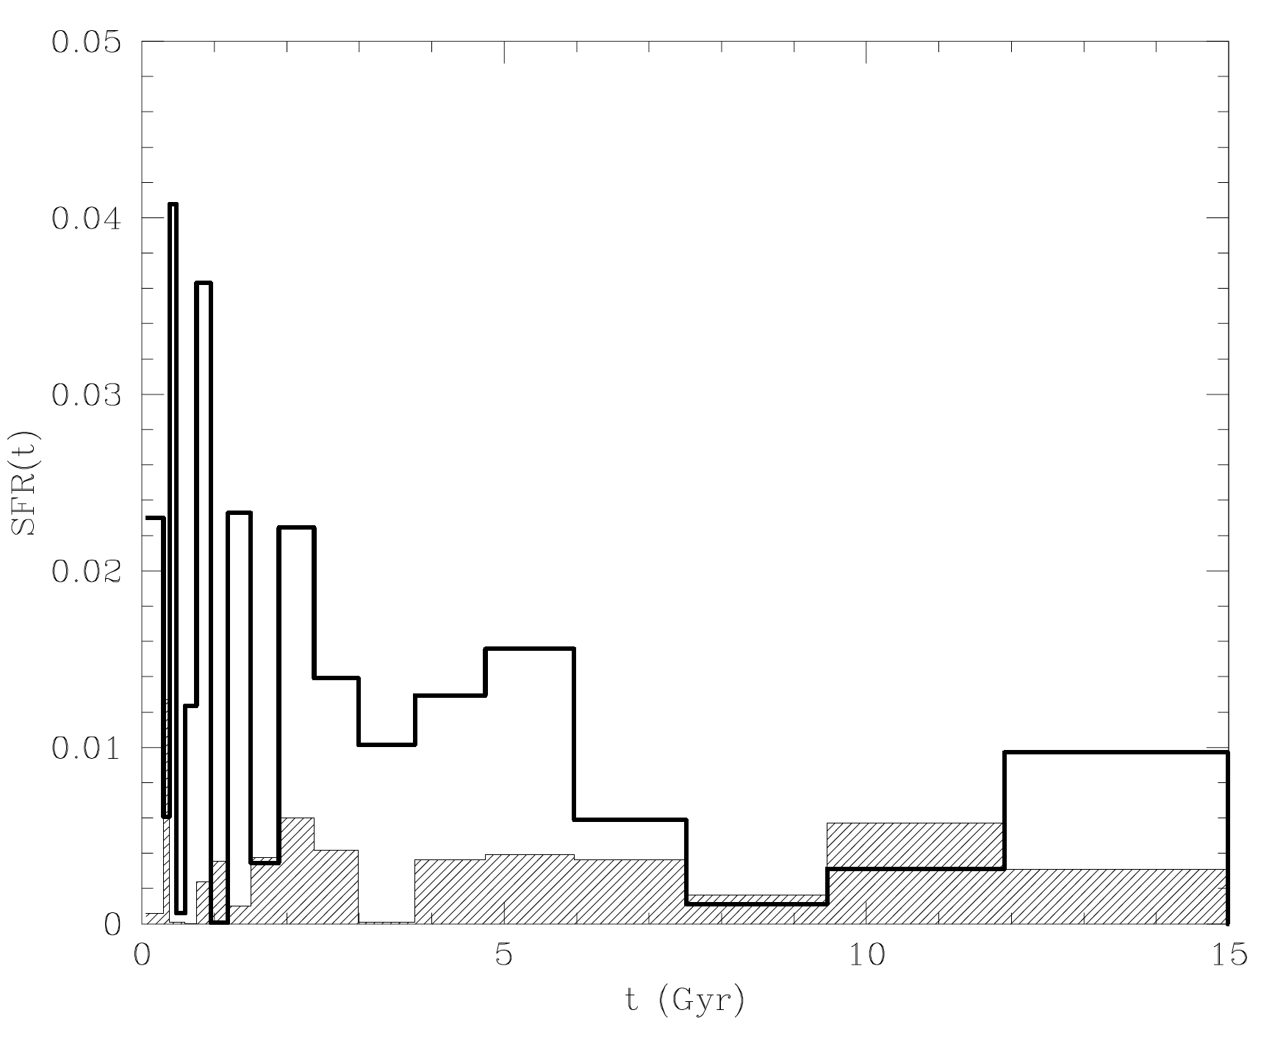
Consistent estimates of star formation history
Meschin
Weisz, Neary
All figures use photometry of different stellar pops, except [α/Fe]
Nidever
Smecker-Hane
Notes:
Burst due to Galaxy, or LMC SMC close approach?
One zone chemical evolution model - Nidever
All photometry except a/fe from

Slide 19
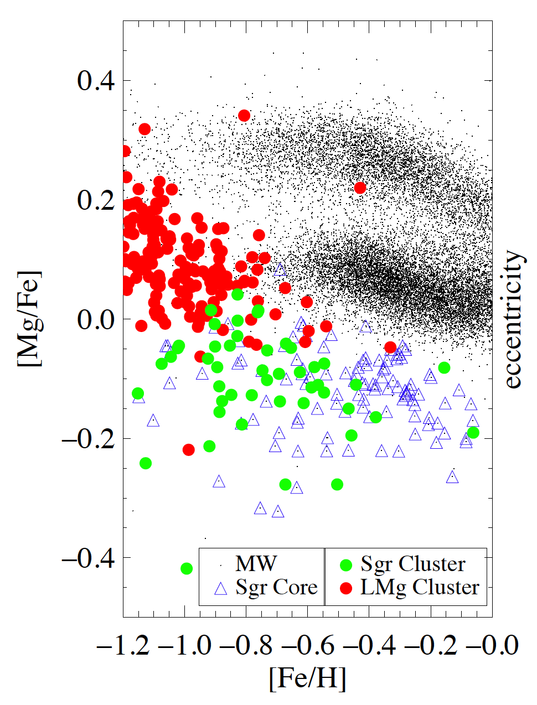
Hasselquist+ 2017, 2018
The Galaxy and its dwarfs
As a community, we should consider better nomenclature for the α-components.
(JBH et al 2019)
α₊
“High-α sequence”
α_{o}
“Low-α sequence”
α₋
“Sub-α sequence”
There are three sequences in the α/Fe-Fe/H chemical plane. The middle sequence carries most of the Galactic stellar mass, but the upper sequence is substantial (~30%).
The lowest sequence is from accreted massive dwarfs. We recognize that some low mass dwarfs have strange tracks in this space (e.g. Tostoy 2009 ARAA).
Notes:
Alpha – high , low, sub??

Slide 20
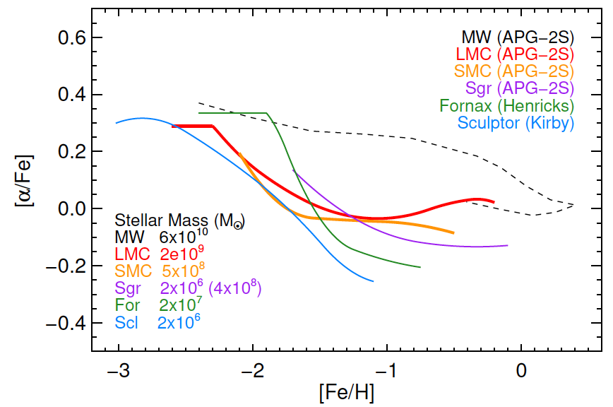
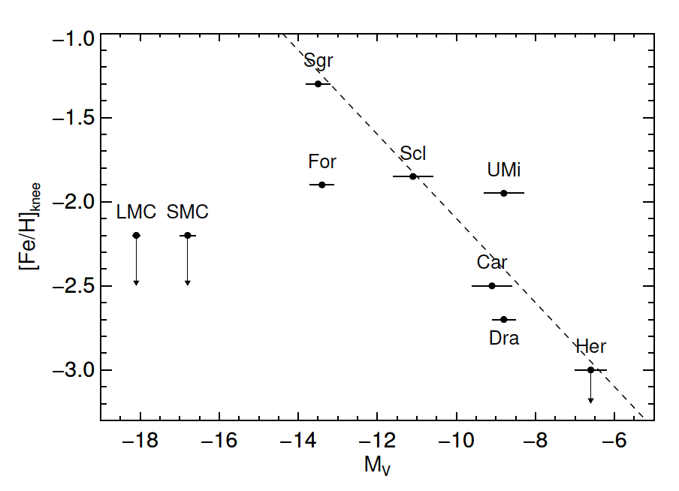
Low star formation efficiency at early times
This is striking for MCs since most halo dwarfs had early bursts. Does [α/Fe]
pick up later on (higher [Fe/H]) because high mass stars not made until MCs experience strong Galactic tidal field at later times ?
No evidence for a second [α/Fe] sequence as seen in the Galaxy.
Nidever et al 2019: [α/Fe] “knee” has a strong stellar mass trend for dwarfs but the MCs are outliers. First infall orbit ?
Notes:
Nidever calls “trendlines” in a/Fe plane; LMC is 1000x more massive than Scl,
Same knee position

Slide 21
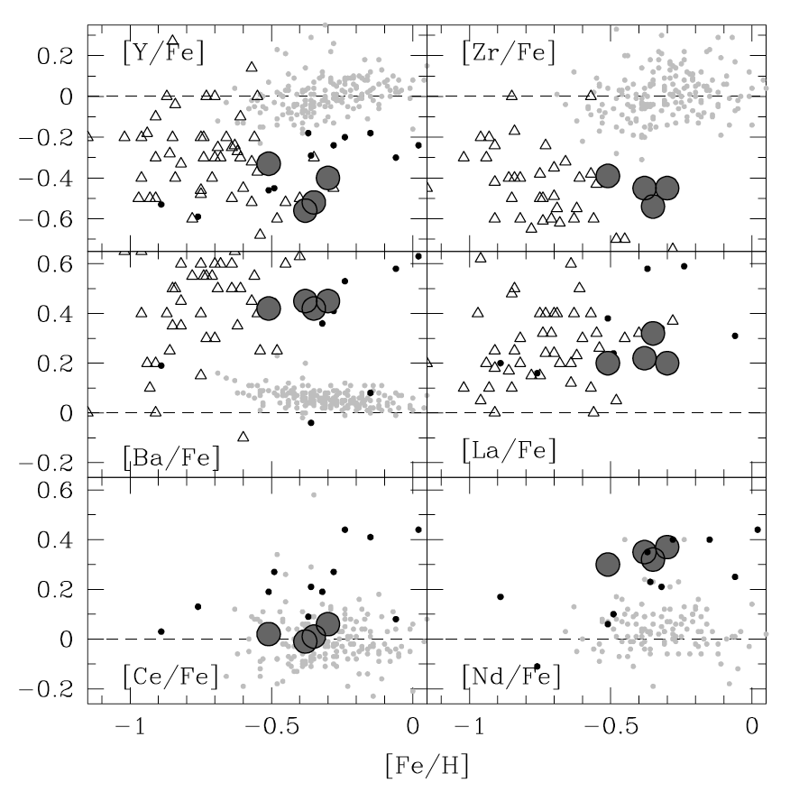
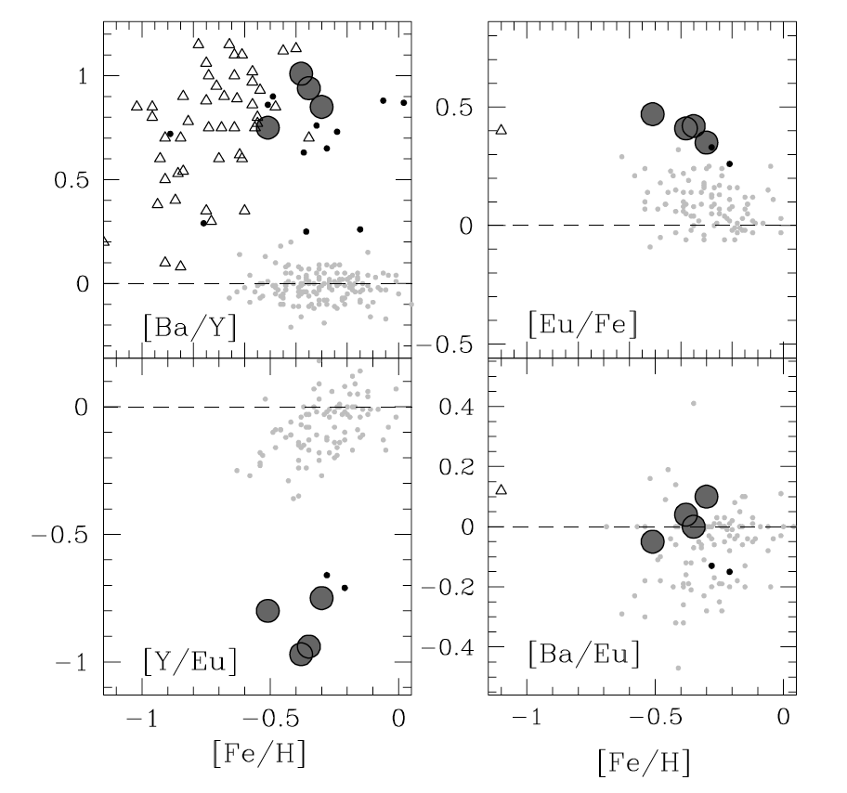
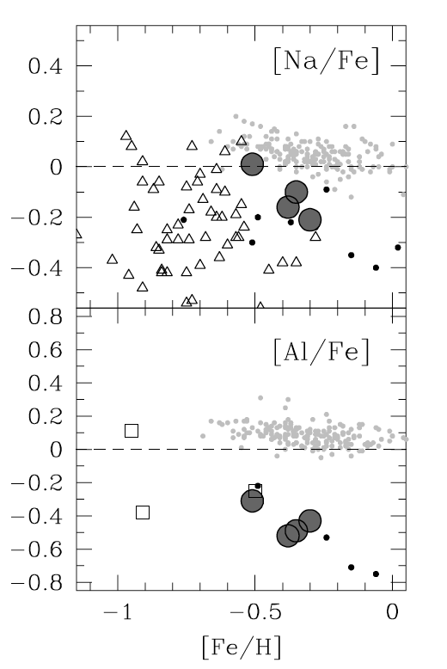
Evolution of the elements & chemical tagging
In addition to the LMC sub-α sequence, there are other chemical anomalies:
Sub-solar light s process, [Cu/Fe]
Super-solar heavy s process, r process
There are many lever arms across the element abundance table to unravel this in time.
Stars, star clusters:
Pompeia + 2008
Mucciarrelli + 2008
Notes:
Pompeia + 08 uses ls, hs lr, hr for lilght heavy r/s – nice
Same story in Sgr now, maybe SMC too
LMC: Triangles are stars from Pompeia, big dots from Mucciarelli + 08
Points are Galaxy thin disk

Slide 22
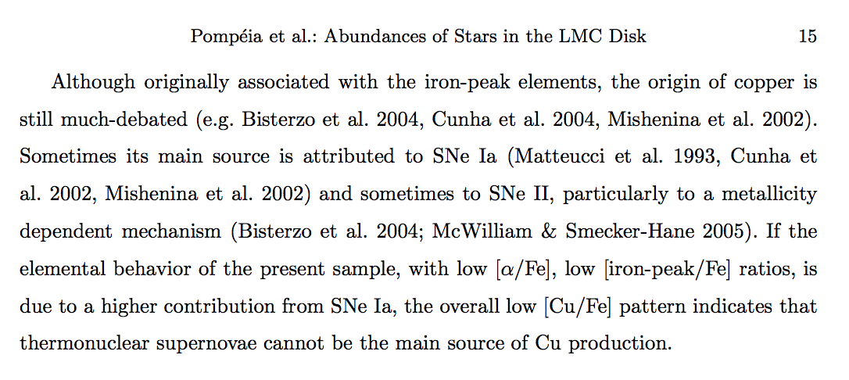
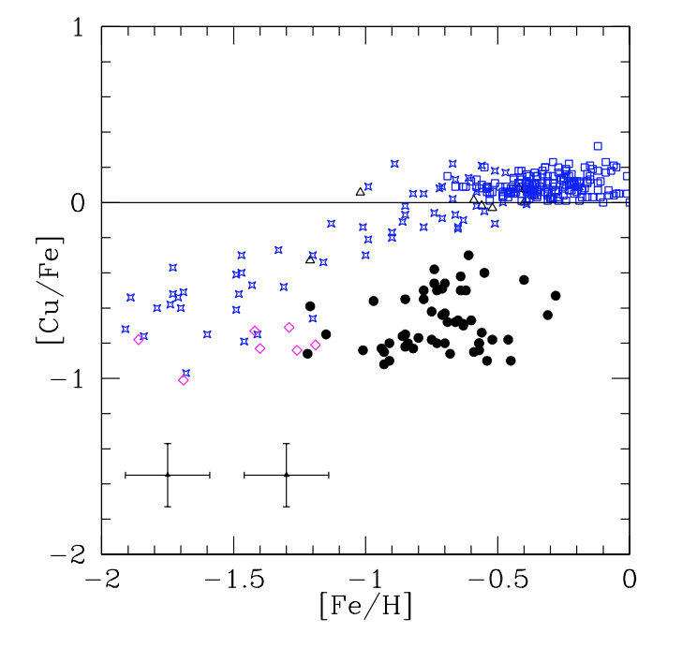

Slide 23
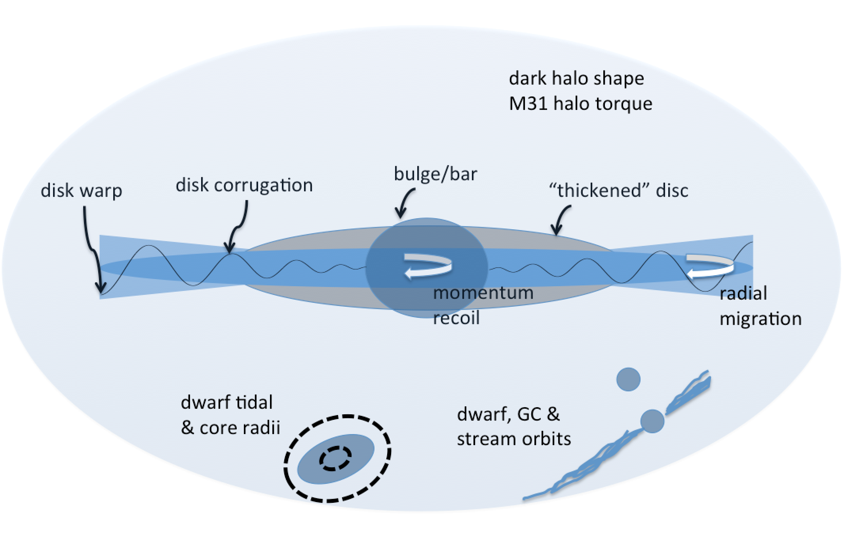
The road to new physics ?
JBH + 2019
With enough information, we may eventually rule out alternative states of dark matter using dynamical models that adequately explain observed departures from equilibrium
(e.g. Hui et al 2017; Böhm & Fayet 2004).
Notes:
See new Spergel & Safarzadeh? Paper – dwarfs and dyn fric,
Also even UFDs are huge, 10^11 Msun. Need tidal radius of
Each to measure total mass within, dyn fric times etc, from
Distribution of orbits
Dwarf core !!!
Could also add stellar migration here, e.g. Quillen
Self gravity important
Dwarf & GC & Stream orbits !!

Slide 24
How massive is the Magellanic Group?
If massive enough, it can have a group corona that may protect its gas streams from the Galactic corona’s interaction. It cannot be so massive that it badly distorts Galaxy dynamics.
disk corrugation
bulge/bar
disk warp
“thickened” disc
momentum
recoil
radial
migration
Dwarf, cluster &
stream orbits
Magellanic Group
overlapping dark halos
Notes:
Post JBH talk, Munich, ESO MCs, Sep 2019.
The case for group infall well made by d’Onghia & Lake 2008, Nichols et al 2011 ,etc.
Next phase in Thorsten Tepper-Garcia’s simulation work – full AGAMA initialisation.
Talking to David Nidever, Adrian Price-Whelan, Naomi McG, Laura Sales, Andy Fox.
Andy can look at ~10 QSOs behind LMC and SMC, maybe, look at absorption trends
With Magellanic Group radius.

Slide 25
Why are the Magellanic Clouds important?
They are surely important in the cosmological narrative for the Milky Way. Some have even predicted the end product of the merger and compared the future Galaxy’s properties to external L★ systems.
They allow study of many astrophysical processes under different environmental conditions, e.g. stellar chemistry, cluster formation, dust production, feedback & recycling, bar dynamics, SN & ULX rates, etc.
They probe the mysterious hot corona & CGM, e.g. is the corona massive, structured, magnetic, multi-phase, rotating ?
Their interaction with the Milky Way can – in principle – probe new physics. Does the dark-matter halo absorb energy and momentum, i.e.
is it fermionic, non-degenerate in nature ?
ESO Conference, Sept. 2019: “A synoptic view of the Magellanic Clouds: VMC, Gaia & beyond”
Notes:
Did not even cover the items in blue…

Slide 26
Synopsis
 | LMC | SMC
DM halo mass (models) | 2x10¹¹ Msun | 2x10¹⁰ Msun
Stellar mass | 3x10⁹ Msun | 3x10⁸ Msun
HI mass (Grcevich & Putman 2009) | 5x10⁸ Msun | 4x10⁸ Msun
Distance (Scowcroft) | 49.97 kpc | 62 kpc
V_{max} (Vasiliev 2018) | 80 km/s
Sigma (Vasiliev 2018) | 40 km/s declining
IMBH ? (Greene+2020) | 50% | 20%
inclination | 30-35 | 65 (60-70)
SFR (Harris & Zaritsky 2009) | 0.4 Msun/yr | 0.2 Msun/yr

