Slide 1
How massive is the Magellanic Group?
If massive enough, it can have a group corona that may protect its gas streams from the Galactic corona’s interaction. It cannot be so massive that it badly distorts Galaxy dynamics.
disk corrugation
bulge/bar
disk warp
“thickened” disc
momentum
recoil
radial
migration
Dwarf, cluster &
stream orbits
Magellanic Group
overlapping dark halos
Notes:
Post JBH talk, Munich, ESO MCs, Sep 2019.
The case for group infall well made by d’Onghia & Lake 2008, Nichols et al 2011 ,etc.
Next phase in Thorsten Tepper-Garcia’s simulation work – full AGAMA initialisation.
Talking to David Nidever, Adrian Price-Whelan, Naomi McG, Laura Sales, Andy Fox.
Andy can look at ~10 QSOs behind LMC and SMC, maybe, look at absorption trends
With Magellanic Group radius.

Slide 2
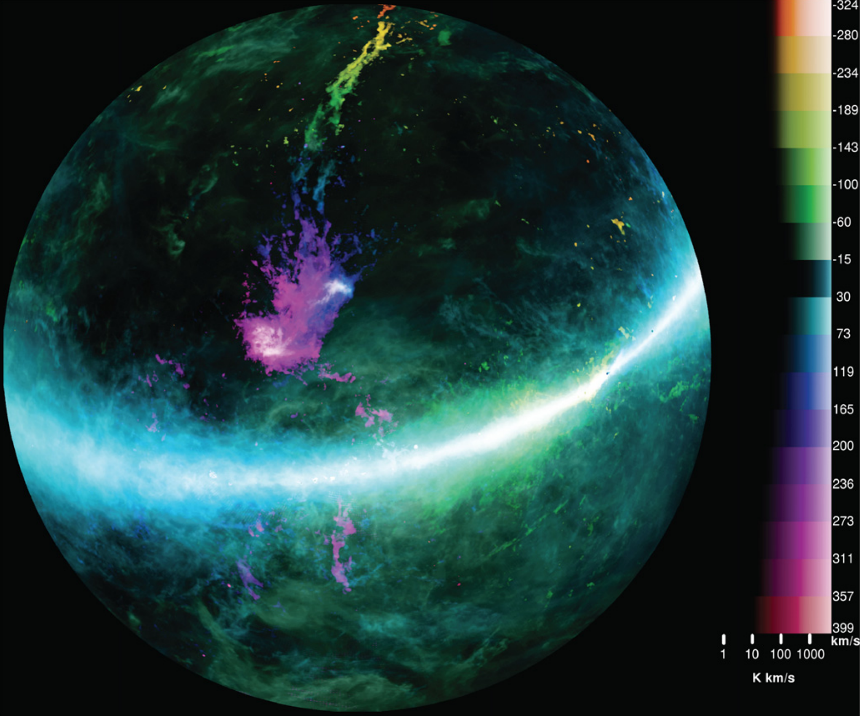
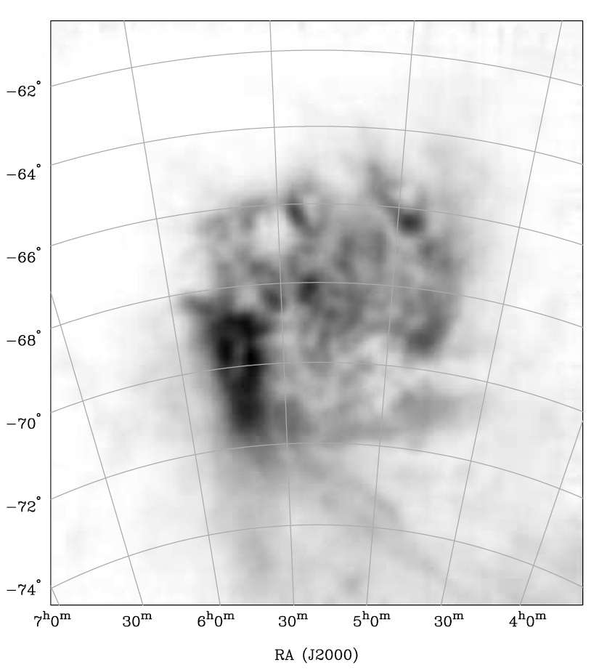
Gas accretion - halo interaction
Trailing stream
Leading edge, LMC HI
SMC
LMC
Leading arms ?
HI mass ~ 10⁹ M
H⁺ mass ~ 10⁹ M
GASS Survey
McClure-Griffiths + 2009
Notes:
Staveley-Smith et al 2003, leading edge ~ 5x10^21 cm^-2
This must mean molecular gas shows same asymmetry – check.
Bridge gas too? SMC more messy, and behind LMC.
NMG to check all of this with ASKAP?
Simple pressure balance rho1.v1^2 ~ n2.k.T2 consistent with TTG’s pressure confinement of leading arm
(rho1=n1.Mp, where n1=1e-4, v1=300 km/s; n2=10, T2=100).

