Slide 1
Astrophotonics and new avenues in quantum networks
Joss Bland-Hawthorn
ARC Laureate Professor
Director, Sydney Institute for Astronomy
AAS Virtual Astrophotonics Workshop
12th January, 2024

Slide 2
OUTLINE
Quantum networks and quantum photonics
Introduction to my 2021 paper
Overview of traditional interferometry
Quantum interferometry
Quantum telescope

Slide 3
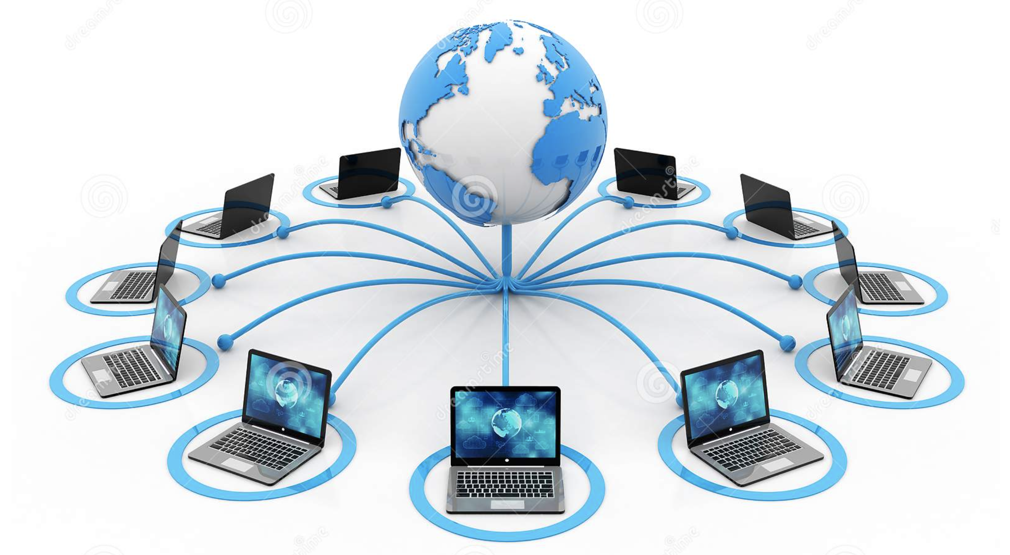
We are accustomed to digital computers interconnected via the telecom network, which vastly increases their usefulness.
Quantum computers will be essentially useless without a “quantum internet.”
Notes:
https://www.dreamstime.com/global-computer-network-internet-communication-d-render-computer-network-isolated-white-background-network-connection-internet-image135330436#_

Slide 4
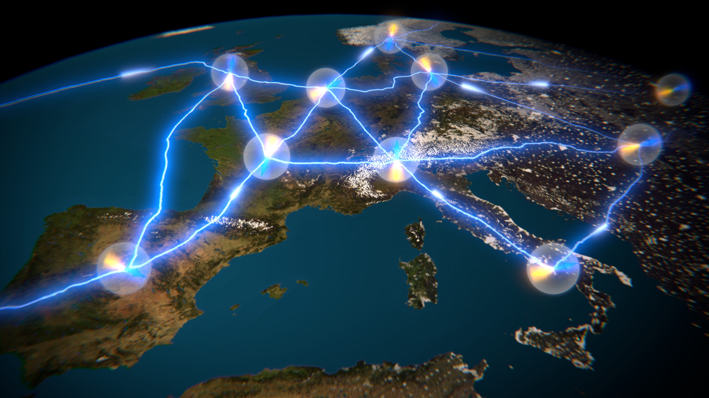
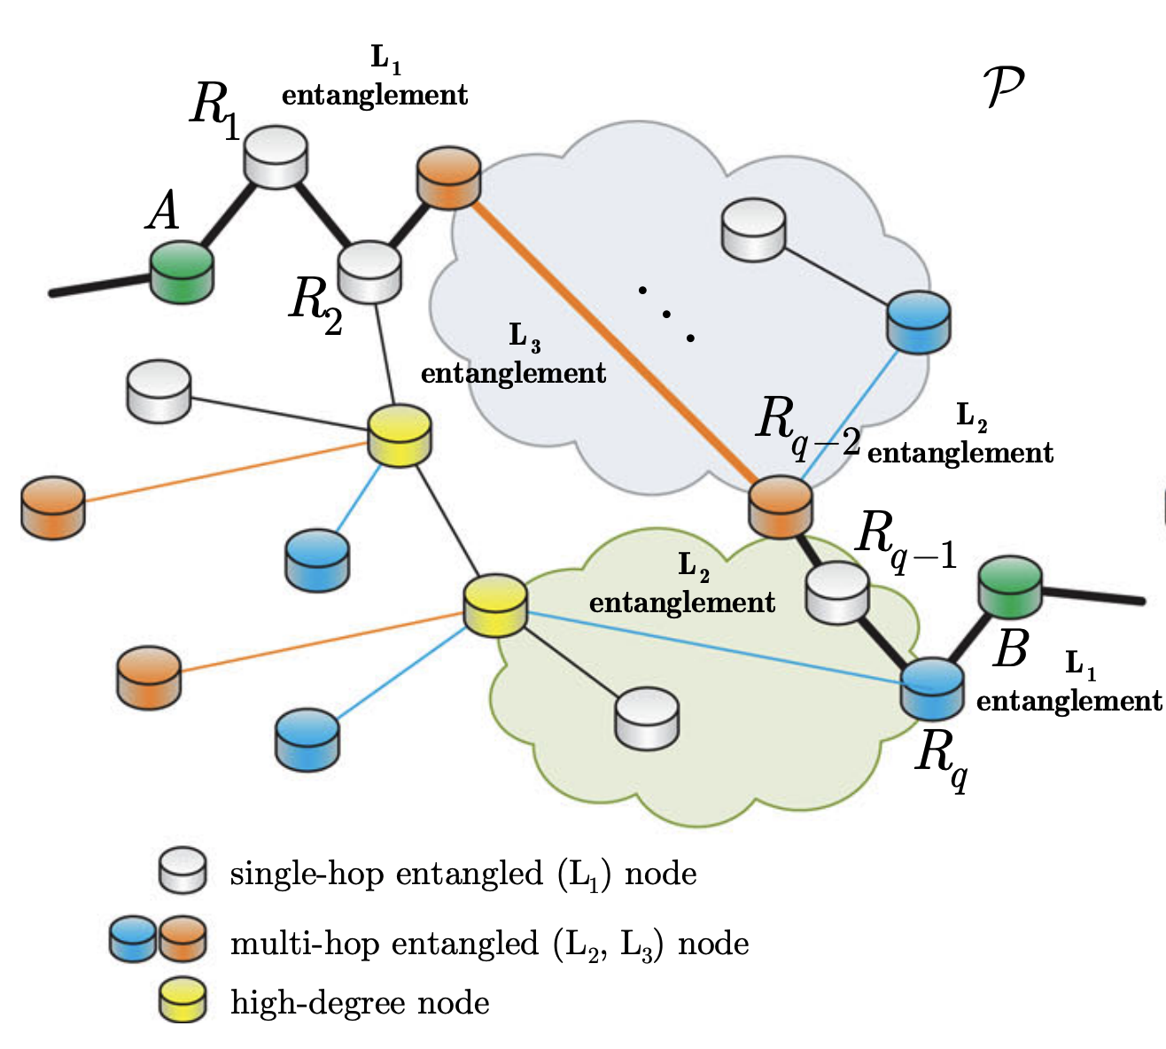
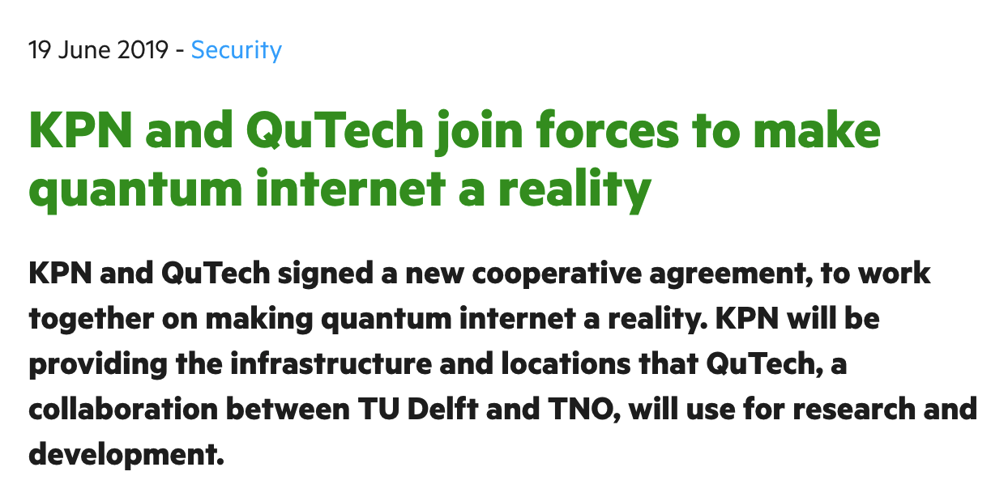
The quantum internet using optical & infrared “photons” is becoming a reality even before quantum computers

Slide 5
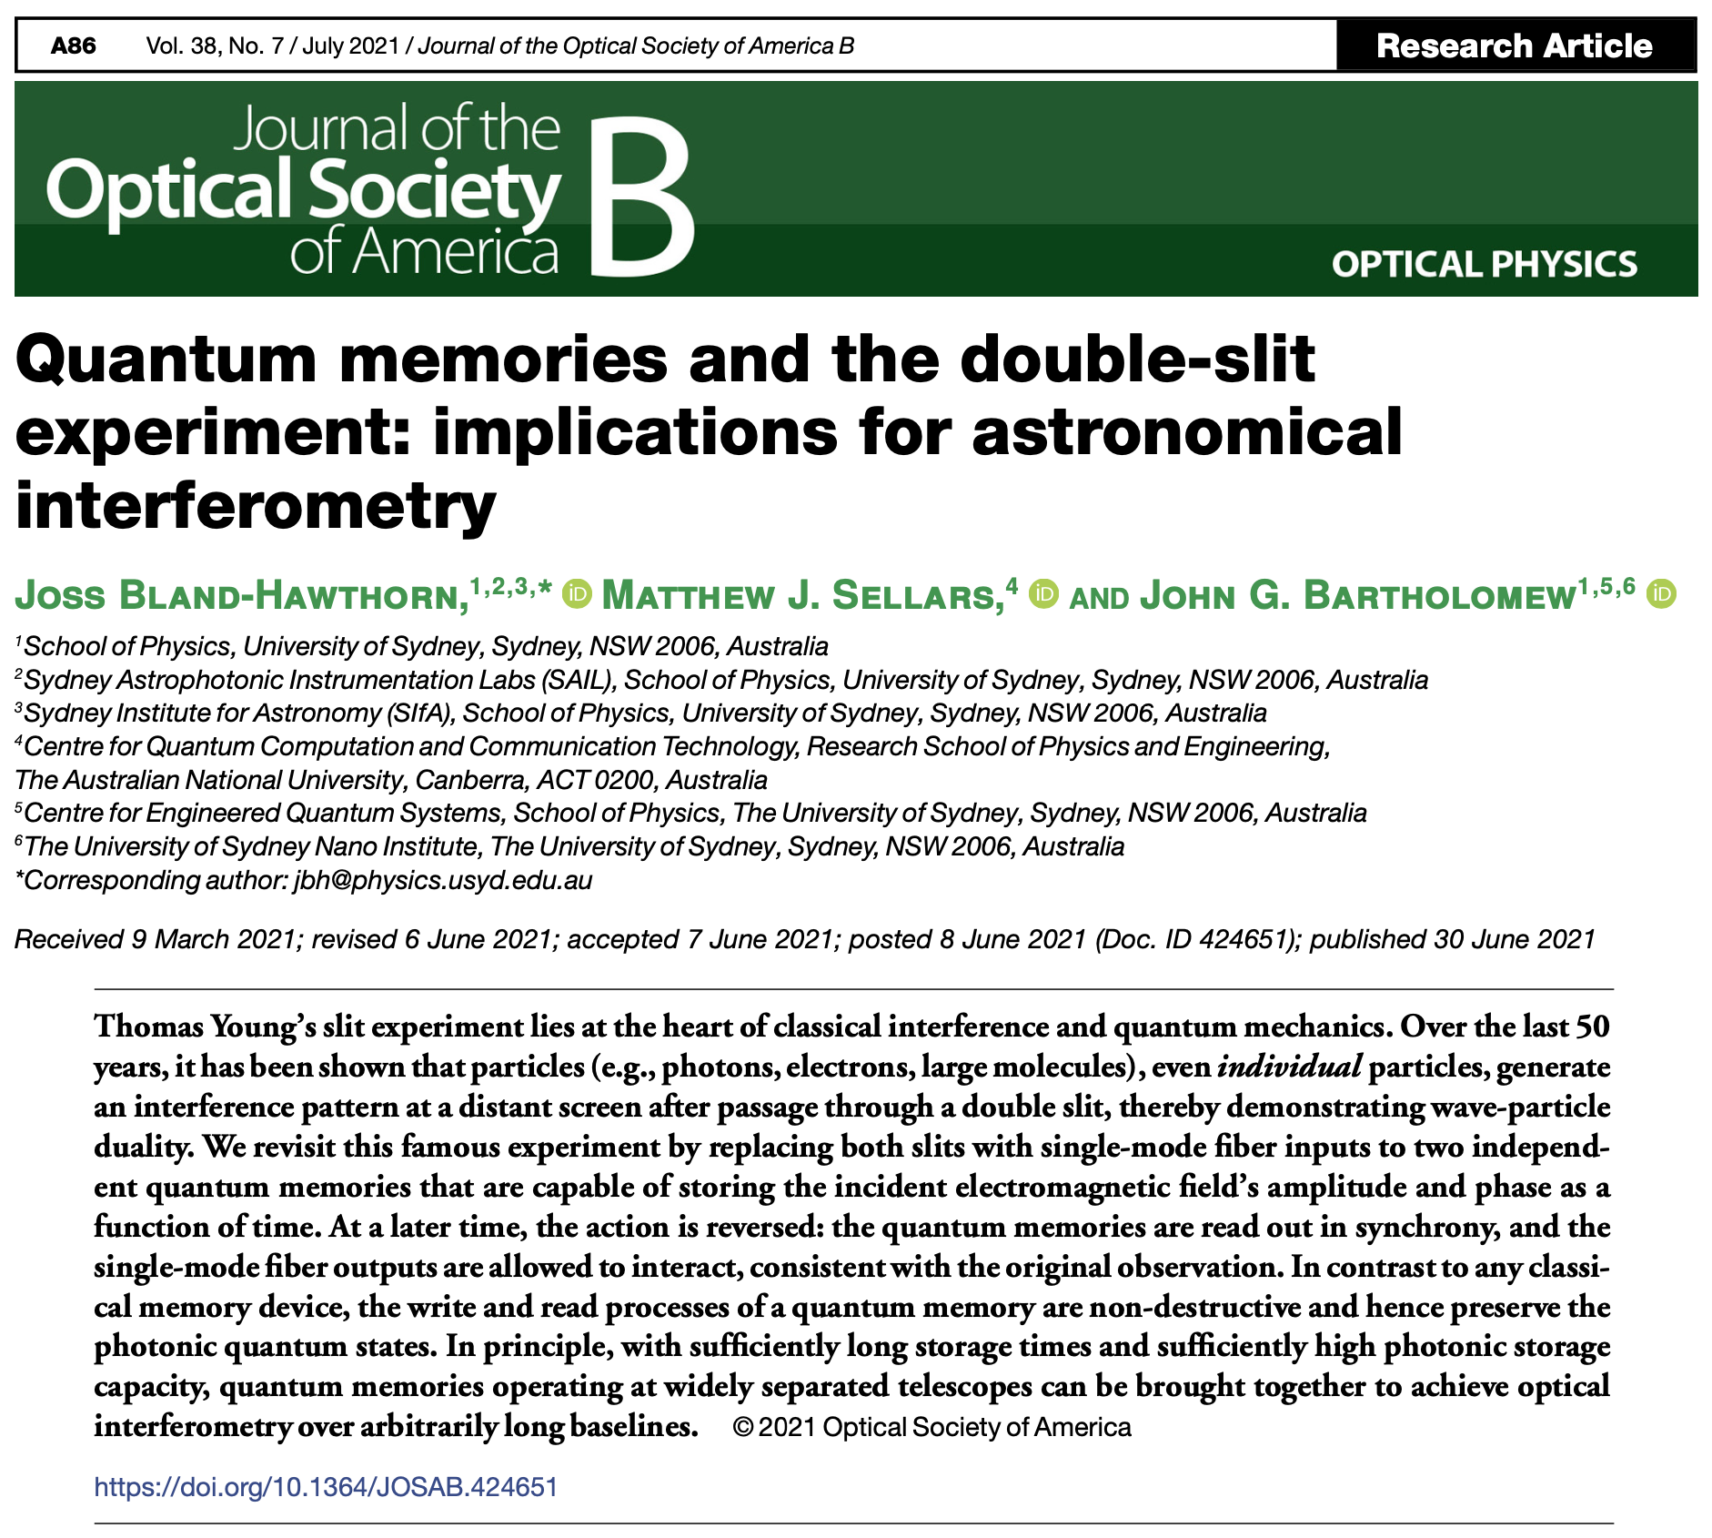
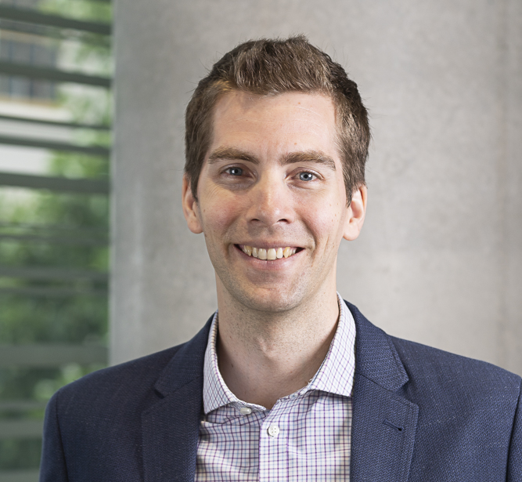
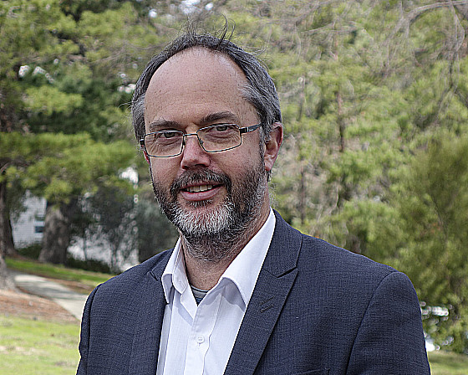
Notes:
Veritasium: https://www.youtube.com/watch?v=Iuv6hY6zsd0

Slide 6
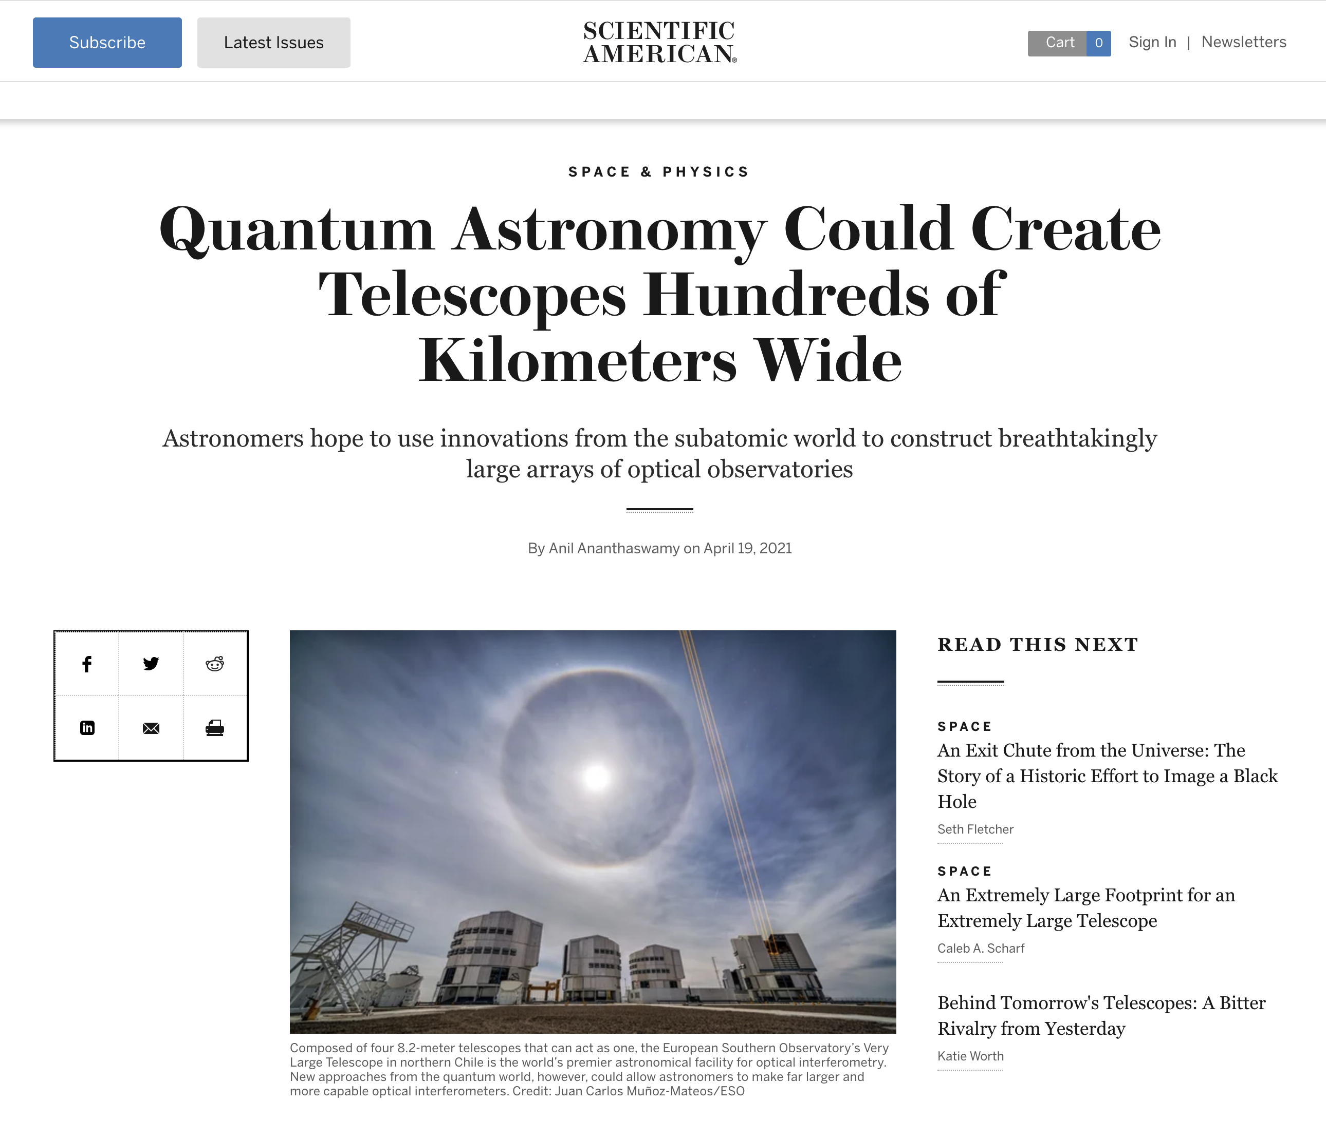
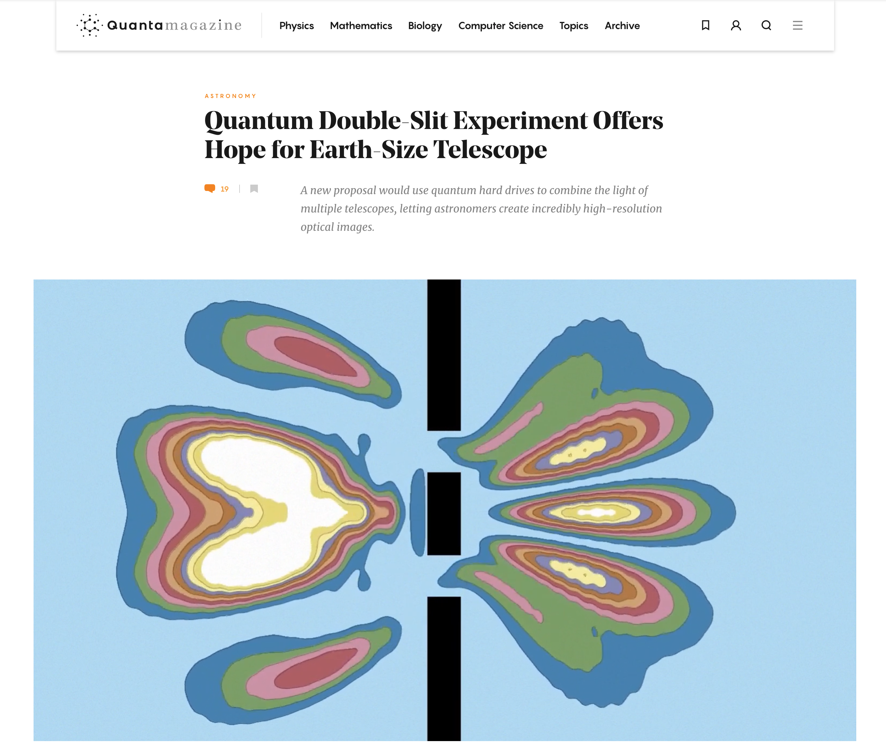
Notes:
Veritasium: https://www.youtube.com/watch?v=Iuv6hY6zsd0

Slide 7
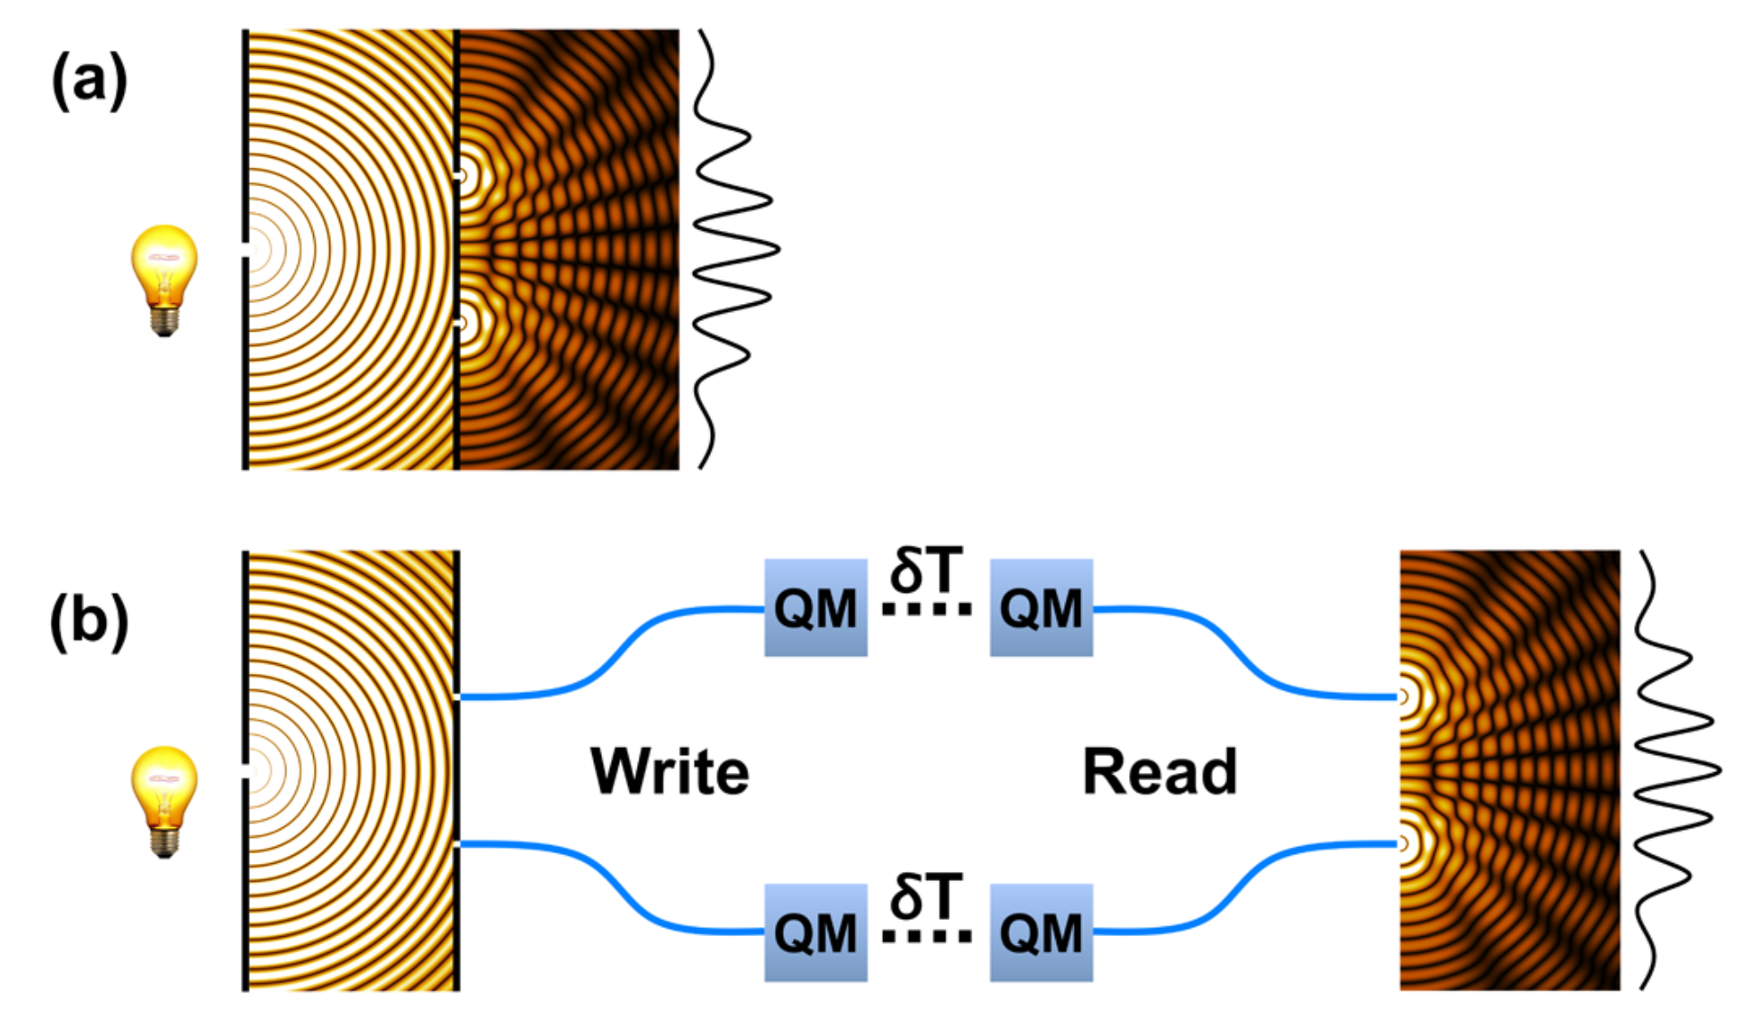
Width of 1 fringe ~ $\frac{λ}{B}$
Nobel Laureate John Mather (July 2021):
“Young’s slit experiment reimagined for the
first time in 220 years!”
Notes:
Feynmann – most of physics is in YS. Newton corpuscular, Christiann Huygens/Netherlands waves. Young polymath, medical, Egyptologist, etc.

Slide 8
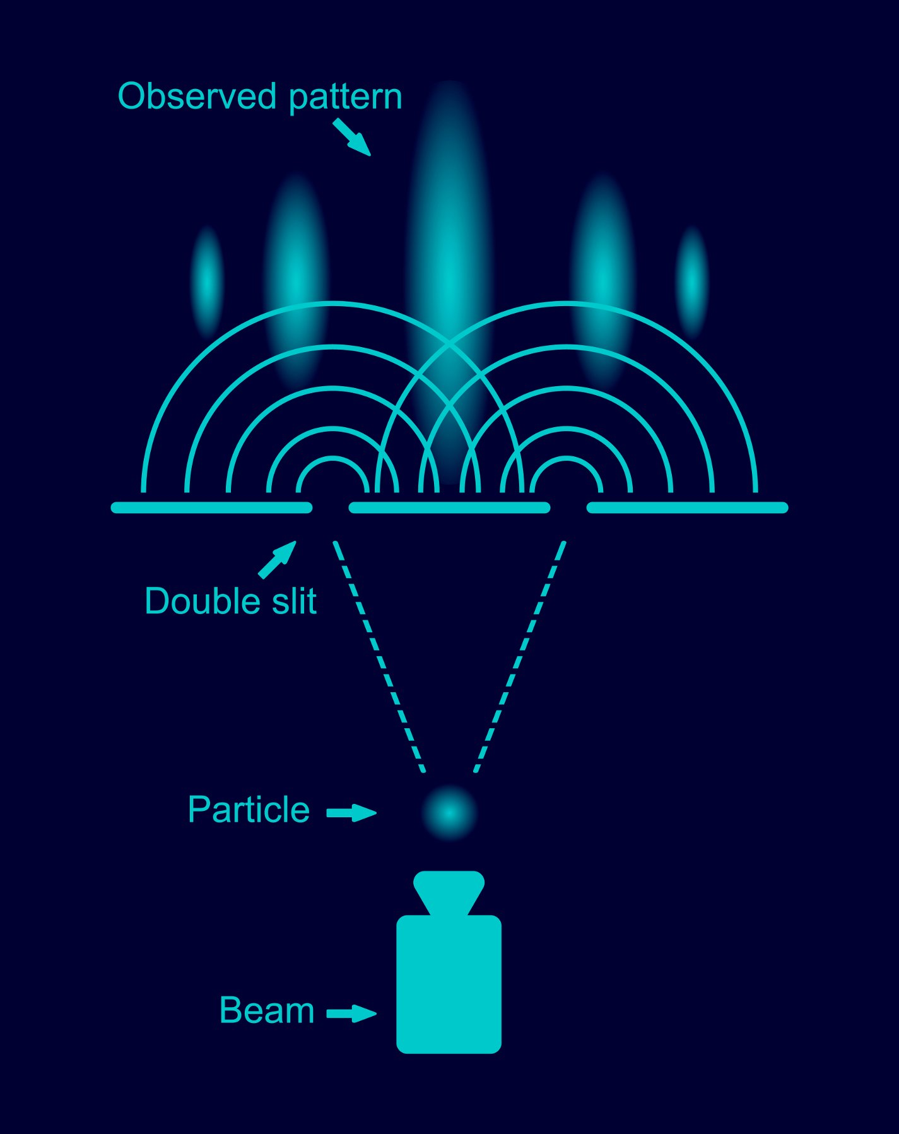
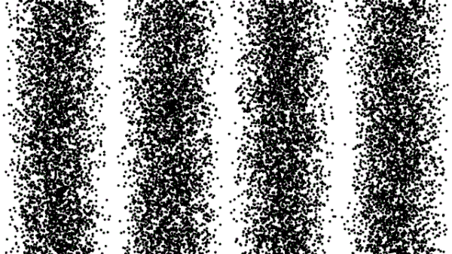
The most astonishing thing about the YS experiment is that even single particles generate fringes.
In QM, you cannot ask - what happened?
The particle’s probability function shows it
went through both slits, but the photonic
state is detected at one location only.
Notes:
Veritasium: https://www.youtube.com/watch?v=Iuv6hY6zsd0

Slide 9
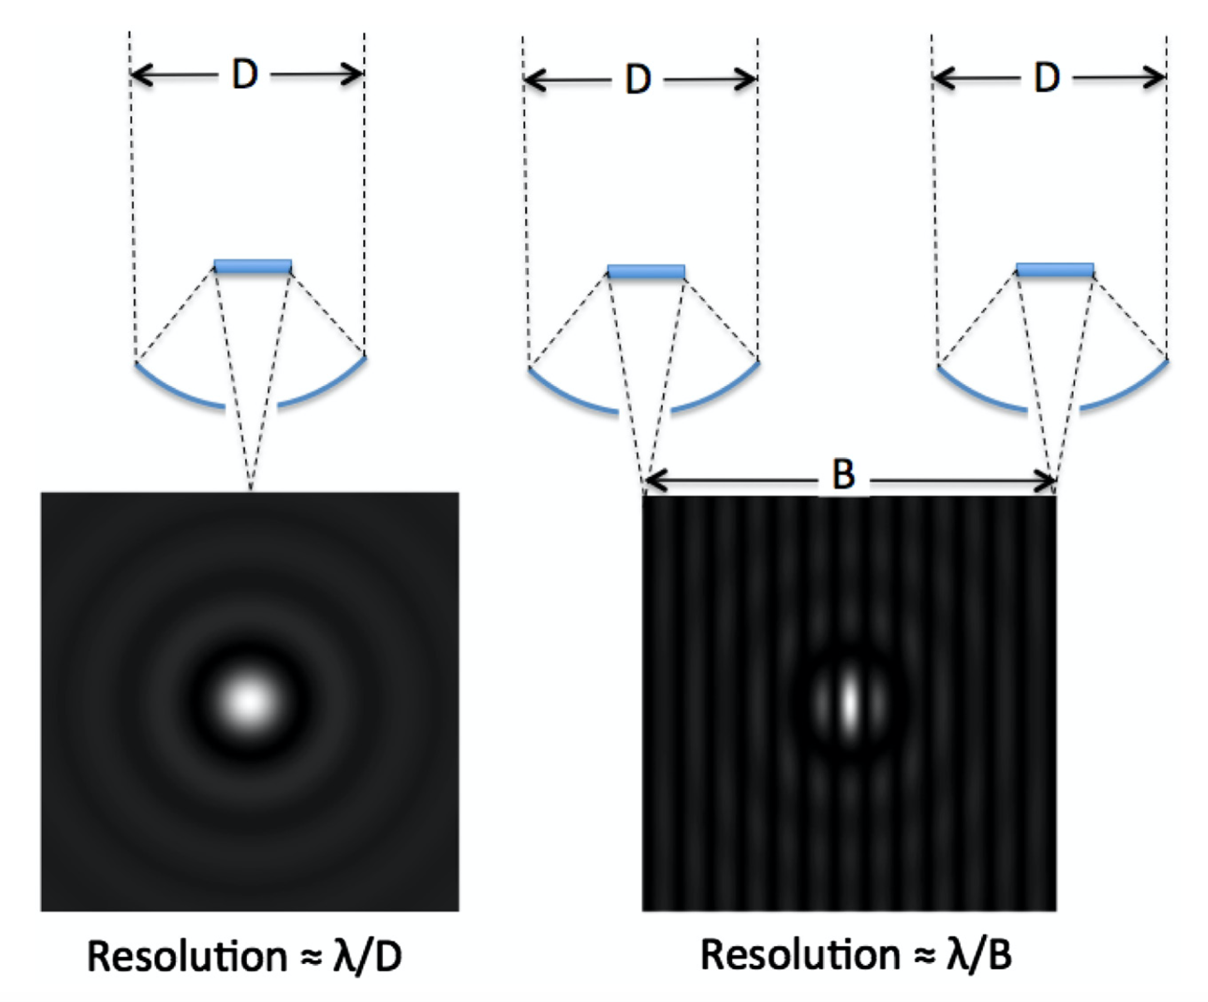
Raw data with N baselines starts to get messy & needs sophistication.
e.g. Fourier transforms.
Notes:
Need this ahead of ESO Gravity

Slide 10
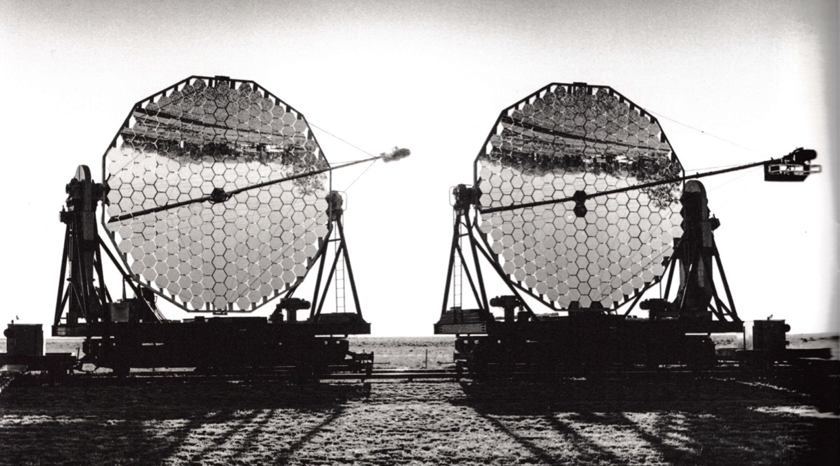
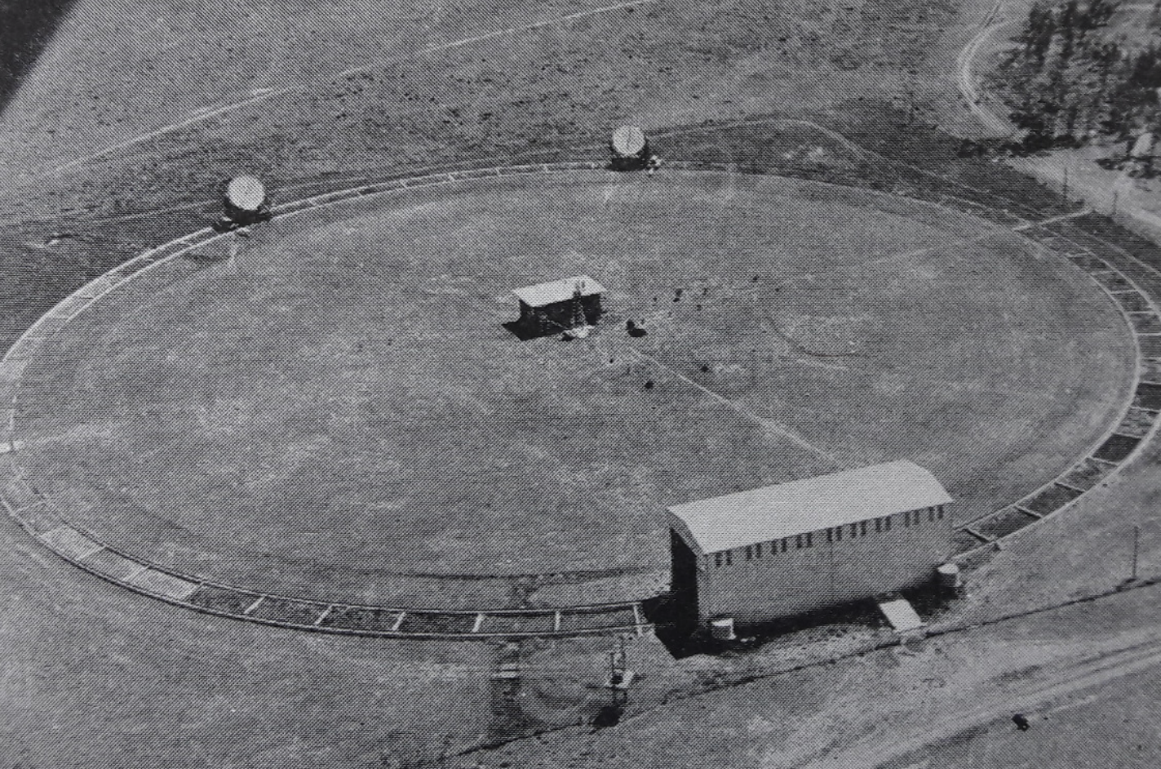
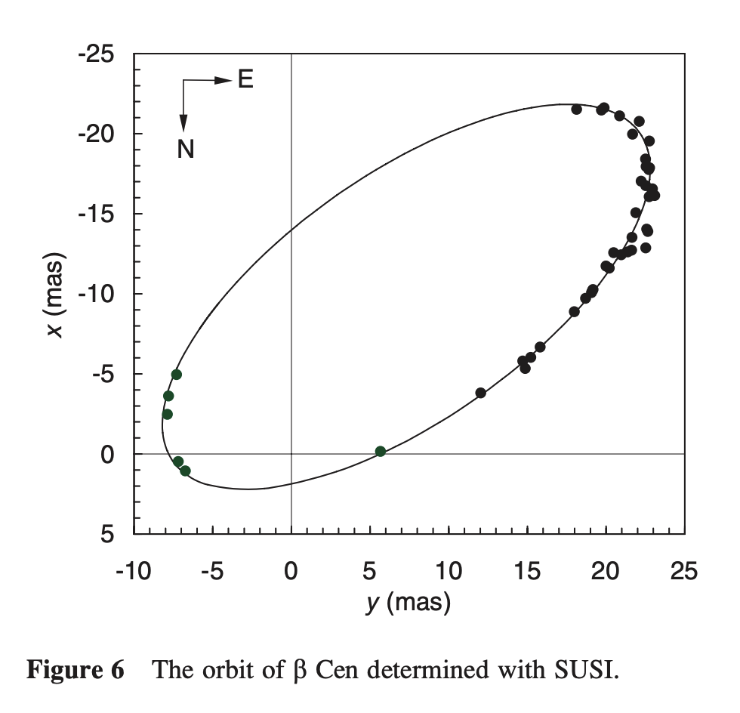
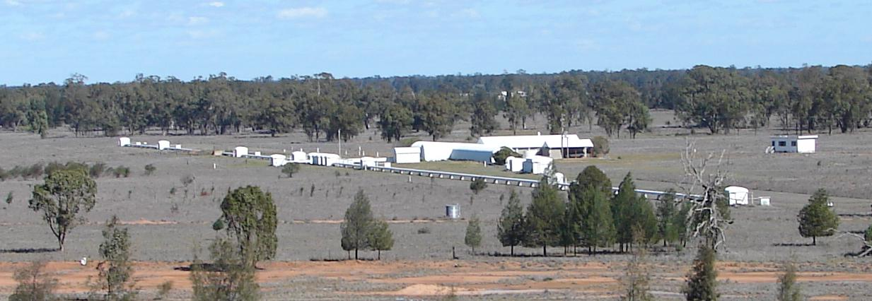
University of Sydney has been hugely influential in stellar interferometry
NSII
SUSI
Notes:
Also in radio interferometry, HBT should have got Nobel

Slide 11
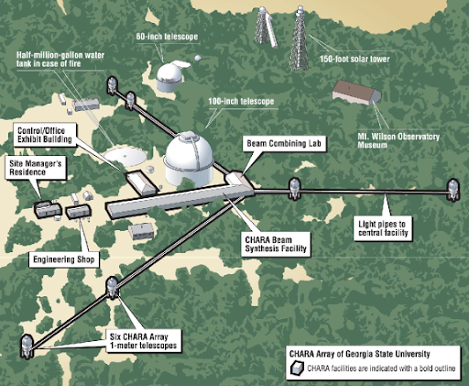
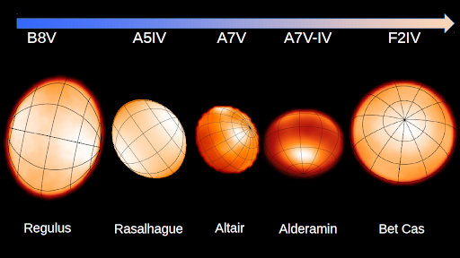
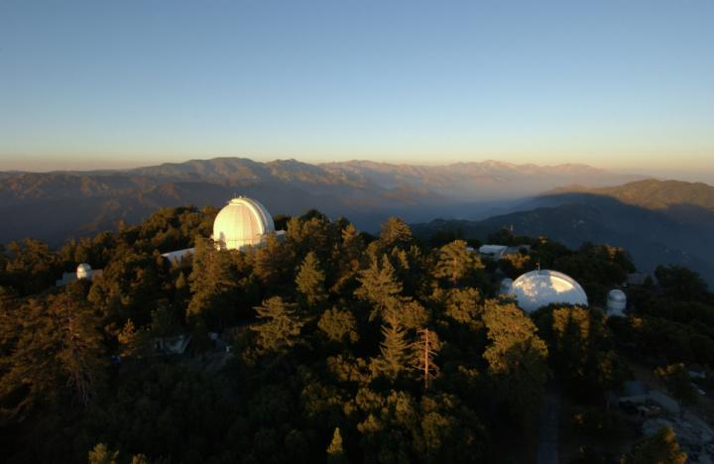
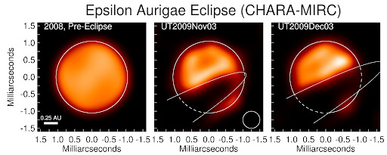
Notes:
Veritasium: https://www.youtube.com/watch?v=Iuv6hY6zsd0

Slide 12
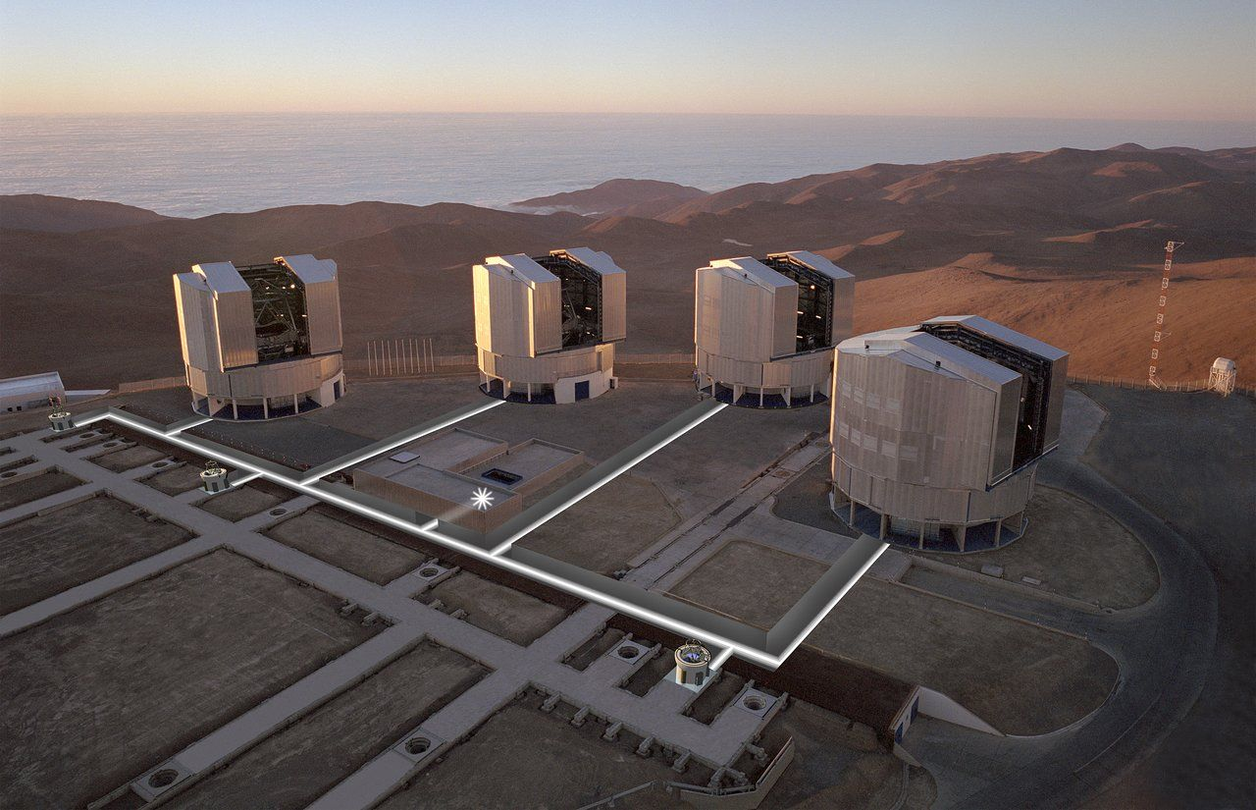
ESO Gravity: narrow-angle, phase-reference μ-arcsec astrometry
(builds on remarkable history: SUSI @ Sydney, CHARA, AMBER/MIDI/VINCI @ VLTi)
ESO VLT @ Chile
Notes:
Veritasium: https://www.youtube.com/watch?v=Iuv6hY6zsd0

Slide 13
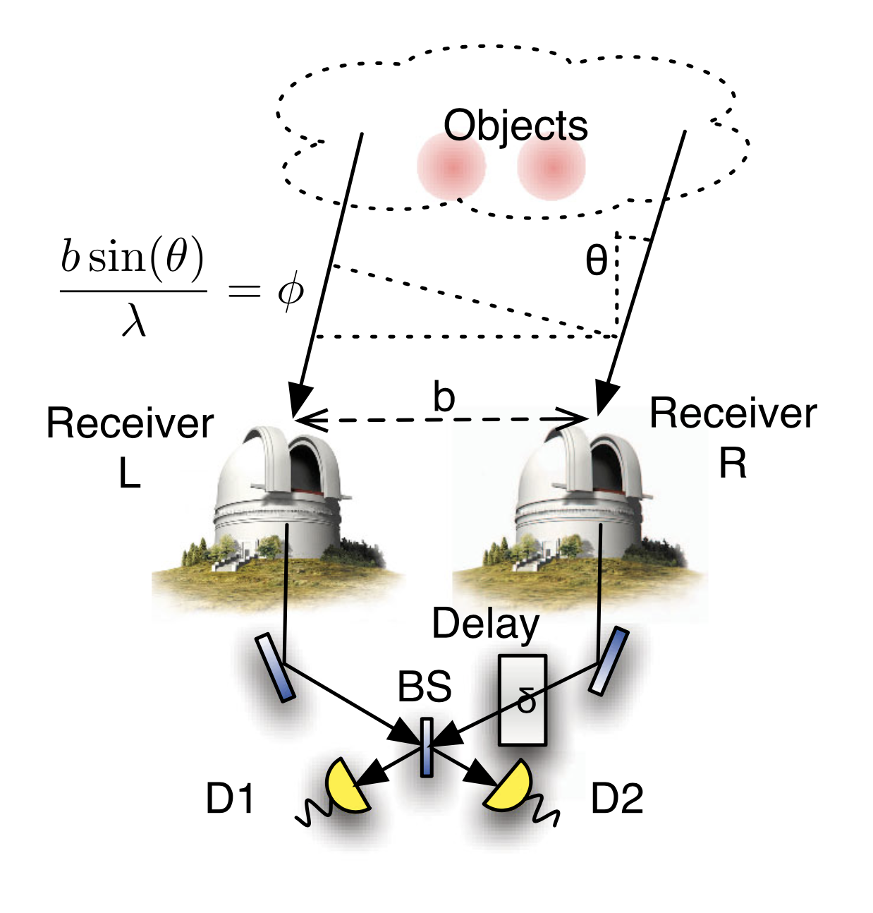
Interferometers have long used conventional networks to connect telescopes.
Gottesman et al (2012) considered the benefits of a quantum network – the key idea was to achieve YS interferference with individual photons.
We must not know which telescope the photons come from if we are to maintain a coherent quantum (photonic) state.

Slide 14
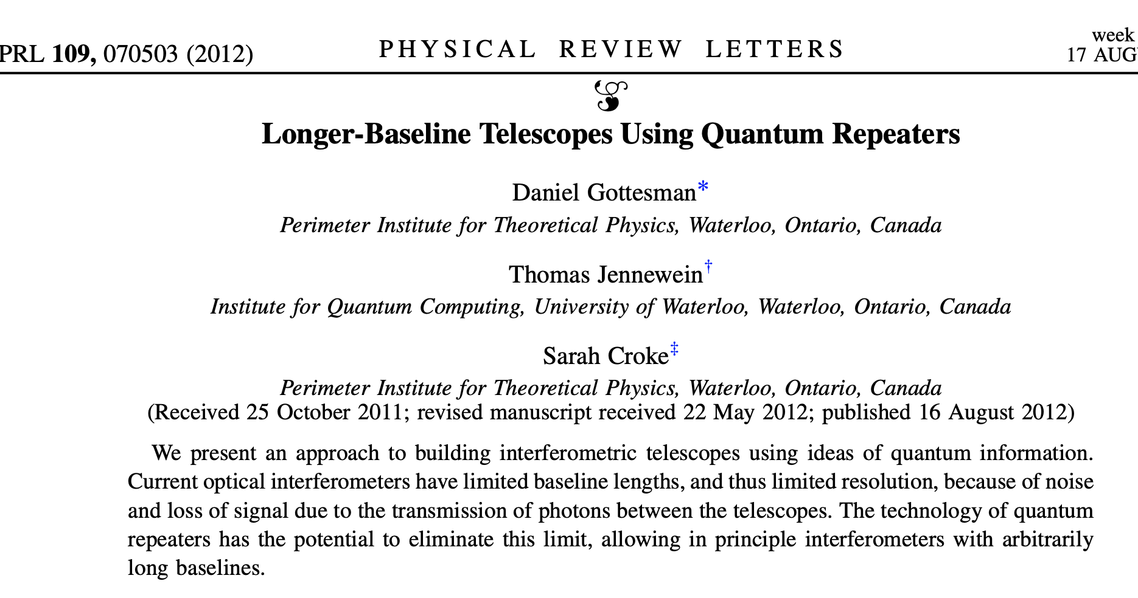
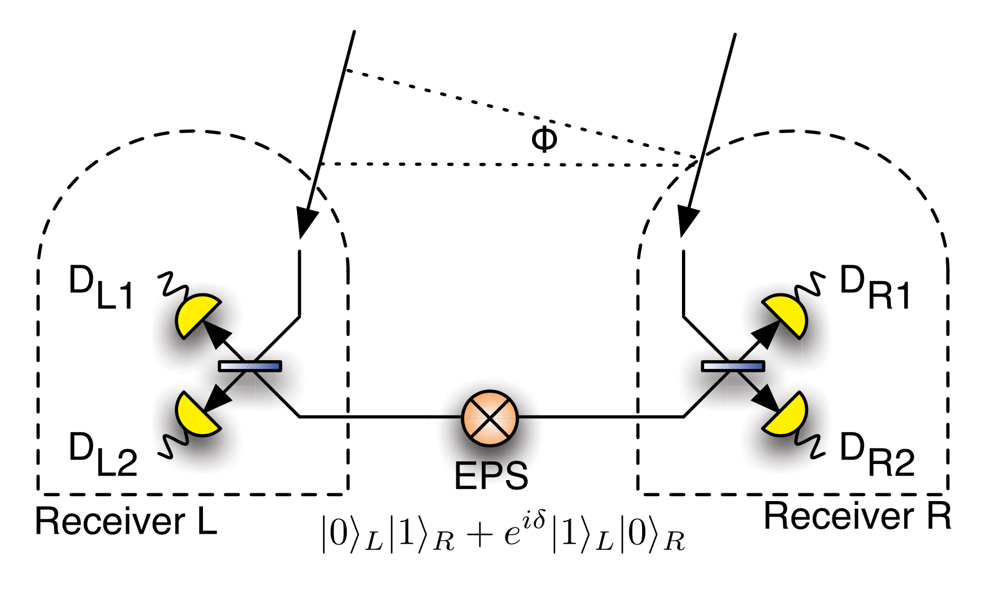
They considered the use of an entangled photon source to “connect” the output of two telescopes.
The “signal” is not the number of photons at the detectors, but the correlation between which L and R detector clicks.
If we can show 2 photonic events at 2 locations are entangled, then they are synchronized, i.e. in phase.
Notes:
BS is used to prove a Bell inequality – means entangled!!
BS useful because photons are inherently polarized – Hong Ou effect relevant? check

Slide 15
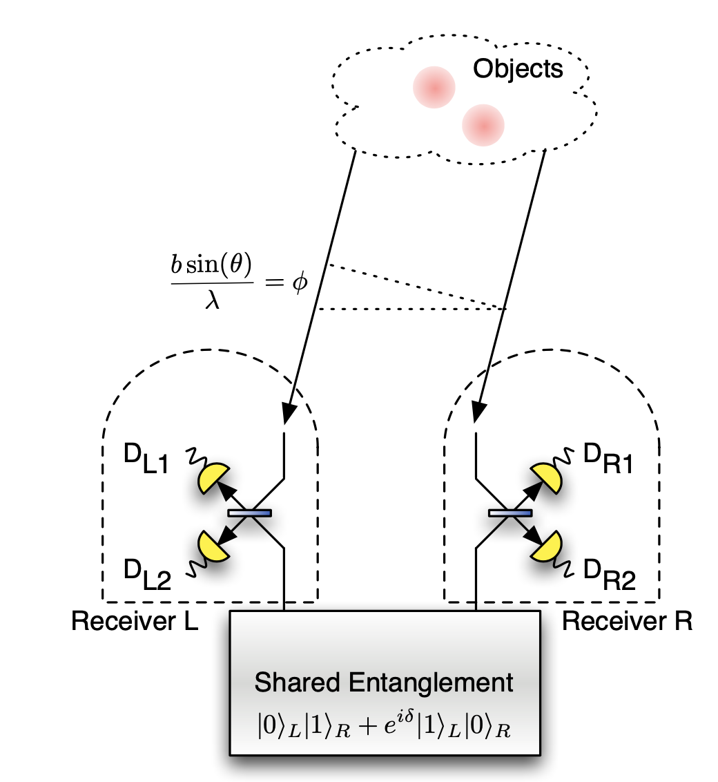
Only the |0⟩|1⟩ and |1⟩|0⟩ quantum states are kept since |1⟩|1⟩ does not maintain the quantum indeterminacy. So we lose half the photons.
One of the quantum states must be from the source, the other from the entangled pair for interference to emerge.
The beam splitter entangles the science photon with one of the pair, so now both telescopes are entangled, but we don’t know which telescope saw the science photon.
For each “detection,” all of this must take place within a correlation time (mostly due to the turbulent atmosphere). We delay one of the entangled pair to simulate baseline scanning.
Notes:
AO really helps here since longer correlation times, lower entangled photon rates
don;t need to say polarized here because even unpolarized photons are entangled
invisibly by their polarization say

Slide 16
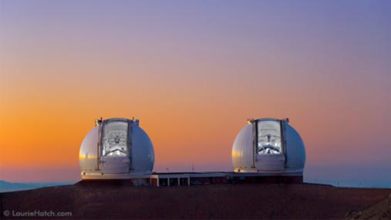
The new idea
Keck @ Hawaii
Store light from N telescopes into N quantum memories, then bring the memories together and interfere the light in a lab. If the storage time is long enough, we can use telescopes spread across Earth to achieve an opt/IR telescope with B >> 300m, the current record. Then we can produce images with microarcsecond (μas), not milliarcsecond (mas), pixels.
Notes:
Veritasium: https://www.youtube.com/watch?v=Iuv6hY6zsd0

Slide 17
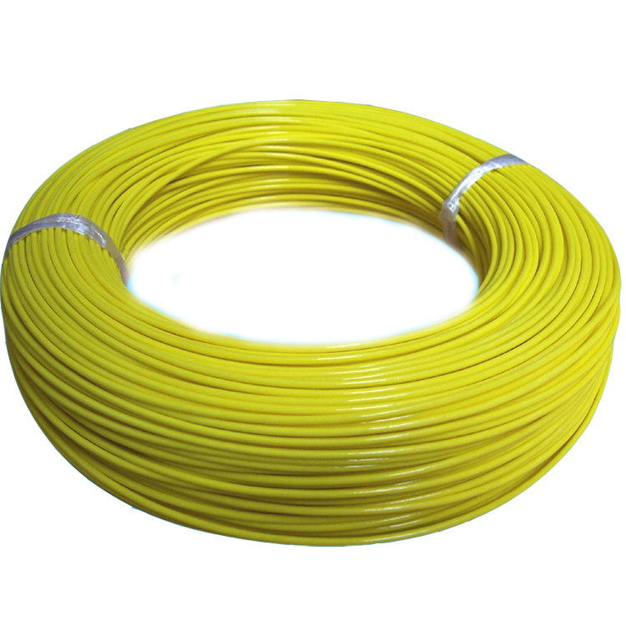
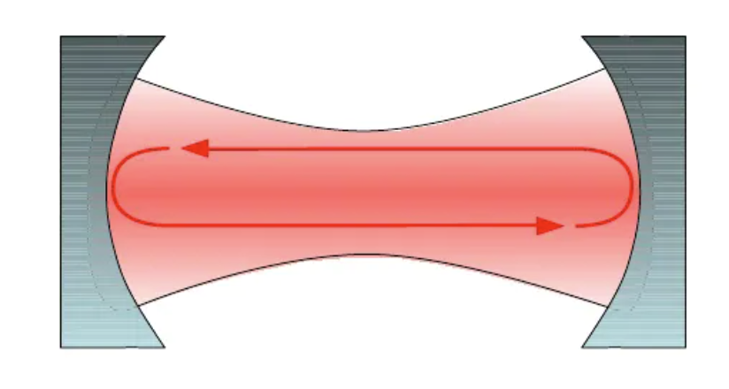
How to trap light ?
A long optical fibre or a resonant trap would only give you ~1 microsecond storage time, without significant loss.
These are of no use to quantum networks.
Notes:
Veritasium: https://www.youtube.com/watch?v=Iuv6hY6zsd0

Slide 18
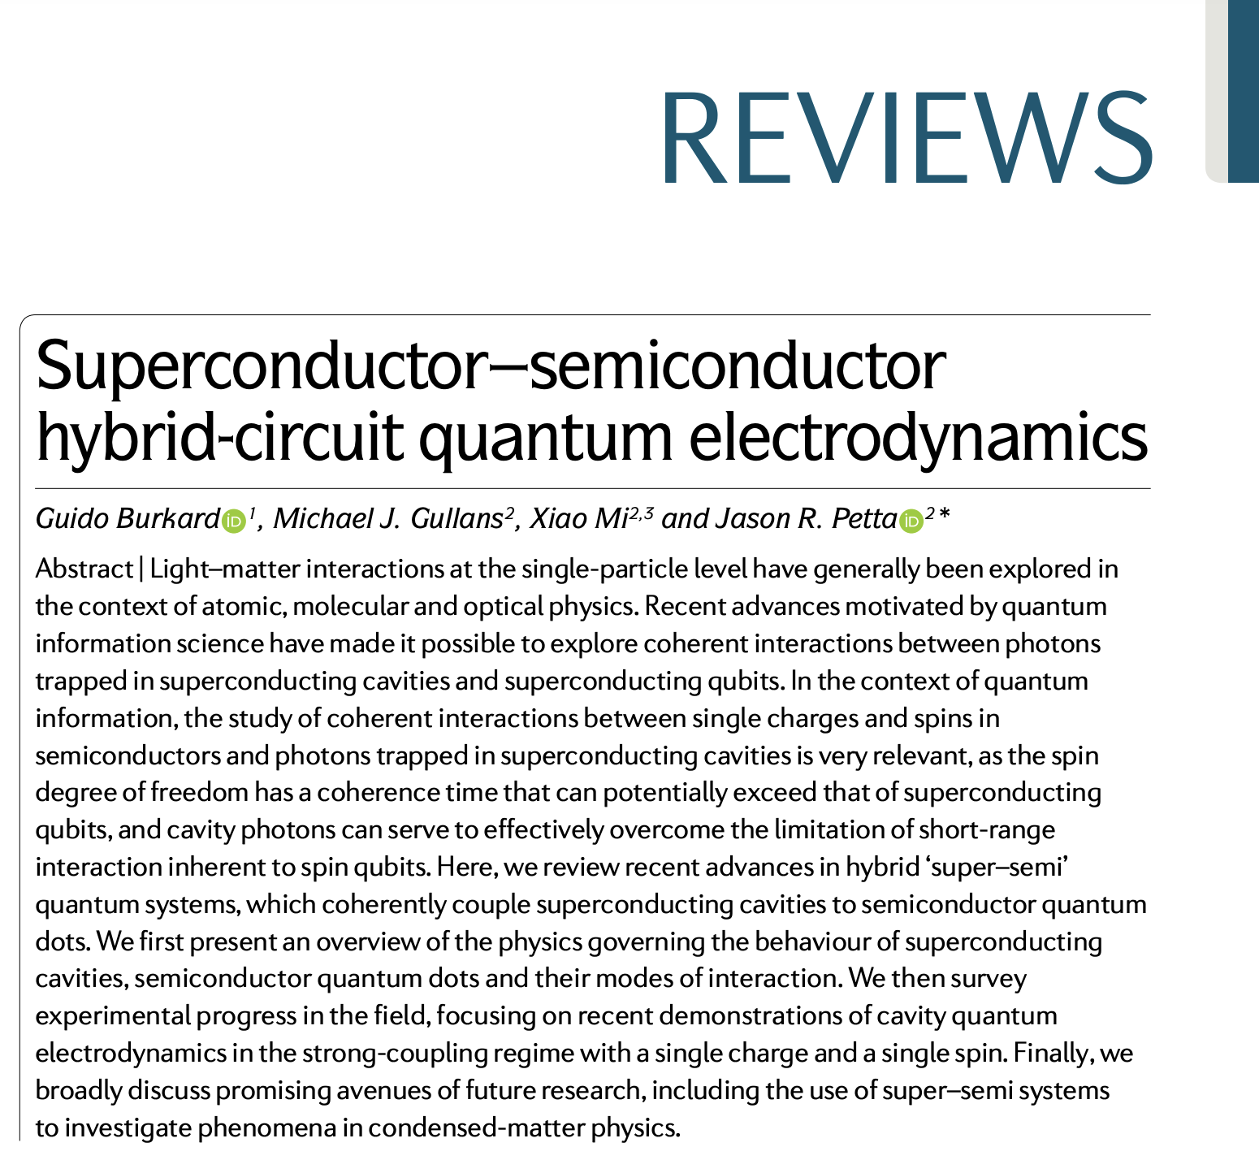
How to trap coherent light for hours, days, weeks, years ?
The open secret is to couple light to matter.
Notes:
The first sentence is how we control the electrons externally
The second sentence is how we get the atom to store the photonic state
See review – basis of qubits in QCs etc – it’s all about SPIN COHERENCE TIMES !!!

Slide 19
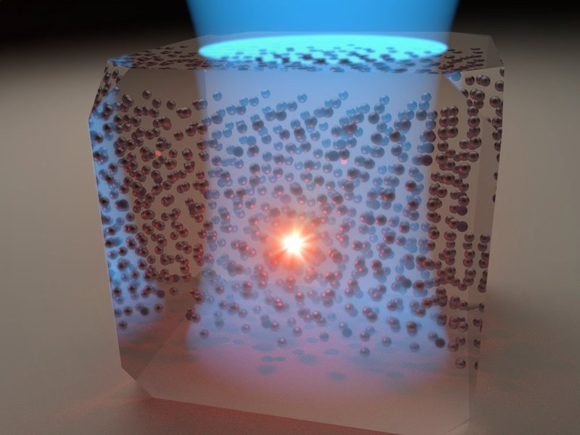
How to trap coherent photonic states ?
YSO crystal doped with Eu ions kept at sub-kelvin temperatures, lit by one or more lasers.
Prepare billions of Eu atoms in one voxel in coherent, low energy state with external microwave signal and magnetic field.
Send in ~1000 photonic states per voxel with optical fibre. Cavity ensures strong interaction with Eu ions. One electron (nuclear spin state) in one Eu ion traps the state, ~100% efficient.
Radio signal is flipped to read out identically.
Longest storage time so far ~ 6 hours.
Notes:
Yttrium orthosilicate: high efficiency

Slide 20
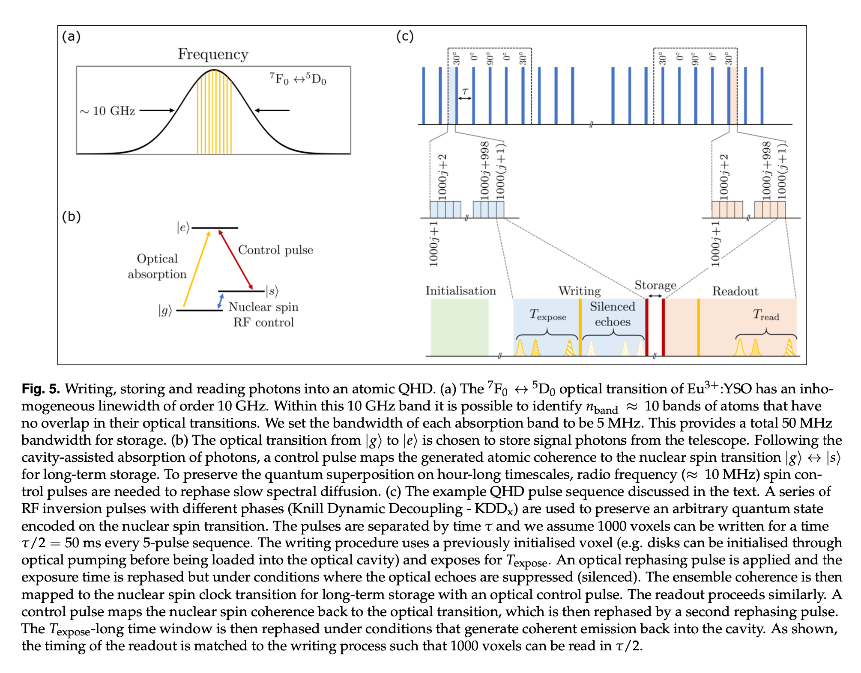
The read-write procedure
is a CQED process, very
technical, experimental.
PhD Ben Field is building
our prototype, all in solid
state – a portable QHD.
See our paper for introduction.

Slide 21
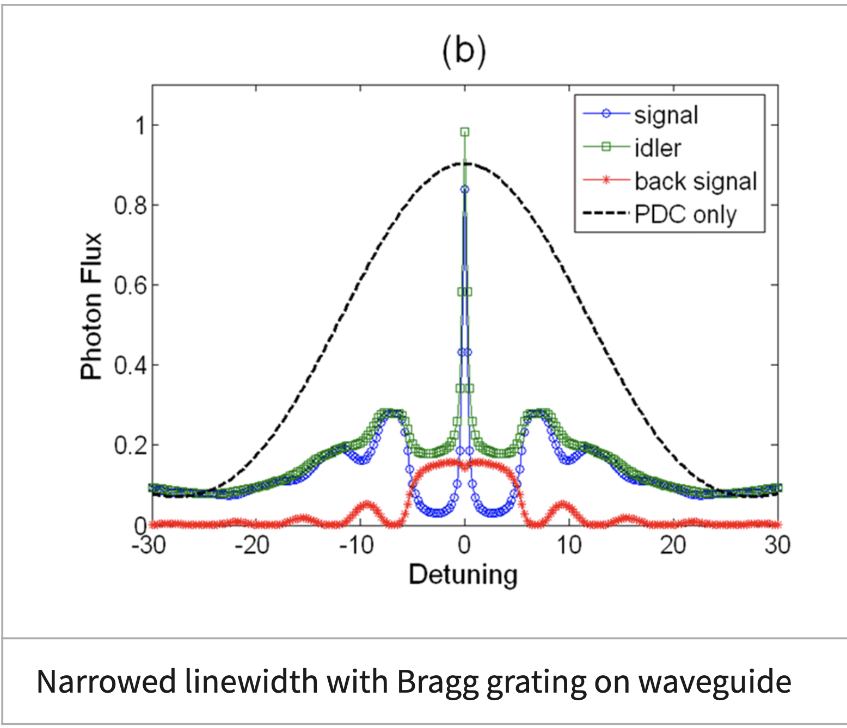
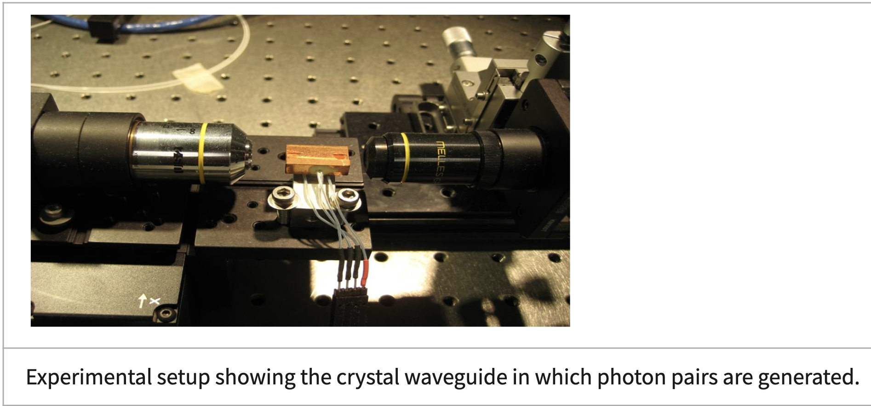
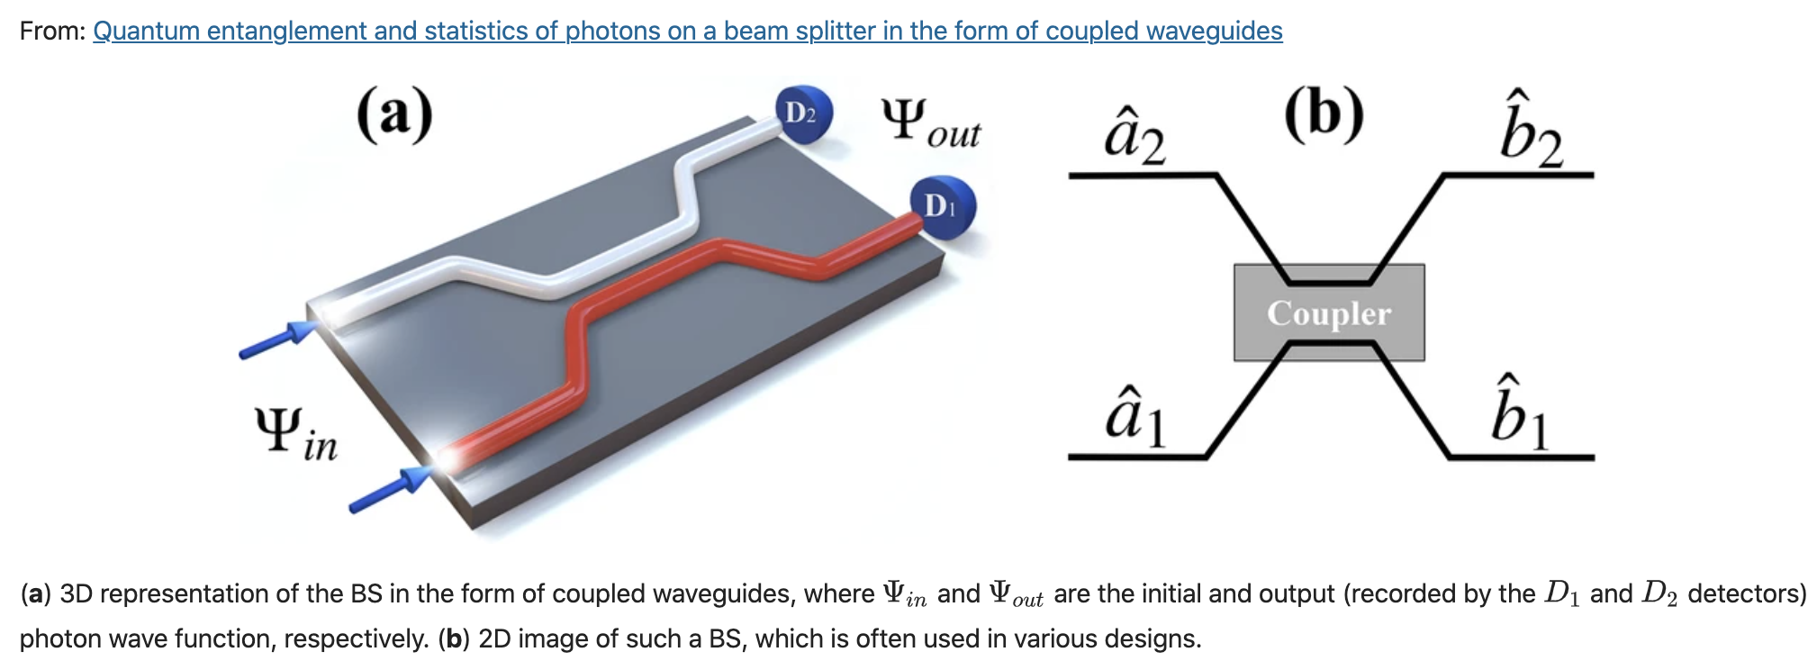
QUANTUM PHOTONICS
NIST IT
Laboratory
Field et al 2024
Makarov et al 2021
Notes:
SAIL labs best filters to date!
1. Crystal waveguide entangled photons
2. Backscatter filter since bright sources
3. Beam splitter waveguide and entangle – coupled waveguide

Slide 22
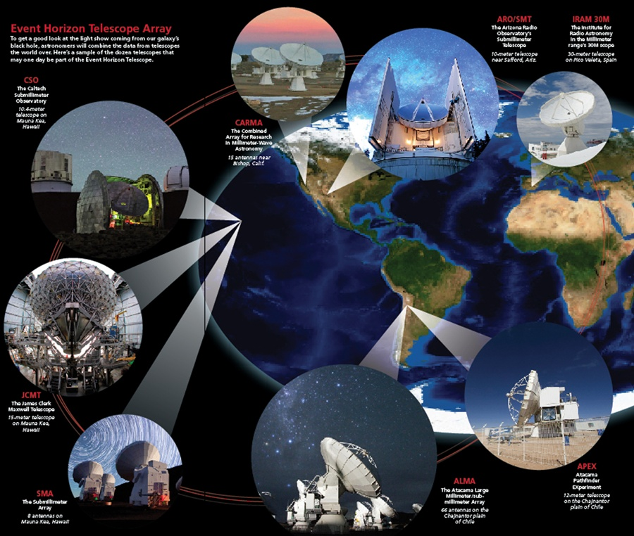
The goal is to build a mid-IR system
Notes:
Done using VLBI

