Slide 1
Coupling light into a space-based microspectrograph
Emma Lindley
Supervised by Joss Bland-Hawthorn and Sergio Leon-Saval

Slide 2
Talk Outline
The world of astrophotonics
Why ‘go photonic’?
Photonic Integrated Multimode MicroSpectrograph (PIMMS)
My project: create a prototype waveguide to be included in PIMMS.
The three stages:
Design
Manufacture
Testing
What’s next?

Slide 3
What is astrophotonics?
Astronomy
Photonics
as·tron·o·my
noun /ə’stränəmē/
1. The branch of science that deals with celestial objects, space, and the physical universe as a whole
pho·ton·ics
noun (plural) /fō’täniks/
1. The branch of technology concerned with the properties and transmission of photons, for example in fiber optics

Slide 4
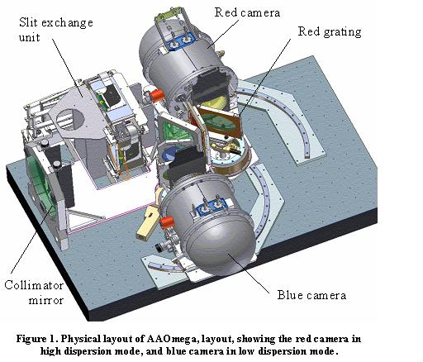
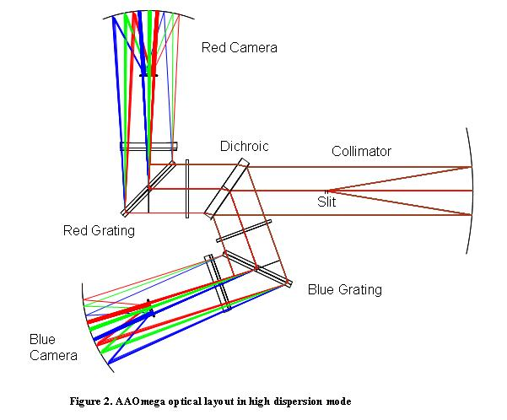
Astronomical instruments

Slide 6
The (astro)photonic advantage
Reductions in size and cost
No loss in performance
“One size fits all” devices
Operating at or close to diffraction limit
Can incorporate photonic processing
Suppression of atmospheric emission lines

Slide 7
Photonic Integrated Multimode MicroSpectrograph (PIMMS)
Works in visible and IR wavelength bands
Number of fibres can vary

Slide 8
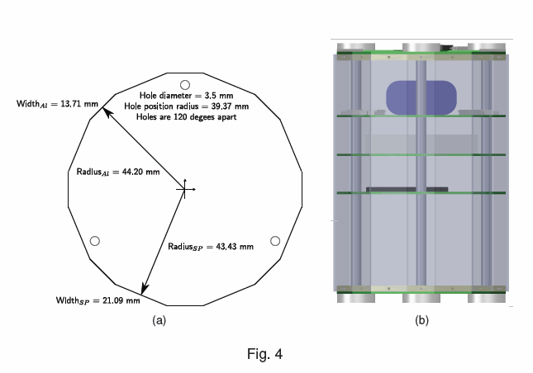
PIMMS in space (90 x 135mm)

Slide 9
My project
Can we reduce the required detector size?
Concept: feed the SMF outputs into a 2D waveguide with converging tracks
?

Slide 10
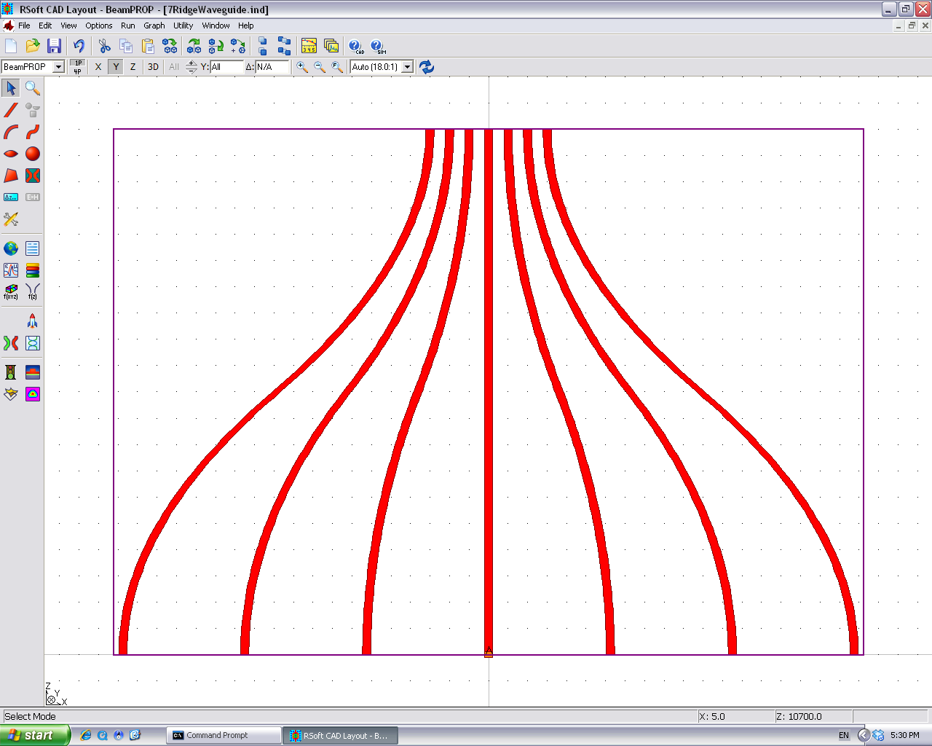
Designing a waveguide
The RSoft Photonics Suite

Slide 11
Things to consider when designing
Radiative losses
Light coupling into neighbouring features
Leakage at bends
Coupling & throughput
What size ridges are best for accepting SMF input?
Keeping the light single-moded
Sometimes compromise is required!

Slide 12
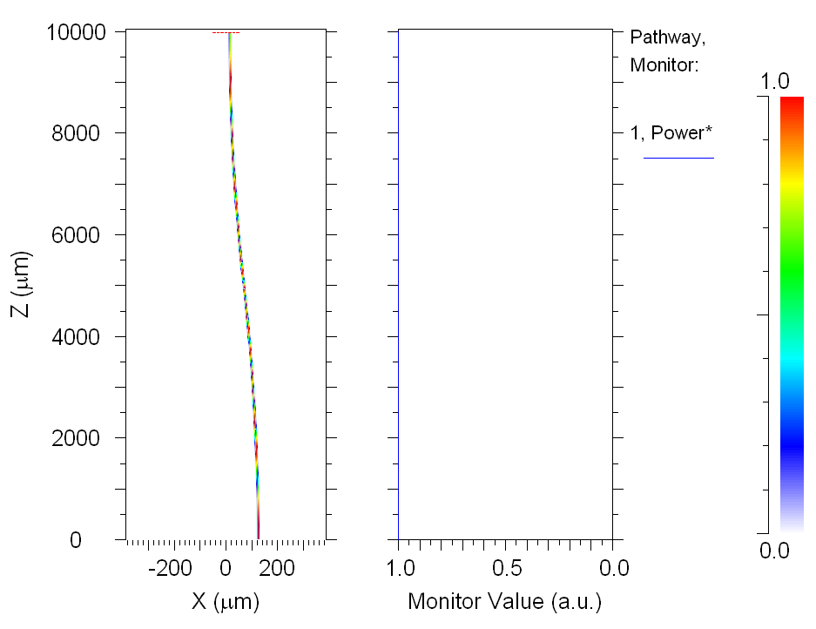
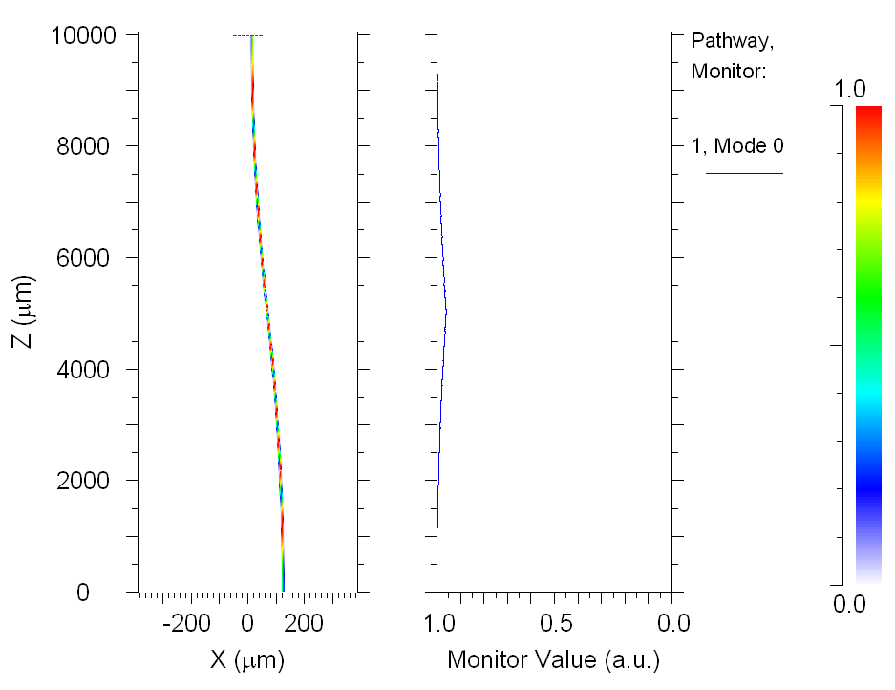
Radiative losses

Slide 13
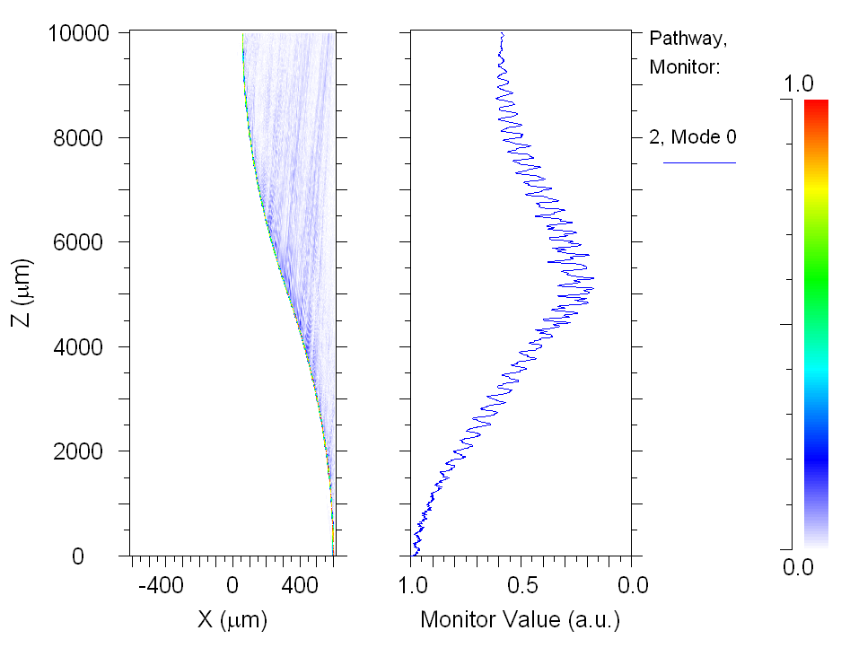
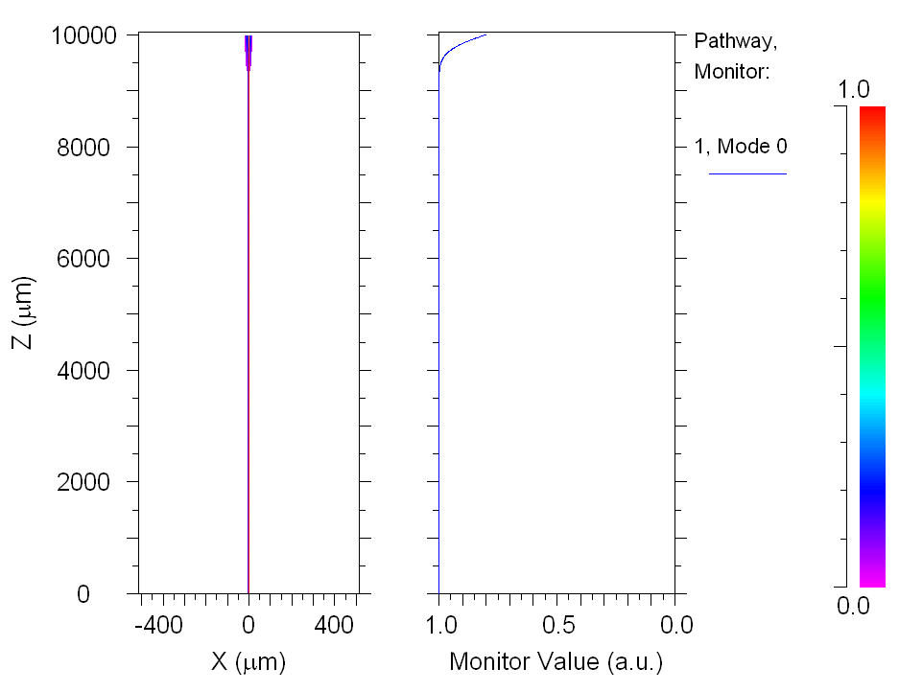
Radiative losses

Slide 14
Throughput vs. Ridge size
Throughput
Throughput
Height (um)
Height (um)
The best throughput is achieved when the ridge dimensions match the input SMF’s dimensions.
Throughput
Height (um)

Slide 15
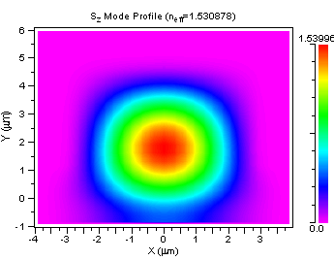
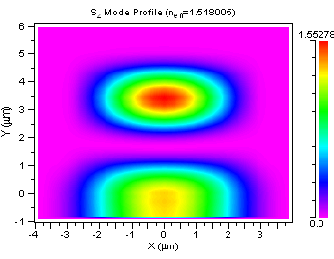
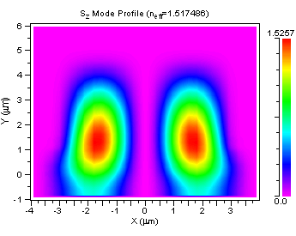
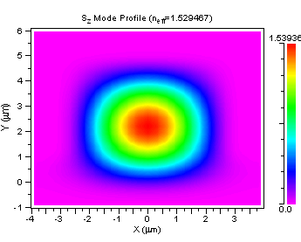
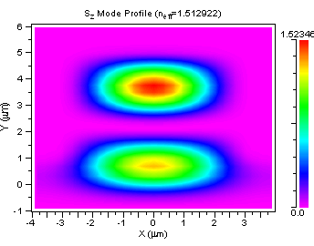
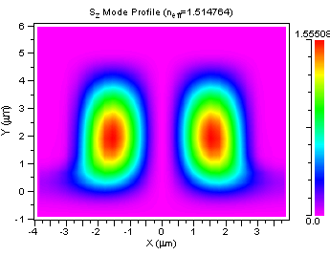
Modes of the ridge
(For single mode operation, V < 2.405)

Slide 16
Thinking about manufacture
What techniques are available to us?
All manufacturing to be done in-house at Bandwidth Foundry International (BFI)
What materials are available?
Long and short term availability
Materials must suit the manufacturing technique being used
Final refinements to design can only be made when materials are chosen!

Slide 17
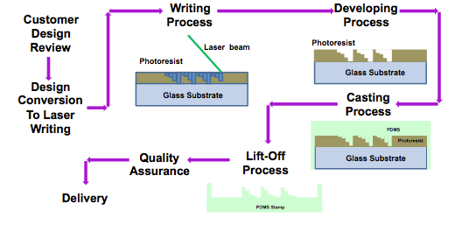
Making a waveguide at BFI
Soft lithography

Slide 18
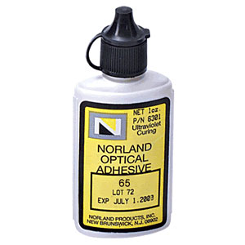
Materials
The unexpected answer...glue

Slide 19
Cross-section of a waveguide
NOA-68 (n=1.54)
NOA-65 (n=1.52)
Substrate

Slide 20
How well does it reproduce the design?

Slide 21
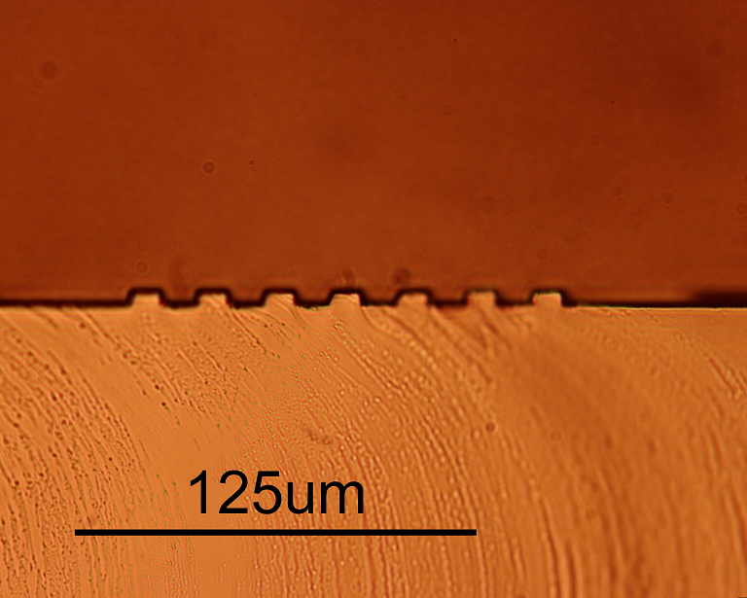
How well does it reproduce the design?

Slide 22
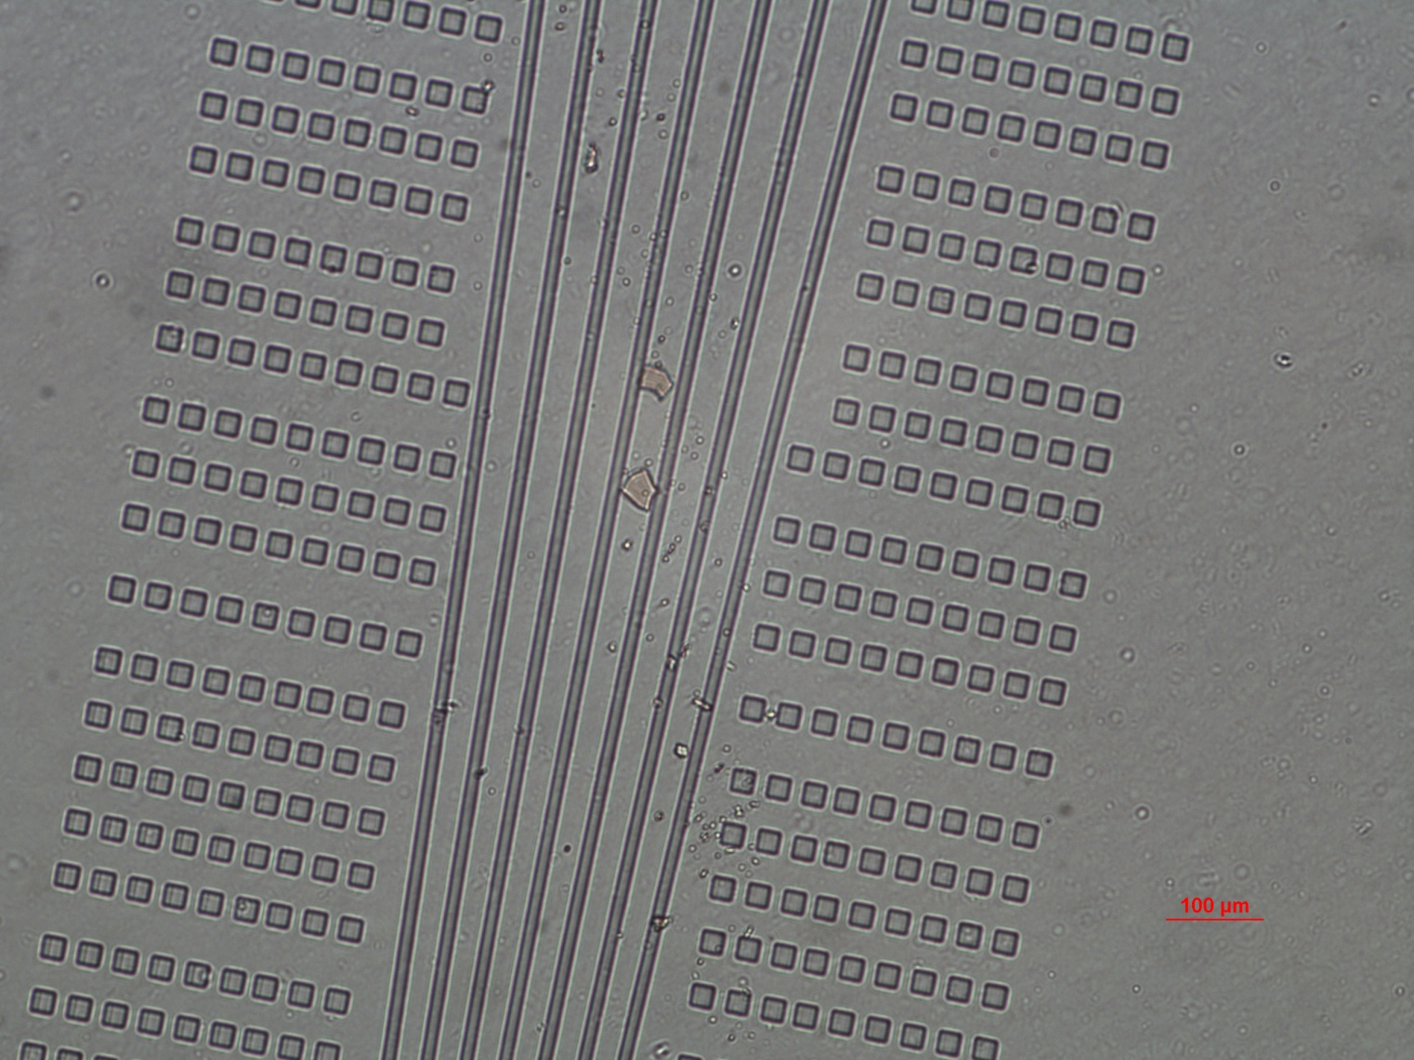
How well does it reproduce the design?

Slide 23
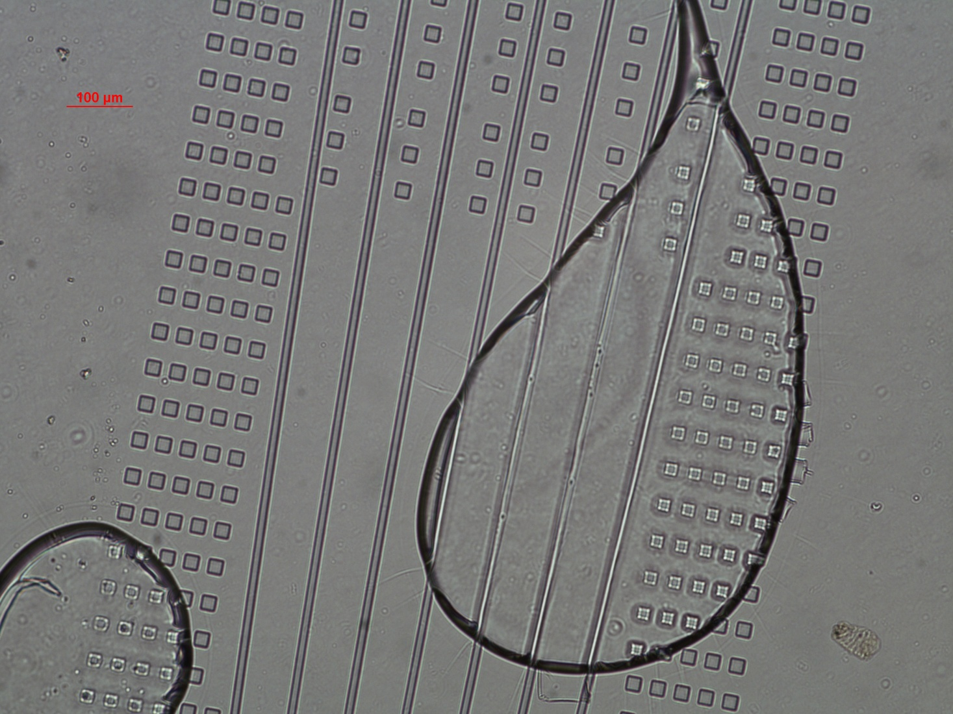
How well does it reproduce the design?

Slide 24
How to test the finished product
Inject light from a tunable laser
Use an IR camera/power meter to measure field at exit
Testing delayed by need for access to BFI facilities – competing with commercial projects

Slide 25
Future developments
Integration into the satellite version of PIMMS
Access to a broader range of materials
A visible-wavelength version
Increased number of tracks to work with a larger number of fibre inputs

