Slide 1




Institute of Photonics and
Optical Science
SAIL: Astronomical Instrumentation
and Beyond
5th IPOS Symposium
IMAGING SPECTROSCOPY
Welcome!
Drs Sergio Leon-Saval & Joss Bland-Hawthorn
Sydney Astrophotonic Instrumentation Laboratory (SAIL)
School of Physics | University of Sydney

Slide 2
SAIL – Mission, Vision and Rationale
SAIL is part of the Sydney Institute for Astronomy (SIfA) and the Institute of Photonics and Optical Science (IPOS).
SAIL is formed by reconfigurable laboratory spaces equipped with the latest technology for design, fabrication, and testing of advanced astronomical instrumentation and astrophotonics concepts.
SAIL will enable development and translation of research in astrophotonics and astronomical instrumentation to real world outcomes for society and applications.
SAIL will expose high calibre students to applied research and training in the area of advance photonics and astronomical instrumentation and technologies.

Slide 3
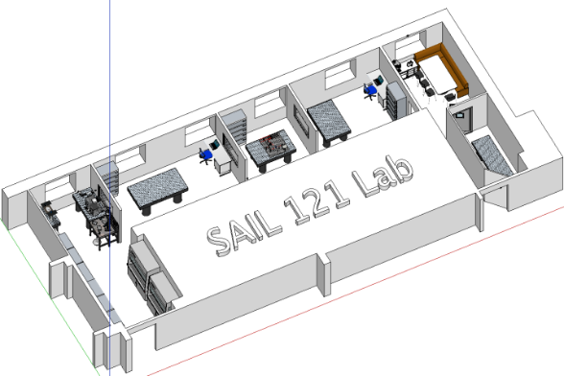

SAIL – New Laboratories
Laboratory refurbishments → SAIL>300 m²
1st Stage completed in August 2015 (Lab 121a,b,c,d,116c)
New open plan lab areas within 121
  1 x Stabilised Environment Room, SER (±0.1C, ±3 HR, 116B)
  1 x SAIL social meeting area (SAIL Hive, 121A)
  1 x Photonic Integration and Glass processing (121D)
  4 x Optical labs (121B, 121C, 119, 120)
  1 x Multipurpose lab (107)
2st Stage completed by Dec 2015 (Labs 116A,119 )
  116A Optical and mechanical prototyping lab
  119 UV FBG and Interferometer fabrication facility
121
C
B
D
A
116
119
120
107
B
A

Slide 4
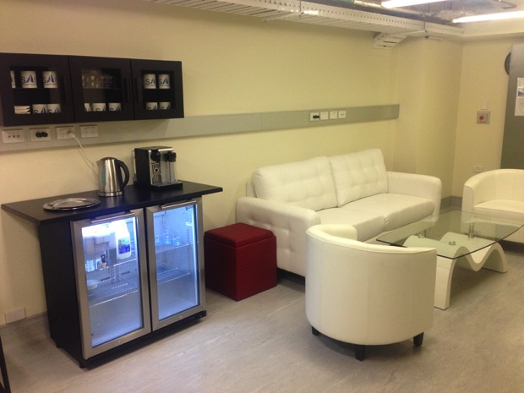
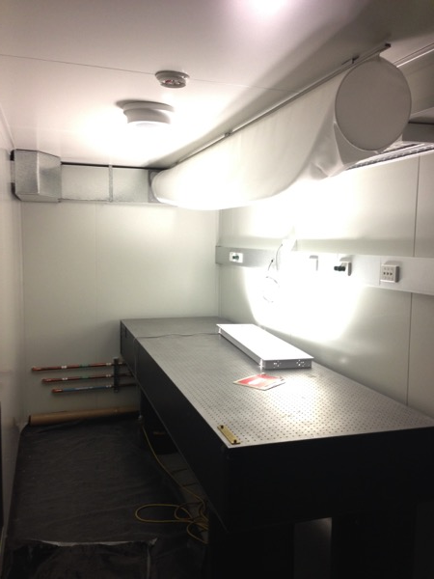
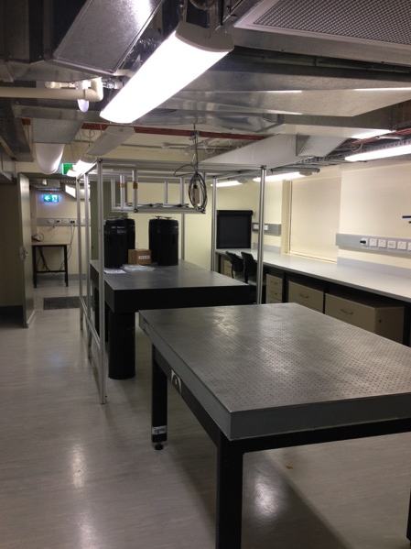
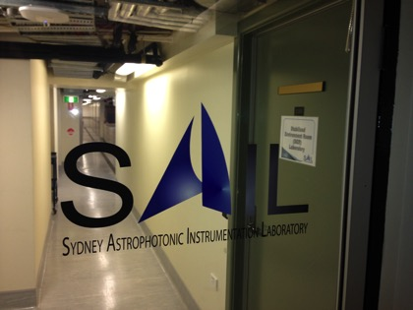
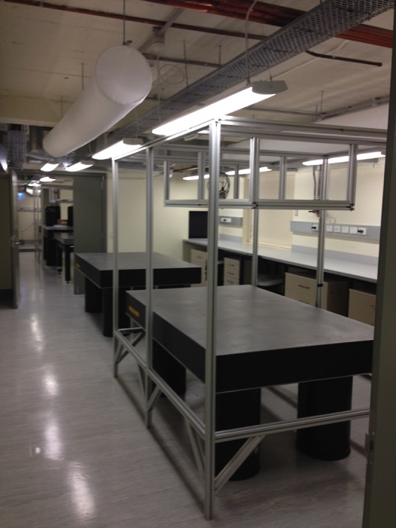
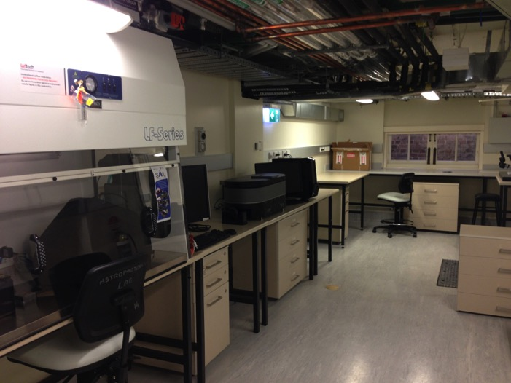
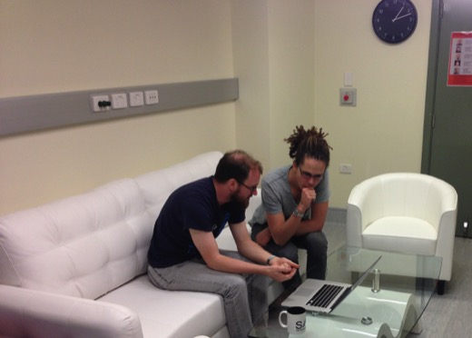

Slide 5
SAIL – Equipment and Capabilities
Equipment and Capabilities
Glass Processing Facility
UV Laser processing facility
Photonic Integration and Characterisation
Instrumentation Prototyping

Slide 6
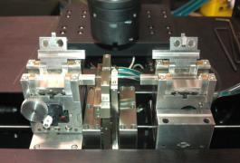
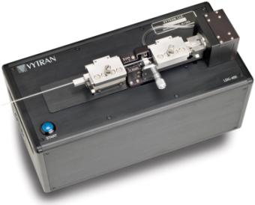
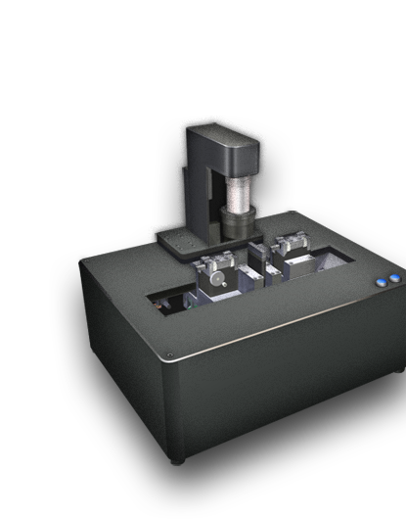
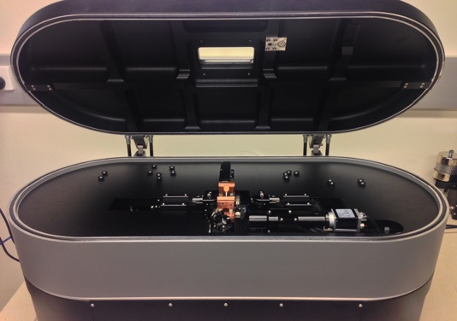
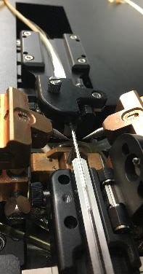
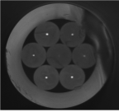
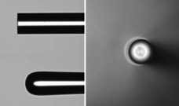
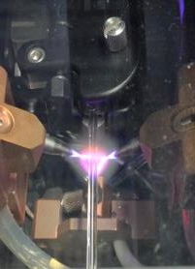
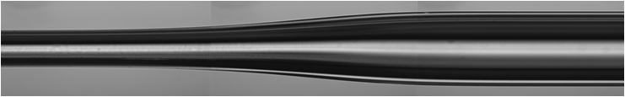
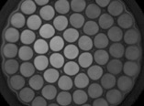
SAIL – Glass Processing Facility
Vytran GPX 3400
Vytran LDC 400
Optical fibres, fibre bundles or glass capillaries from
80 µm to 1750 µm
Filament technology
Extreme versatility in fibre processing
Splices, dissimilar and non-standard shape fibres
Optical fibre tapers
Bundling fibres inside capillaries (hexabundles)
Fusing fibres together (photonic lanterns)
Optical fibre couplers
Fibre lensing and termination
Optical fibres, fibre bundles or glass capillaries from 80 µm to 1500 µm
precision cleaving
3SAE TMS
Optical fibres, fibre bundles or glass capillaries from
20 µm to 2600 µm
Plasma technology

Slide 7
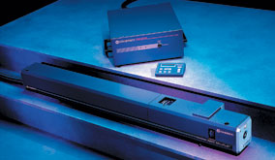
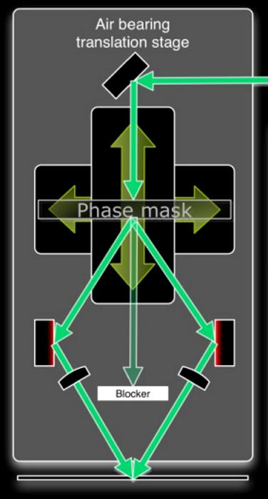
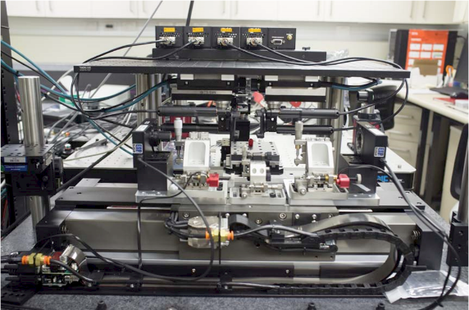
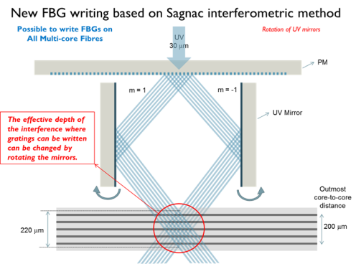
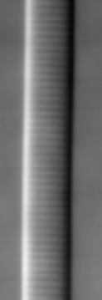
SAIL – UV Laser processing facility
Coherent CW UV laser 244 nm
State of the art UV Laser Interferometer for fibre and glass processing
FBG writing based on a Sagnac Interferometer
Optical setup based on 12 piezoelectric motors
Higher precision and interference depth
Sagnac Interferometer
Multicore fibre FBG
Planar waveguide gratings
Polymer fibre gratings

Slide 8
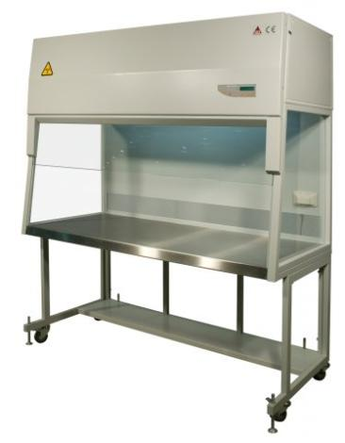
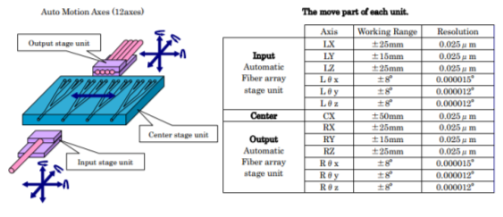
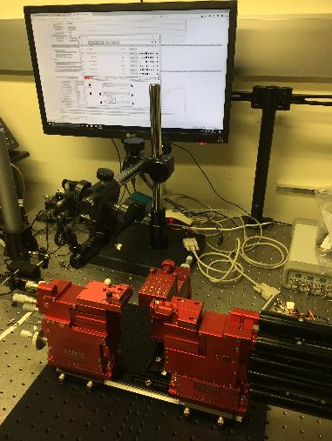
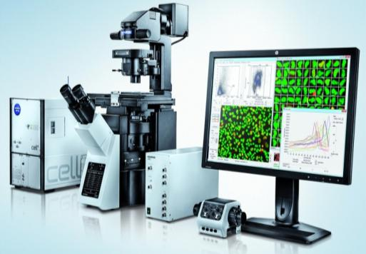
SAIL – Photonic Integration and Characterisation
NIS alignment system
13 Automatic Axis
UV light source and UV glue dispenser
Laminar Air Flow Cabinets
Air cleanliness in the work zone is ISO (14644) Class 3 (AS 1386 Class 0.035).
Use of ULPA-grade filters, in place of HEPA, enables air cleanliness to be two classifications cleaner than conventional cabinets with HEPA filters.
Olympus IX83 Microscope
Differential Interference Contrast ready
Field of View selections 5x, 10x, 20x, 50x, 100x, 150x

Slide 9
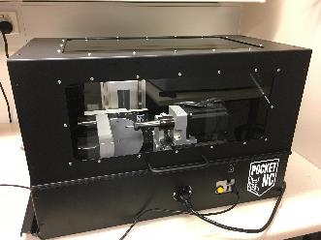
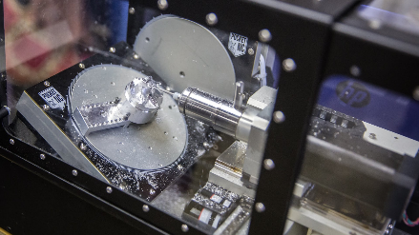

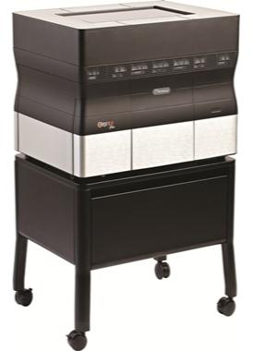
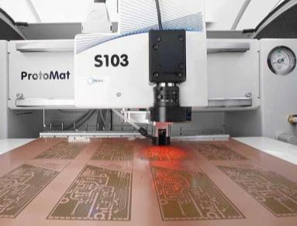
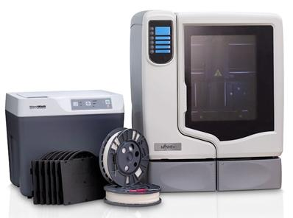
SAIL – Instrumentation Prototyping
Pocket CNC
3D Printing facility
PCNC 1100 Benchtop CNC
Object 30 Pro (PolyJet Technology)
  7 materials ( plus soluble support material)
  294 x 192 x 148.6 mm build size
  28 μm (16 μm VeroClear) layer
  X-600; Y-600 ; Z-900 dpi build resolution
  100 μm accuracy
uPrint SE Plus (FDM Technology)
  ABS + soluble support material (10 colors)
  203 x 203 x 152 mm build size
  250 μm (330 μm ) layer
  X-600; Y-600 ; Z-900 dpi build resolution
  100 μm accuracy
PCB prototyping (Quantum Physics Group)
LPKF ProtoMat S103
  Milling and drilling single- and double-sided PCBs
  Contour routing of PCBs and Milling flexible, rigid-flex PCBs
Objet30 Pro
uPrint SE Plus

Slide 10

SAIL – Facilities, Equipment and Capabilities
Laboratories & Capabilities
Instrumentation
Testing
Instrumentation
Prototyping
Research & Development
Stabilised
Environment Room
(SER)
3D
Printing
CNC
Machining
Photonic
Integration &
Characterisation
Glass
Processing
Facility
UV Laser
Processing Facility
PCB
Prototyping

Slide 11
SAIL – Enabling next generation instruments
Glass
Processing
Facility
From SAMI to HECTOR
CNC
Machining
Photonic
Integration &
Characterisation
3D
Printing
UV Laser
Processing Facility
CNC
Machining
From GNOSIS to PRAXIS
3D
Printing
Glass
Processing
Facility
Photonic
Integration &
Characterisation
Micro-spectrographs
from LAB to TELESCOPE
Photonic
Integration &
Characterisation
CNC
Machining
Stabilized
Environment Room
3D
Printing
Glass
Processing
Facility
PCB
Prototyping

Slide 12
SAIL – INDUSTRY ENGAGEMENT
SAIL expose high calibre students and postdocs to applied research and training in the area of advance photonics and astronomical instrumentation and technologies. PERFECT PLATFORM FOR INDUSTRY ENGAGEMENT
Two types of industry engagement:
  Research technology transfer
  Skill technology transfer
Just in 2017, SAIL completed two consultancy projects worth $200K with industry in the area of photonic and optical fibre technologies.
  Melbourne Water and Draco Analytics Greenhouse spectroscopy sensors
  (SAIL is now in the process of drafting an ARC Linkage worth $1M grant with Melbourne Water to exploit photonic gas sensors in water utilities).
  Ocular Robotics Optical fibre assemblies for LIDAR rotatory joins.
Recent contracts now completed and ongoing include:
  Photonic lanterns to AT&T Bell Labs ($100K)
  Hexabundles to the University of North Carolina ($120K)
  Horticulture Australia Limited (Hort Innovation) ($270K)
  University of Maryland and NASA ($400K)
  Grains Research and Development Corporation (GRDC) ($1,269K)

Slide 13

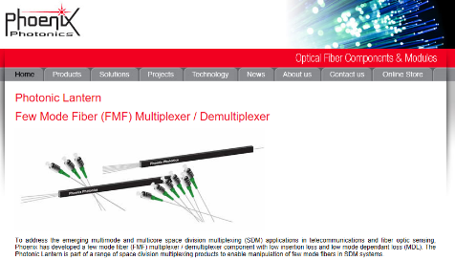
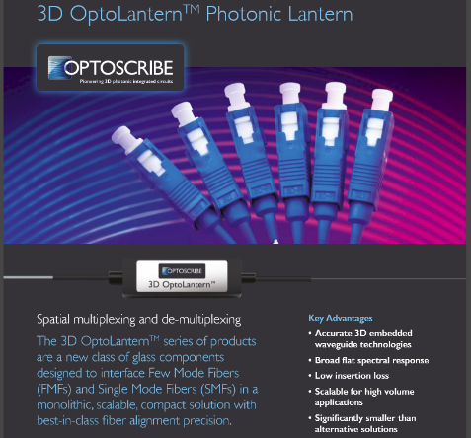
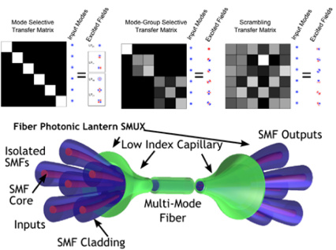
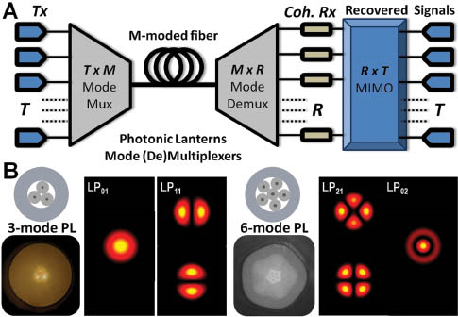
SAIL – Industry Engagement Projects
Research technology transfer
From multimode fibre OH filtering for GNOSIS (photonic lantern development) to multimode optical telecommunications
Two UK companies developed product lines based on this translational research
We developed asymmetric photonic lanterns for Bell Labs US to be use as mode spatial multiplexers for Space Division Multiplexing future communication systems.
Photonic lanterns are broadly use in SDM communications research worldwide.
Two UK companies have photonic lantern multiplexers as major product lines for passive optical communications systems.

Slide 14


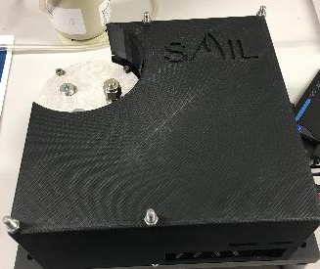
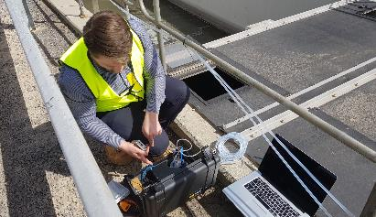
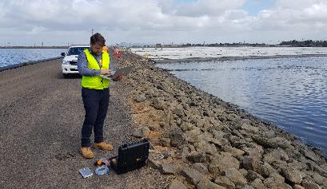
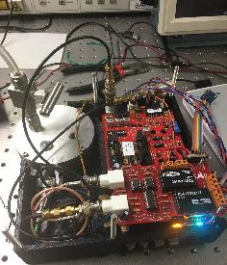
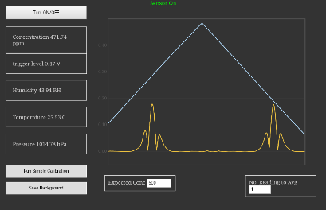
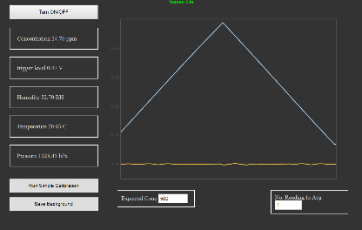
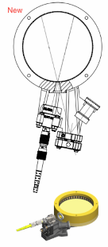
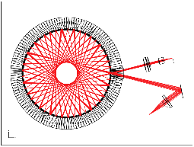

SAIL – Industry Engagement Projects
Research technology transfer
From fibre etalon laser for HERMES calibration (photonic Comb) to portable optical Methane sensors
SAIL developed a new fibre etalon photonic comb laser locked to Rb lines with sub-metre stability. This technique has technical similarities to Wavelength Modulation Spectroscopy.
Melbourne Water and Draco Analytics funded a 5 months consultancy research contract to develop a table-top prototype Methane portable sensor under 2Kg for Unmanned Aerial Vehicles (UAV).
SAIL produced a battery operated prototype with 1ppm sensitivity tested in the field. From optics to electronics.
$1M ARC Linkage Grant in preparation.
PROTOTYPE FIELD TEST - Western Treatment Plant (Werribee) 20 October 2017
PROTOTYPE – Wavelength Modulation Spectroscopy sensor
Agitator Plan
Adjacent Lagoon
471 ppm CH₄
14 ppm CH₄

Slide 15


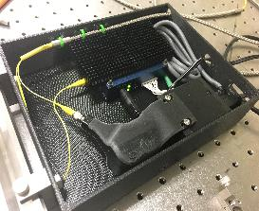
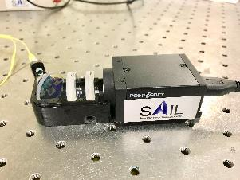
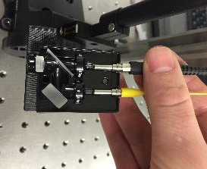
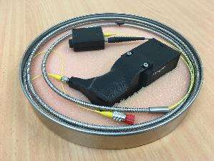
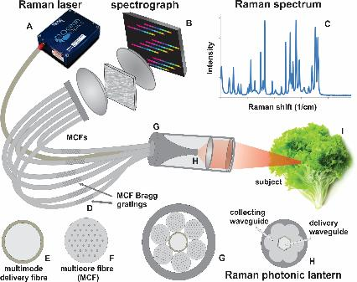
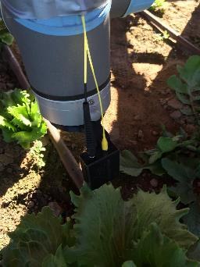



SAIL – Industry Engagement Projects
Research technology transfer
From compact diffraction-limited spectrographs (PIMMS/TIGER) to advanced Raman sensors in farm-robots
This project is a joined effort with the Australian Centre for Field Robotics (ACFR) and SAIL.
SAIL developed a new type of diffraction-limited photonic spectrographs based on photonic lantern technologies for high-resolution spectroscopy.
Horticulture Innovation Australia funded ACFR and SAIL to develop a compact photonic Raman spectrograph to be mounted in an ACFR farm-robot for the real-time detection of deadly bacteria in the field.
SAIL produced a prototype photonics Raman spectrograph and robot-arm input fore optics that was tested on the field.
This project attracted further USyd Strategic Funding Initiatives Funds SREI2020 for 2017-18.

Slide 16






SAIL – Industry Engagement Projects
Skill technology transfer
Specialty fibre skills are transfer to industrial partners by consultancy work and services
SAIL skills in specialty fibre and fibre optics have attracted local SME companies interest.
Ocular Robotics are the leaders in rotary specialty optics for LIDAR technologies with recent defence and Google funding.
SAIL provided consultancy work in the development of an optical fibre USB link connection to a rotary fibre join to be tested in as major prototype for a defence contract.

Slide 17







SAIL – Industry Engagement Projects
Skill technology transfer
Laser and optical fibre skills are transfer to industrial partners by research contracts
This project is a joined effort with the Australian Centre for Field Robotics (ACFR), SAIL and the University of Sydney Precision Weed Control Lab at Narrabri funded by GRDC.
SAIL developed a portable high-power laser unit for robotic integration.
GRDC funded in June 2018 ACFR, SAIL and PWCL to develop a compact Laser Weeder system to be mounted in an ACFR farm-robot for real-time detection and eradication of weeds with a $1.269M - 2 year project.
This project attracted further USyd Strategic Funding Initiatives Funds SREI2020 for 2017-18.
Laser exposed | Control

Slide 18





SAIL – Industry Engagement Projects
Research and Skills technology transfer
From diffraction-limited spectrographs, 3D prototyping, and optical design to space instrumentation.
$4.9M ARC Industrial Transformation Training Centre on CubeSats, UAVs, and Their Applications (5 years/March 2018)
ARC ITTC scheme fosters close partnerships between university-based researchers and industry to provide innovative Higher Degree by Research (HDR) and postdoctoral training, for end-user focused research industries that are vital to Australia's future.
SAIL will be leading 2 major optical instrumentation projects in the ARC ITTC.
  2 PhDs and 1 Postdoctoral Fellow to be hired
The two projects: 1) Photonic Spectrometers and Hyper-spectral Imagers; and 2) Compact Imagers will be done in close collaboration with Australian industry and government.

Slide 19
Conclusion
SAIL will strengthen Australia leadership in Astrophotonics instrumentation.
SAIL reconfigurable laboratory spaces and equipment will be open to the rest of Australia astrophotonics community.
SAIL aims to the translation of research and complementary efforts in astronomical instrumentation between University and Industry

Slide 20
Formatting

Slide 21



Hexabundles
Originally 61 optical fibres fused together using our glass fibre processing unit in the SAIL labs at Sydney University.
Advantages of this design:
Fill fraction ~75%.
Low cross-talk < 0.5%
Low focal ratio degradation
(Bryant et al. 2011-14; Wang, Brown+ 2021)
~10mm
1mm

Slide 22
Hector Hexabundles
Bigger, better, more of them
Hector-I: 21 hexabundles across 2-degree field
37-169 optical fibres per hexabundle => up to 26” on-sky
Regular packing.
Hexabundles up to 26” to cover 2R_{e} will substantially improve:
Gas kinematics and maximum rotation measures
Mapping of star formation processes
Measuring gas accretion
Kinematic signatures of interactions
Angular momentum

Slide 23




Hector Hexabundles
Bigger, better, more of them
Adeline Wang & Rebecca Brown
AAO-USydney/SAIL labs at Sydney Uni

Slide 24





Astrophotonics:
when astronomy meets photonics
A/Prof Sergio Leon-Saval
Deputy Director | Institute of Photonics and Optical Science (IPOS)
Director | Sydney Astrophotonic Instrumentation Laboratory (SAIL)
University of Sydney, Australia
SAIL laboratories key research areas:
Specialty photonic fibre devices
Astronomical photonic imaging interferometry
Advanced astronomical fibre-based instrumentation
Space photonic instrumentation

Slide 25

SAIL now packages & ships photonic lanterns & hexabundles

Slide 26







SAIL / ANFF - Advanced FBG manufacturing
Sagnac interferometer
Complex FBG structures in refractive index and phase
Ability to create extremely narrow FBGs in frequency
  Distributed Feedback lasers
  Sub-KHz to MHz line filters
Ability to create complex multifrequency responses
  Aperiodic filters for sensing
  Multiline FBG in a single grating design

